Slide 1
Fighting Failure: The Persistent Real Effects of Resolving Distressed Banks
Ivan T. Ivanov Federal Reserve Board | Stephen A. Karolyi Treasury-OCC
September 28, 2021
* The views expressed here are those of the authors and not necessarily the views of the Federal __Reserve Board or the Federal Reserve System, the Office of the Comptroller of the Currency, the __U.S. Department of the Treasury, or any federal agency and do not establish supervisory policy, __requirements, or expectations.

Slide 2
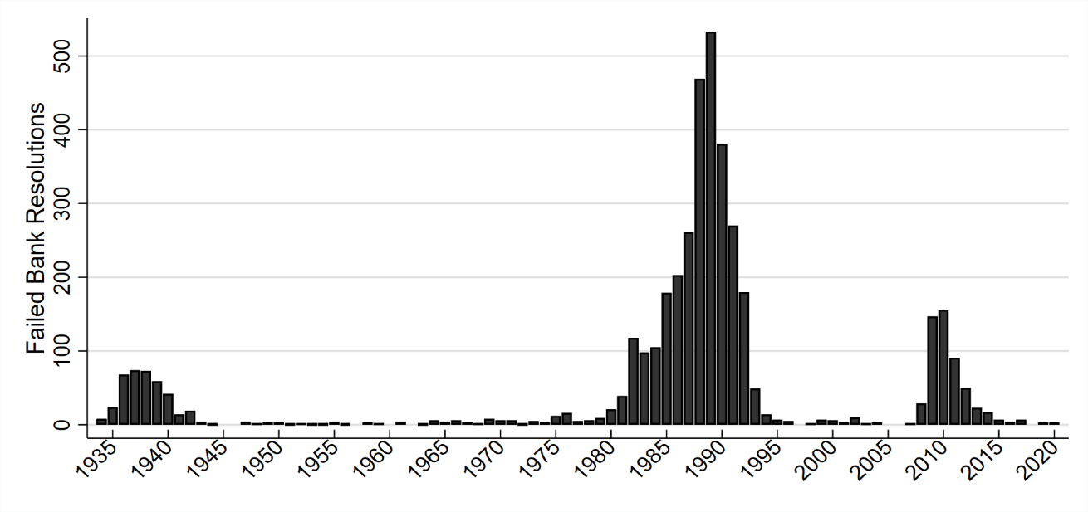
Motivation
Banking crises cause persistent and significant output losses (see, Cerra & Saxena, 2008).
Greater output losses than wars or currency crises!
What are typical regulatory responses to banking crises?
Support for the solvent, resolutions for the insolvent
Resolutions have played a critical role in the U.S. since the Banking Act of 1933
>3,500 resolutions since the first in 1934

Slide 3
This paper
Objective: understand the causal effect of resolutions on the real economy. Empirical challenges:
These two populations are very different!
Interventions are endogenously targeted at distressed institutions.
Potential spillover costs from targeted interventions (e.g., TARP).
The FDIC Improvement Act generates quasi-experimental variation in resolution propensity around the 2% tangible equity threshold.
Subpopulation of banks we care about resolving the most.
We estimate the LATE for distressed banks using RDD around the 2% cutoff.

Slide 4
Preview of findings
Significant compliance with the FDICIA threshold:
~53 percentage points jump in resolution propensity at the threshold.
Persistent adverse effect on local economies of resolutions:
2% – 4% drop in employment and establishments within 3 years.
Effects increase until at least 5 years post-resolution.
Evidence for a credit channel based on soft information:

Slide 5
Institutional background
Prompt corrective action thresholds mandated by FDICIA identify “critically undercapitalized” banks
E.g., tangible equity ratio < 2%
Typical resolution timeline:
Once 2% is breached, primary regulator sends notice of prompt corrective action to bank managers and the FDIC*
The FDIC makes on-site visit to collect financial and operational information, markets the bank to pre-determined set of bidders
Compares bids to liquidation costs to the Deposit Insurance Fund
Selects least-cost option
Subject to discretion to act or forbear based on capital restoration plan adequacy and the state of the economy
Notes:
INSERT FIGURE HERE!

Slide 6
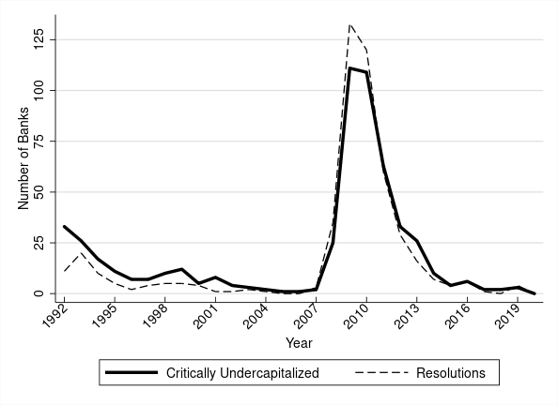
Resolutions over time
Discretion to resolve
Discretion to forbear

Slide 7
Identification
Goal: estimate ATE of resolutions on local economy
Approach: fuzzy regression discontinuity
Threshold-based resolution policy introduced by FDICIA in 1991
Instrument resolution propensity with “critically undercapitalized” classification based on 2% tangible equity ratio cutoff
Output: LATE estimates of resolutions on local economy for distressed banks
Primary caveat concerns external validity

Slide 8
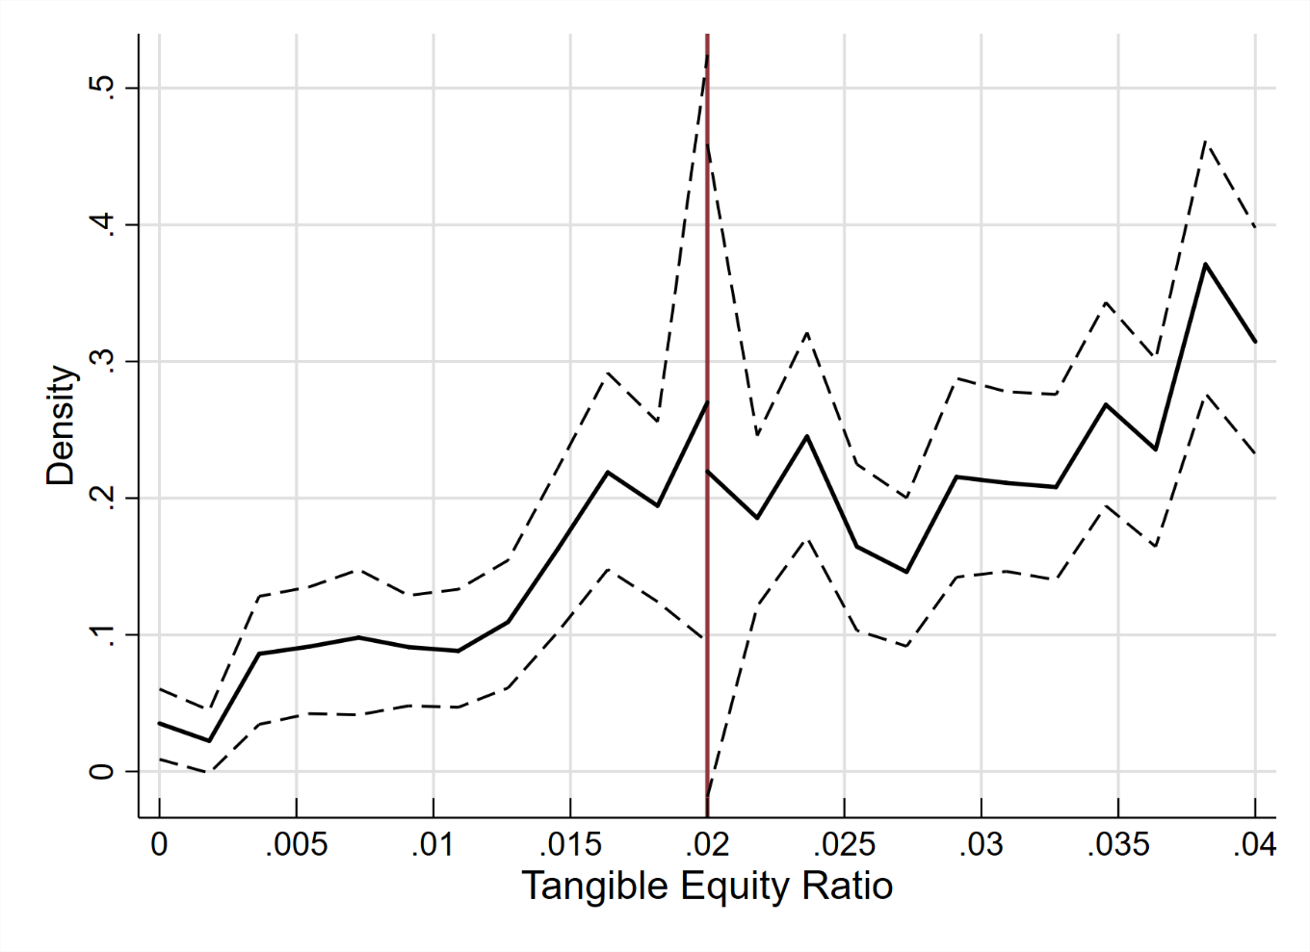
Identification
Identifying assumptions: Roberts & Whited `12
Local continuity in the running variable – banks cannot precisely manipulate TE

Slide 9
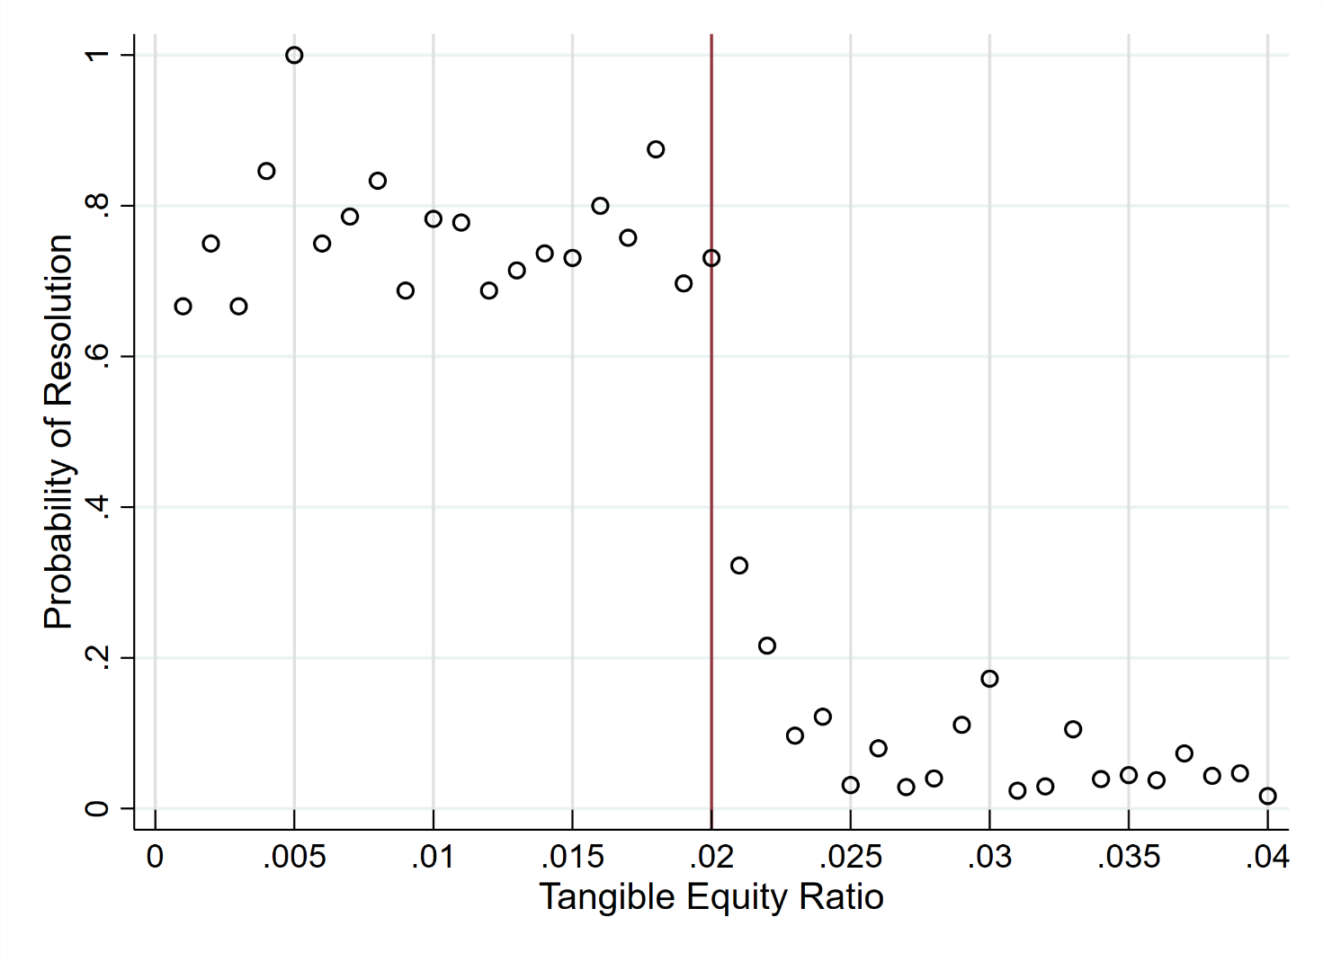
Identification
A jump in resolution propensity at the 2% TE ratio cutoff:

Slide 10
Empirical setting
Estimate two equation system following recent applied econometrics literature – Calonico et al `14, `20; Cattaneo & Vazquez-Bare `16; Gelman & Imbens `19; Imbens & Kalyanaraman `12
First stage:
Second stage:

Slide 11
Prompt corrective action
Critically undercapitalized banks are more likely to be resolved
1st or 2nd degree local polynomials following Gelman & Imbens `19
Triangular kernel and MSE-optimal bandwidth (Imbens & Kalyanaraman `12; Calonico et al `14, `20), controls following Calonico et al `19
Dependent Variable: Resolution | (1) | (2) | (3) | (4) | (5) | (6)
1{TE < 2%} | 0.559*** | 0.529*** | 0.533*** | 0.535*** | 0.530*** | 0.528***
 | (0.053) | (0.056) | (0.056) | (0.060) | (0.058) | (0.060)
N | 158,081 | 158,040 | 158,040 | 158,081 | 158,040 | 158,040
N Left of Cutoff | 447 | 446 | 446 | 447 | 446 | 446
N Right of Cutoff | 157,634 | 157,594 | 157,594 | 157,634 | 157,594 | 157,594
Order Loc. Poly. (p) | 1 | 1 | 1 | 2 | 2 | 2
Bank Controls | N | Y | Y | N | Y | Y
Local Economy Controls | N | N | Y | N | N | Y

Slide 12
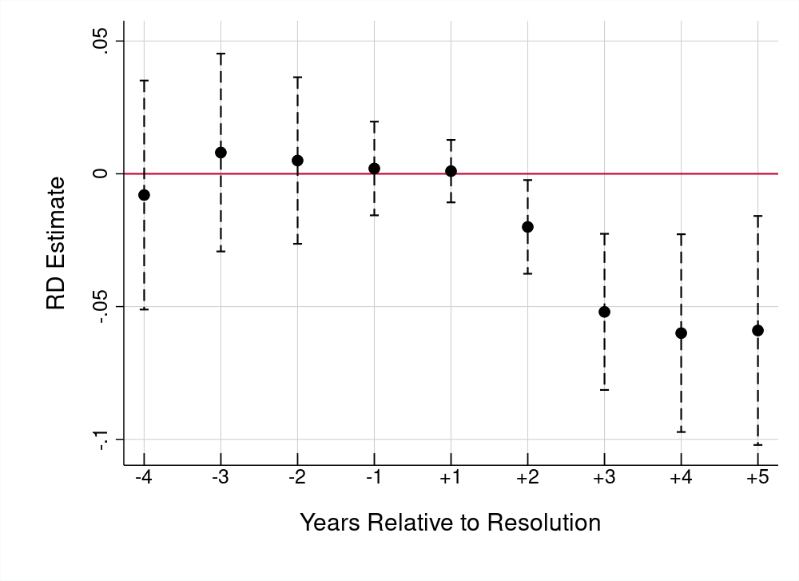
Local economic impact
Employment growth dynamics

Slide 13
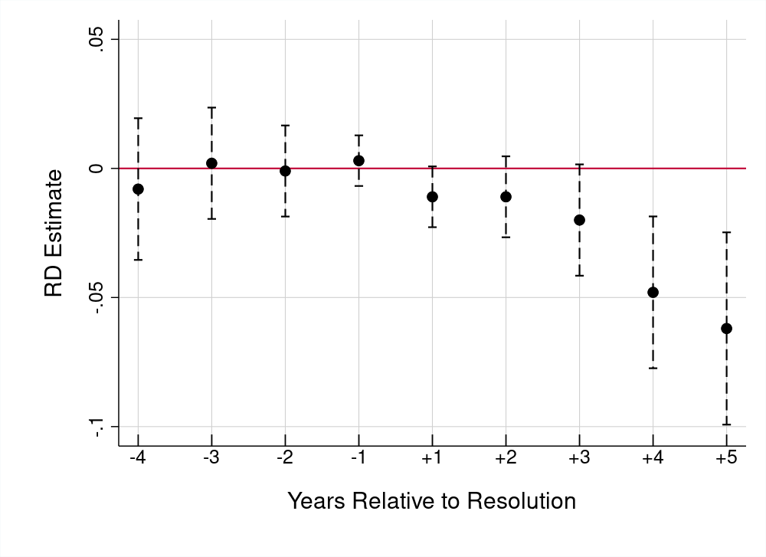
Local economic impact
Establishment growth dynamics

Slide 14
Bank lending channel
Acquiring institutions that are large and have capacity to absorb hidden losses provide “least cost” option
Resolutions lead to potential absorption of community banks into larger, out-of-market banks
Loss of soft information about borrowers of the resolved bank
Large banks do not lend to small borrowers – Berger & Udell `02; Huber `21
Acquirers ration credit to borrowers of their targets – Degryse et al `11

Slide 15
Bank lending channel
Effects concentrated in smaller, less urban counties.
Horizon (years) | 1 | 2 | 3 | 4 | 5
Dependent Variable: | ΔEstablishments
RD estimate (Small) | -0.009 | -0.010 | -0.030** | -0.083*** | -0.116***
 | (0.008) | (0.012) | (0.015) | (0.023) | (0.031)
RD estimate (Large) | 0.008 | 0.023 | 0.034 | 0.022 | -0.011
 | (0.010) | (0.016) | (0.025) | (0.029) | (0.028)
Dependent Variable: | Δemployment
RD estimate (Small) | -0.017 | -0.042*** | -0.064*** | -0.077** | -0.056
 | (0.012) | (0.016) | (0.022) | (0.033) | (0.036)
RD estimate (Large) | 0.020 | 0.011 | -0.000 | 0.000 | -0.009
 | (0.012) | (0.014) | (0.016) | (0.019) | (0.022)

Slide 16
Bank lending channel
Does SME lending decline (ΔOriginations/Establishments)?
Dependent Variable: ΔSME Lending | (1) | (2) | (3)
Horizon (years) | 1 | 2 | 3
RD estimate (All) | -0.0010 | -0.0003 | -0.0003
 | (0.0009) | (0.0009) | (0.0009)
RD estimate (Small) | -0.0042*** | -0.0024* | -0.0034**
 | (0.0013) | (0.0013) | (0.0013)
RD estimate (Large) | 0.0011 | 0.0021 | 0.0021
 | (0.0014) | (0.0018) | (0.0019)
N | 157,898 | 118,404 | 39,494
N Left of Cutoff | 444 | 191 | 253
N Right of Cutoff | 157,454 | 118,213 | 39,241
Order Loc. Poly. (p) | 2 | 2 | 2
Bank Controls | Y | Y | Y
Local Economy Controls | Y | Y | Y

Slide 17
Concluding remarks
We develop a quasi-experimental approach to estimate the effect of failed bank resolutions on economic growth
Main findings:
Significant adverse effects on employment and establishments
Credit supply drops, consistent with a bank lending channel
Policy implications:
Negative externalities of the least-cost resolution policy
Design of resolution process, specifically the use of discretion by primary bank regulators and FDIC

Slide 18
Thank you!

