Slide 1
Core Profitability of Community Banks
1985-2015
Jared Fronk
Federal Deposit Insurance Corporation

Slide 2
Disclaimer
The views here expressed are those of the author and no not necessarily reflect the official positions of the Federal Deposit Insurance Corporation.

Slide 3
Research Question
To what extent is community banking profitability a function of external factors?
Profitability: industry-average pretax return on assets

Slide 4
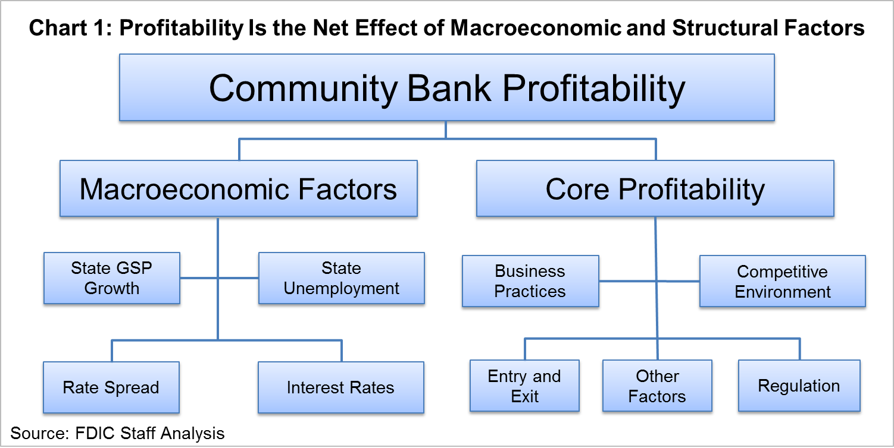
What Is Core Profitability?

Slide 5
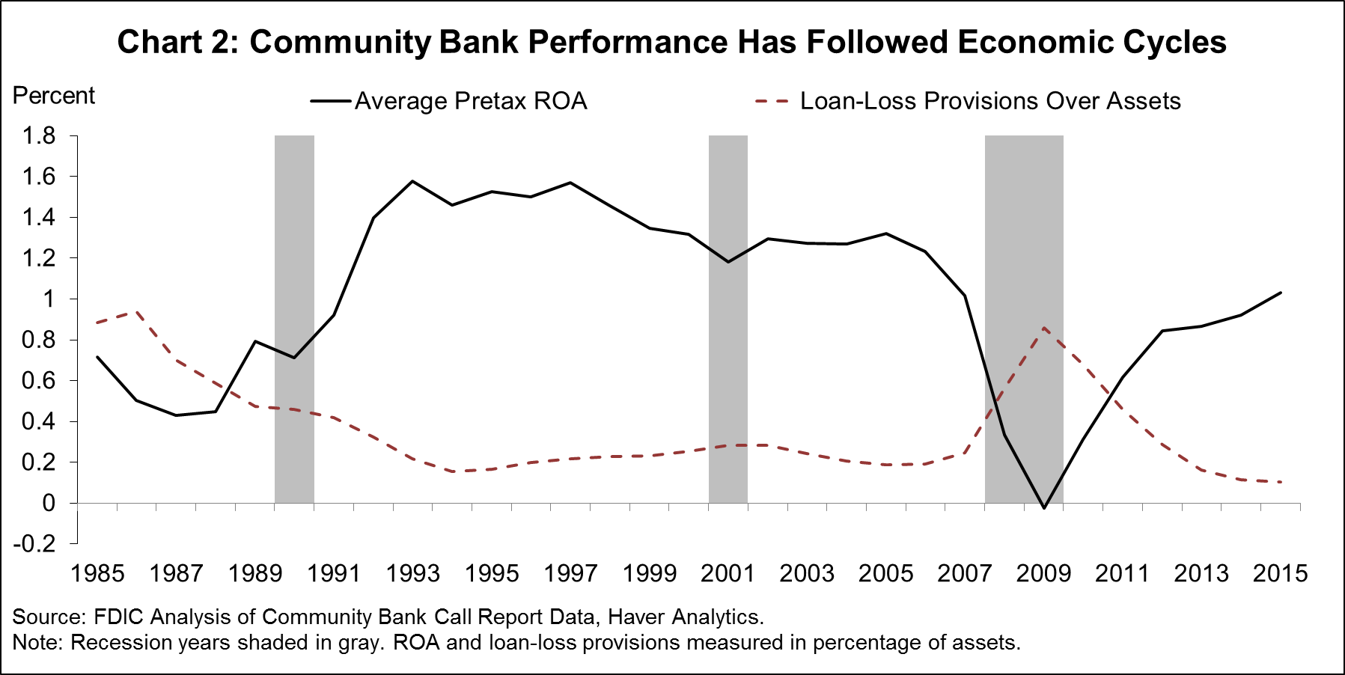

Slide 6
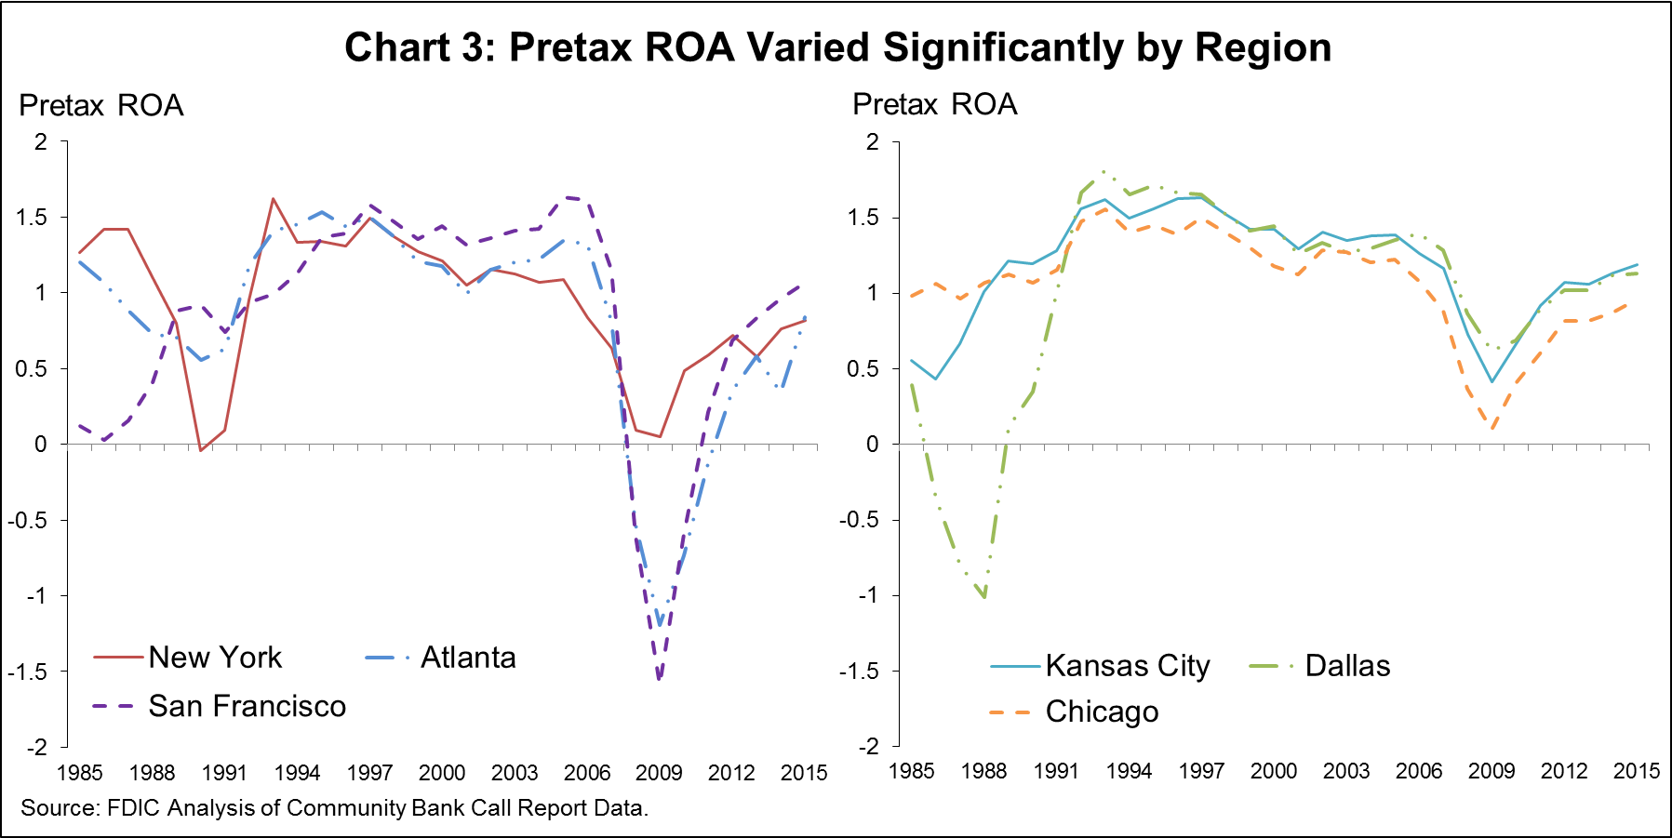

Slide 7
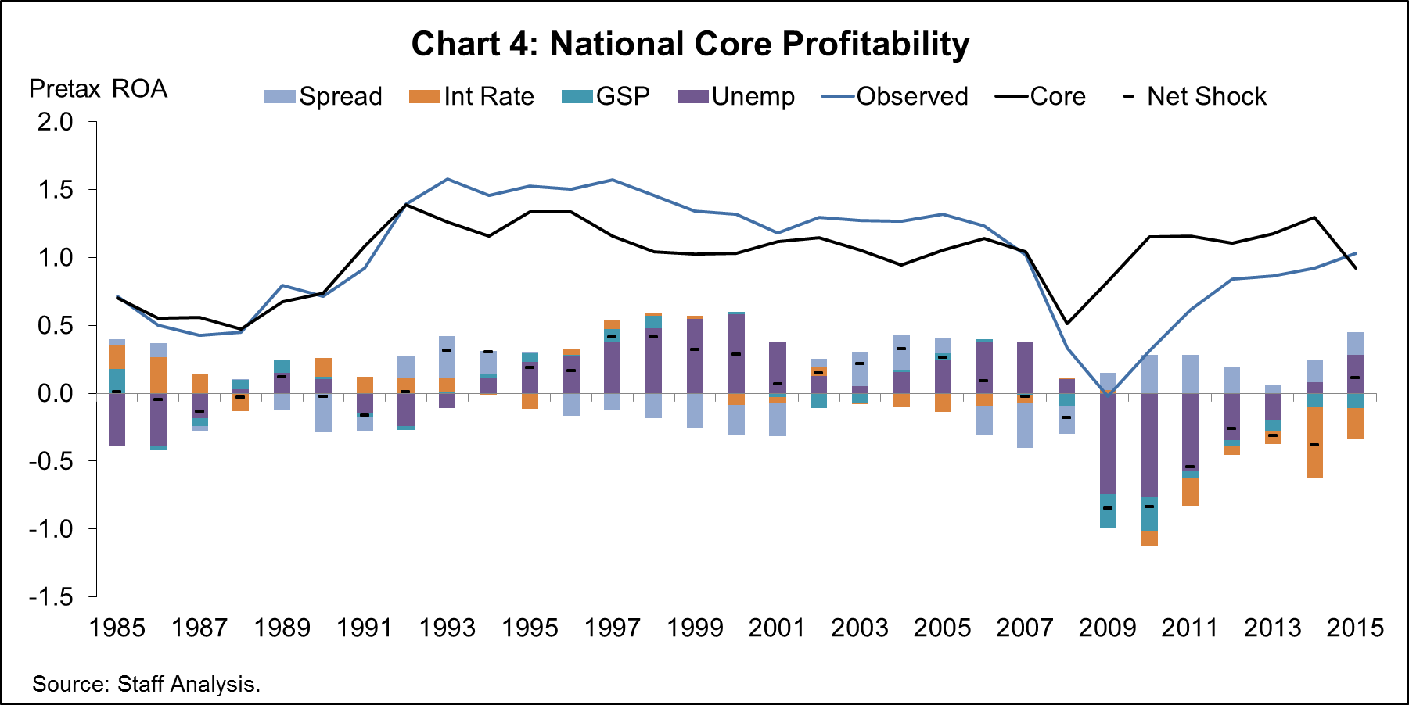

Slide 8
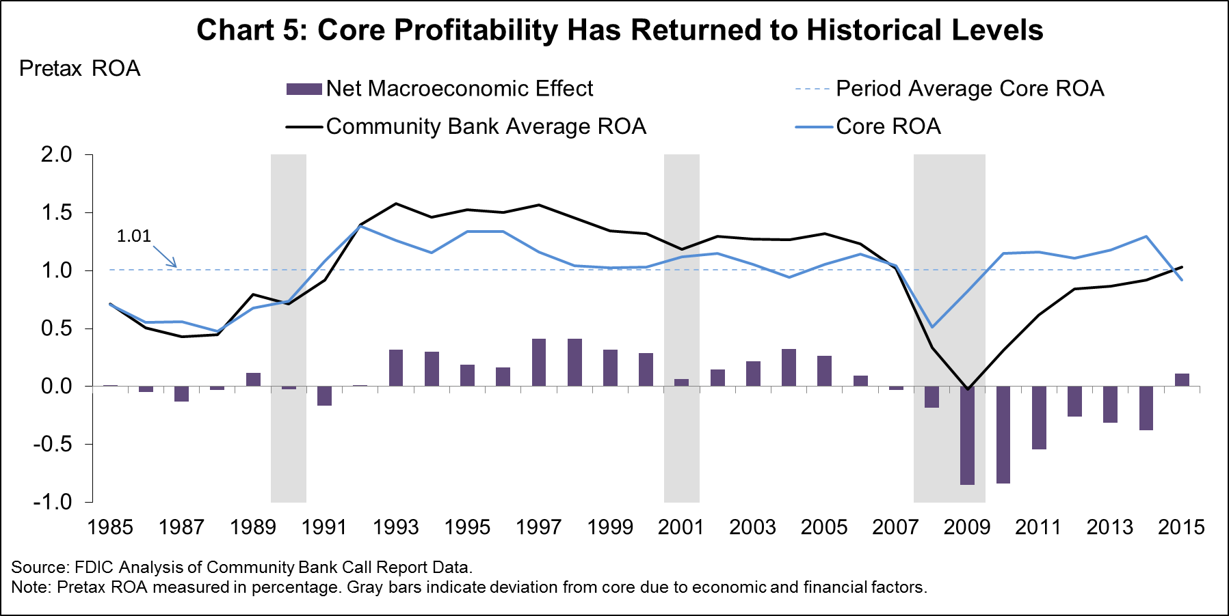

Slide 9
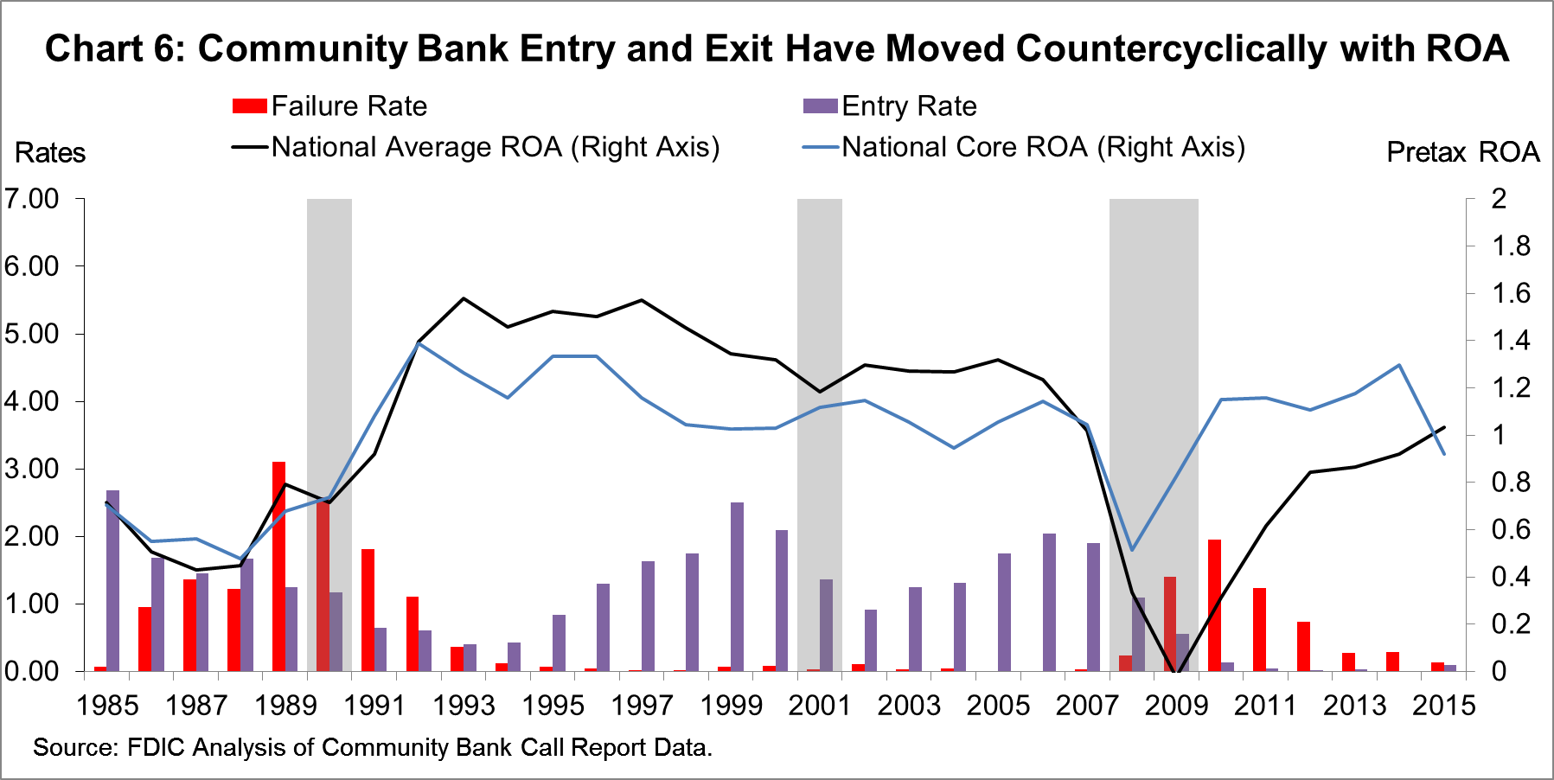

Slide 10
Caveats
Does not predict individual bank performance
Does not estimate the impact of regulation…or any other unmeasured factor
Results are dependent on the sample period

Slide 11
Key Conclusions
1985-2015: 65% of deviation from core ROA can be attributed to economic factors.
Post-financial crisis: 80% explained by econonomic factors
Crisis and recession effects have been persistent, but are now fading
Core profitability declined from 1990 to 2008, but has since trended upward
Core profitability has returned to its historical average

Slide 12
Appendix 1.1: Attrition Correction
Model

Slide 14
Appendix 1.2: Primary Regression
Model

Slide 16
Appendix 2.1: Summary Statistics

Slide 17
Appendix 2.2: Bank Characteristics

Slide 18
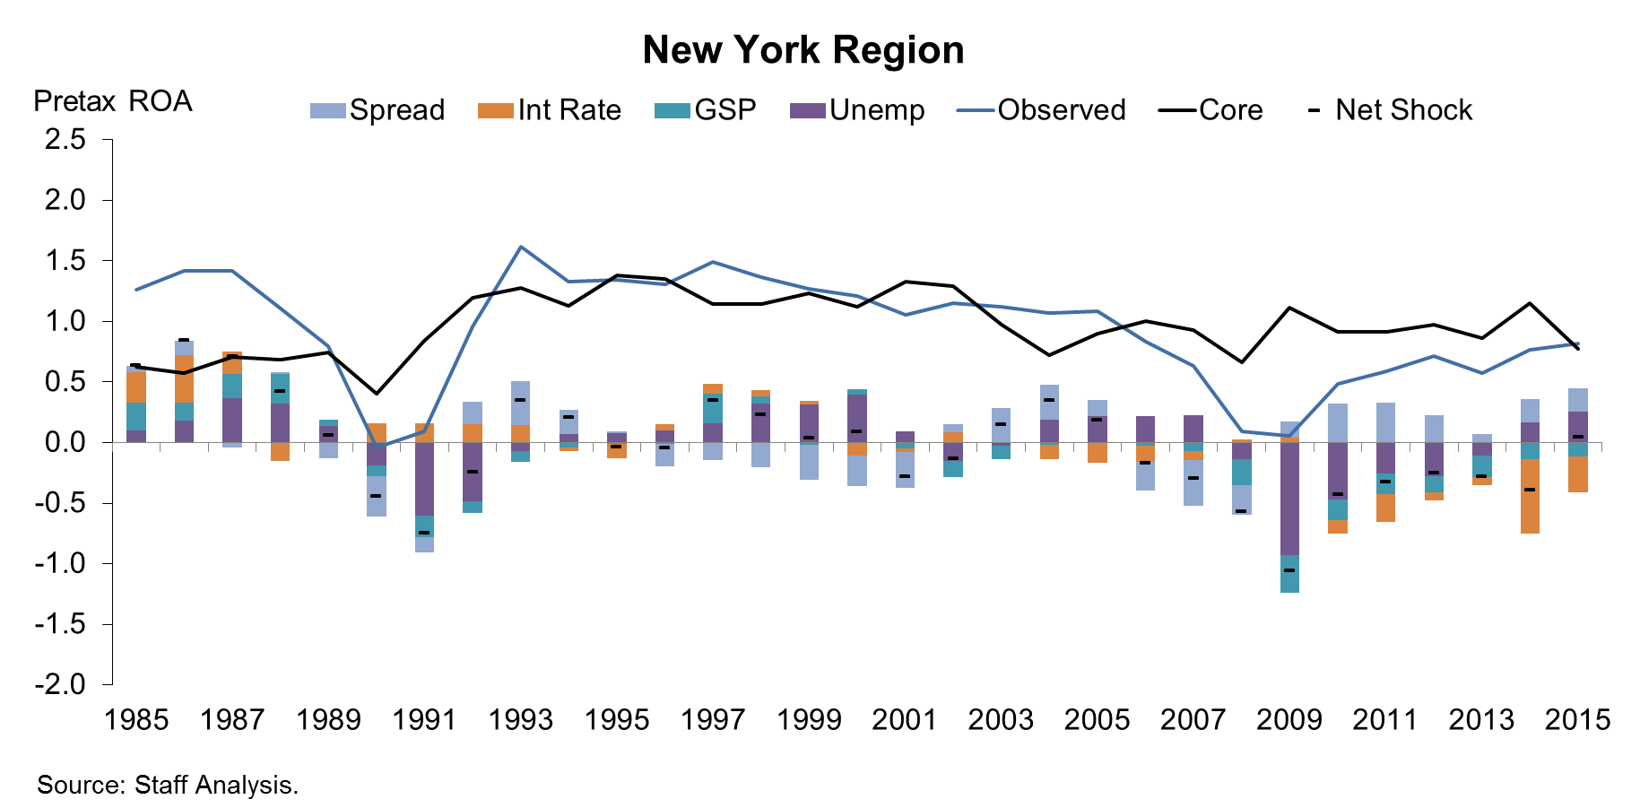

Slide 19
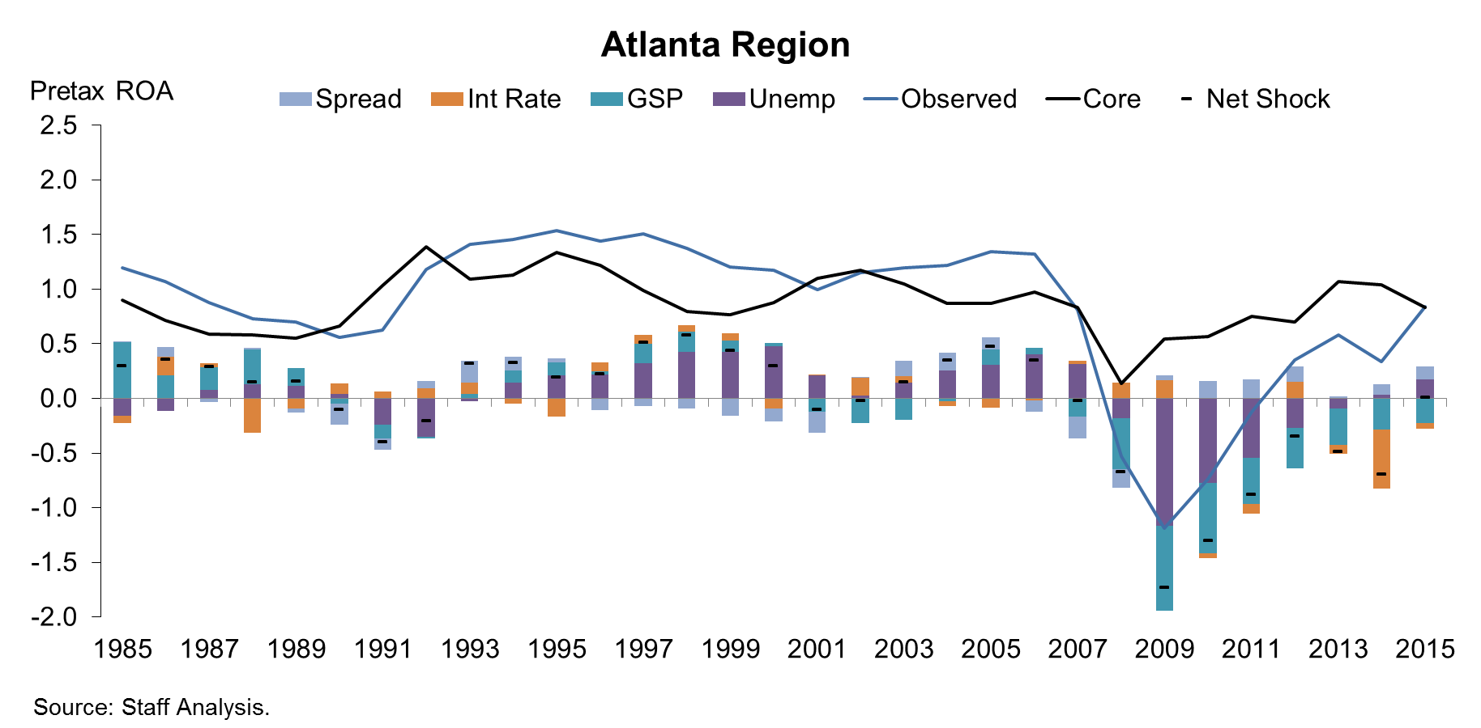

Slide 20
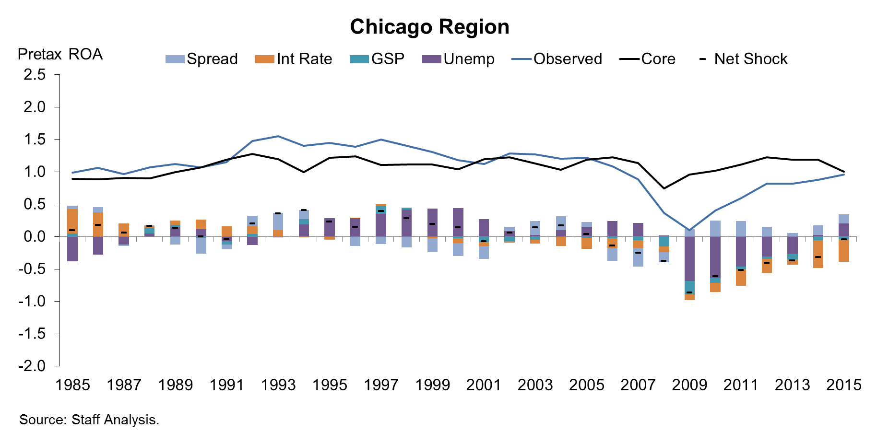

Slide 21
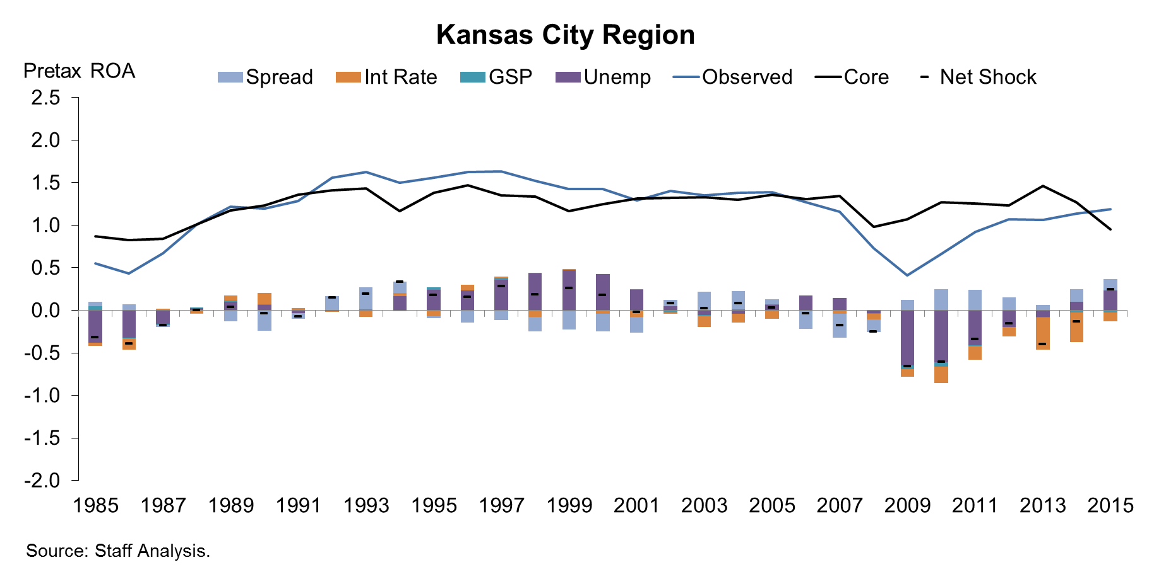

Slide 22
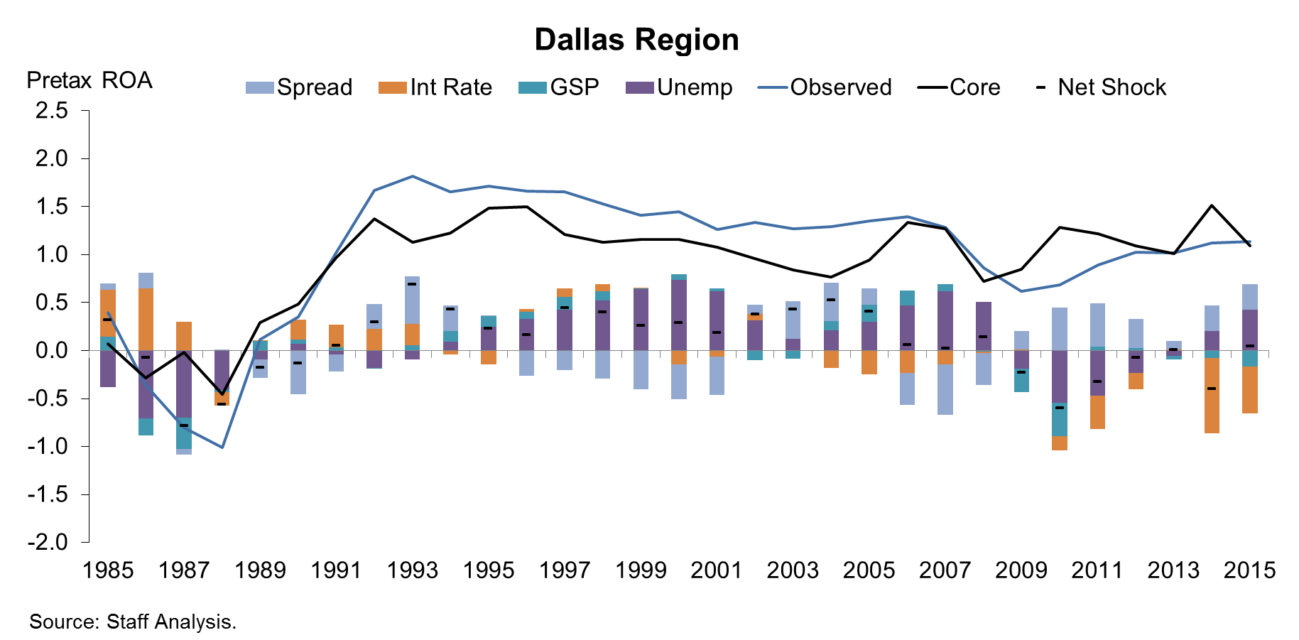

Slide 23
