Slide 1
Financial crises, financial constraints, and government intervention
John Hackney
Oct. 5, 2017
Darla Moore School of Business
University of South Carolina

Slide 2
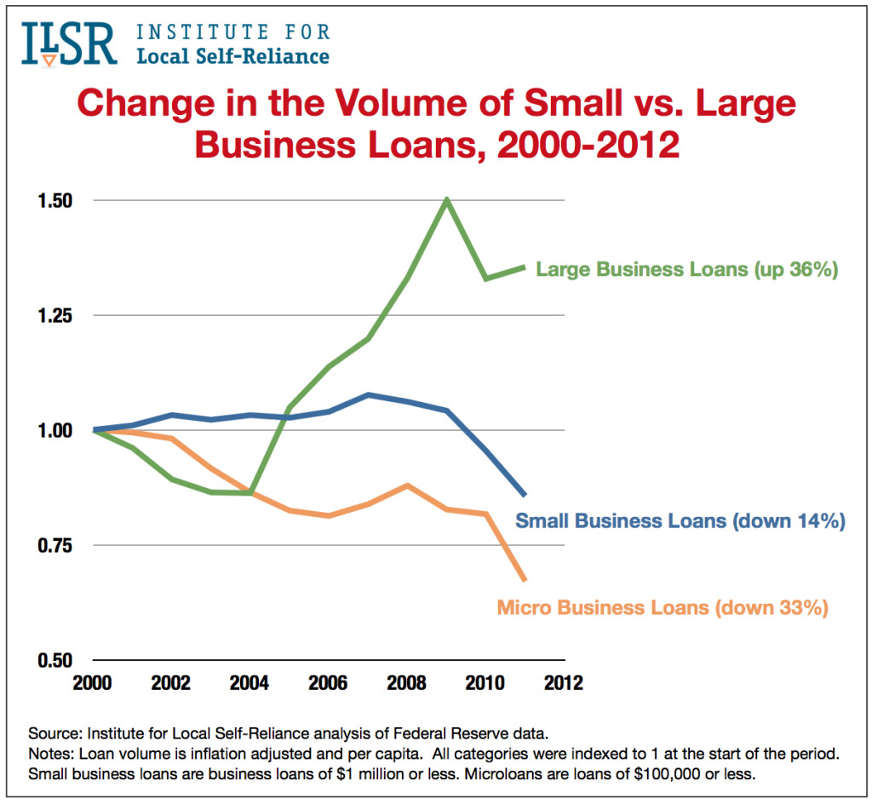
Small Business Credit During the Crisis

Slide 3
Small Business Credit During the Crisis
From 2008-2011 (Cole (2012))
Small business: declined 18%
Total business: declined 9%
Small businesses depend on bank credit (60% of total borrowing)
Potential negative implications for investment and real outcomes
Small businesses are a large and important part of US economy
Over half of total employment and private non-farm GDP

Slide 4
Small Business Credit- Policy Response
“Making credit accessible to sound small businesses is crucial to our economic recovery and so should be front and center among our current policy challenges.”
Ben Bernanke “Addressing the Financing Needs of Small Businesses,” (July 12, 2010)

Slide 5
Small Business Credit- Research Question
Whether/how can policymakers help to ease financial constraints for small businesses, especially during crisis times when they are particularly constrained?
Examine SBA 7(a) Guaranteed Loan Program
Largest and longest-running program targeted at small businesses
Provides partial guarantee on small business loans granted by participating lenders

Slide 6
Empirical Approach
Use the local proportion of SBA lender branches to identify the effect of the availability of government-guaranteed loans on small business credit and real outcomes when financial constraints are severe
Crisis and non-crisis times
Control for local demand and supply effects

Slide 7
Preview of Findings
A standard-deviation increase in the local proportion of SBA lenders increases the volume of small business credit to the smallest firms by 2.6-3.4%
Local real outcomes improve
One-year ahead unemployment decreases
Employment and establishment creation increase, but only for small firms
Results coming from hiring
SBA Loan outcomes do not worsen

Slide 8
SBA 7(a) Program
Bank:
Provides capital
Incurs all screening and monitoring costs
Must follow specific SBA underwriting guidelines and submit to SBA review
Roughly 5% of small business loan originations are SBA loans
SBA:
Guarantees up to 85% of the loan balance
Caps interest rate at spread above prime or LIBOR
Borrower:
Meet size standards and use of proceeds rules
Must satisfy a “credit elsewhere” requirement

Slide 9
Small Business Lending- Frictions
Information frictions make small business lending costly
Opacity
Heterogeneity
Lack of standardized underwriting procedure- reliance on “soft” information
These features render small business loans largely illiquid
Banks’ liquidity and willingness to take on credit risk decreased during the recent financial crisis

Slide 10
How can SBA lending help?
Provide insurance through the partial guarantee
Provide liquidity through an active secondary market for the guaranteed portion of the loans

Slide 11
Small Business Credit- Baseline Results
 | (1) | (2) | (3) | (4)
 | Loans<$1 Mil. |  | Firms<$1 Mil. Rev.
VARIABLES | Volume per capita | Number per capita | Volume per capita | Number per capita
SBA Branch Share (t-1) | -0.06*** | -0.00*** | -0.04*** | -0.00***
 | (-5.344) | (-8.902) | (-5.495) | (-5.131)
Crisis | -0.59*** | -0.05*** | -0.33*** | -0.01***
 | (-4.395) | (-12.522) | (-3.973) | (-2.880)
SBA Branch Share (t-1) * Crisis | 0.02** | 0.00* | 0.03*** | 0.00
 | (2.171) | (1.961) | (4.015) | (0.616)
Ln(Median Inc.) | -0.18*** | -0.03*** | -0.24*** | -0.01***
 | (-4.883) | (-25.502) | (-13.527) | (-29.894)
Ln(Median Inc.) * Crisis | 0.05*** | 0.00*** | 0.03*** | 0.00
 | (4.414) | (12.002) | (3.546) | (1.584)
Ln(Population) | 0.22*** | -0.00** | 0.23*** | 0.00***
 | (5.142) | (-2.239) | (7.719) | (4.710)
Weighted HPI Growth | -0.06 | 0.02*** | -0.06 | 0.01***
 | (-0.825) | (10.336) | (-1.427) | (6.747)
Weighted HPI Growth * Crisis | -0.05*** | -0.00*** | -0.03*** | -0.00***
 | (-39.360) | (-51.347) | (-35.466) | (-50.461)
Unem. Rate | 0.01*** | 0.00*** | 0.01*** | 0.00***
 | (4.931) | (15.024) | (8.481) | (17.466)
Unem. Rate * Crisis | 2.83*** | 0.32*** | 3.08*** | 0.17***
 | (7.419) | (29.725) | (16.046) | (33.391)
Constant
Observations | 24,229 | 24,229 | 24,229 | 24,229
R-squared | 0.333 | 0.555 | 0.304 | 0.573
Number of Counties | 2,741 | 2,741 | 2,741 | 2,741
County FE | Yes | Yes | Yes | Yes
Robust t-statistics in parentheses
*** p<0.01, ** p<0.05, * p<0.1
Takeaway:
Volume increases, especially for the smallest businesses.
A one standard deviation increase in the proportion of SBA branches corresponds to roughly $9,000 (per 1,000 people) more volume during the crisis.

Slide 12
Interpretation of Results
Is the local proportion of SBA branches causing small business lending to increase?
May be correlated with local demand- i.e. SBA lender branches are located in areas that also were better equipped to weather the crisis
May be correlated with other characteristics of the local banking market that were affected by crisis- i.e. large bank presence or exposure to mortgage market
Reasons to believe this is not the case
SBA loans make up a small proportion of lenders’ portfolios
Include controls that proxy for local demand and supply
Look at outcomes for local large firms that are not eligible for SBA loans

Slide 13
Large vs. Small Local Firms
 | (1) | (2)
VARIABLES | Ln(Employment)- Small Firms | Ln(Employment)- Large Firms
SBA Branch Share (t-1) | -0.02956*** | -0.01127
 | (-6.220) | (-0.704)
Crisis | 0.00497 | -0.08609
 | (0.064) | (-0.402)
SBA Branch Share (t-1) * Crisis | 0.01136** | -0.02185
 | (2.041) | (-1.364)
Observations | 22,989 | 22,901
R-squared | 0.923 | 0.855
Number of Counties | 2,728 | 2,724
County FE | Yes | Yes
Local Banking Chars. | Yes | Yes
Local Econ Vars. | Yes | Yes
Robust t-statistics in parentheses
*** p<0.01, ** p<0.05, * p<0.1
Employment increases only for small firms

Slide 14
Hiring or Firing?
 | (1) | (2) | (3) | (6)
VARIABLES | All Hiring- Small Firms | All Hiring- Large Firms | Separations- Small Firms | Separations- Large Firms
SBA Branch Share (t-1) | -0.00216** | 0.00073 | -0.00370*** | -0.00465**
 | (-2.181) | (0.360) | (-4.746) | (-2.433)
Crisis | 0.01676 | 0.05724* | -0.08362*** | -0.07572**
 | (1.158) | (1.710) | (-7.360) | (-2.400)
SBA Branch Share (t-1) * Crisis | 0.00241** | -0.00509** | 0.00097 | -0.00087
 | (2.033) | (-2.077) | (1.072) | (-0.365)
Observations | 22,989 | 22,903 | 22,989 | 22,903
R-squared | 0.0162 | 0.120 | 0.0397 | 0.104
Number of Counties | 2,728 | 2,722 | 2,728 | 2,722
County FE | Yes | Yes | Yes | Yes
Local Banking Chars. | Yes | Yes | Yes | Yes
Local Econ Vars. | Yes | Yes | Yes | Yes
Robust t-statistics in parentheses
*** p<0.01, ** p<0.05, * p<0.1

Slide 15
Total County Unemployment
 | (1)
VARIABLES | Unemployment (t+1)
SBA Branch Share (t-1) | 0.12715**
 | (2.514)
Crisis | 18.51886***
 | (15.057)
SBA Branch Share (t-1) * Crisis | -0.83676***
 | (-8.804)
Observations | 20,225
Number of Counties | 2,730
R-squared | 0.797
County FE | Yes
Local Banking Chars. | Yes
Local Econ Vars. | Yes
Robust t-statistics in parentheses
*** p<0.01, ** p<0.05, * p<0.1

Slide 16
Results so far
The prevalence of SBA lender branches led to more small business credit during the crisis, especially to the smallest firms
Employment increases, but again only for small firms
Coming from an increase in hiring rather than a decrease in firing
Remaining question: Were these “good” loans?
Maybe credit was extended to bad small businesses that simply had not failed yet
Look at 3-year default and charge-off rates of SBA loans

Slide 17
SBA Loan Outcomes
 | (1) | (2) | (3) | (4)
VARIABLES | SBA Loan Default Rate | % SBA Loans Charged Off | SBA Loan Default Rate | % SBA Loans Charged Off
SBA Branch Share (t-1) |  |  | -0.06905*** | -0.03307***
 |  |  | (-5.044) | (-3.175)
Crisis | -0.92920*** | -0.25670 | -0.48482* | -0.09137
 | (-3.932) | (-1.332) | (-1.855) | (-0.415)
SBA Branch Share (t-1) * Crisis |  |  | -0.00172 | -0.00558
 |  |  | (-0.079) | (-0.306)
Observations | 17,197 | 17,197 | 16,255 | 16,255
R-squared | 0.147 | 0.0125 | 0.164 | 0.0164
Number of Counties | 2,672 | 2,672 | 2,652 | 2,652
County FE | Yes | Yes | Yes | Yes
Local Banking Vars. | Yes | Yes | Yes | Yes
Local Econ Vars | Yes | Yes | Yes | Yes
Robust t-statistics in parentheses
*** p<0.01, ** p<0.05, * p<0.1
Takeaway:
Default and Charge-off rates decline during the crisis.
Suggests that the pool of SBA borrowers got better- i.e. better small businesses were pushed in SBA loans

Slide 18
Policy Implications
In the presence of private market frictions, potentially positive role for government intervention
Results suggest that SBA guarantee allowed banks to extend credit to financially constrained small firms, who subsequently increased employment and establishments
Decrease in default rates and total charge off percentage suggest loans funded positive NPV projects
Interpret with caution- does not capture the whole picture. Merely adds to the policy debate

