Slide 1
The University of Akron
Jeff Kelbach
Michael Moore
Kenan Sprague
Jacob Ruocchio-Cole
Faculty Advisor
Dr. Bhanu Balasubramanian

Slide 2
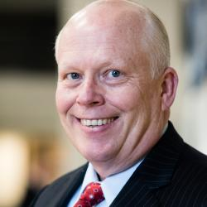
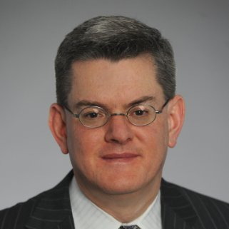
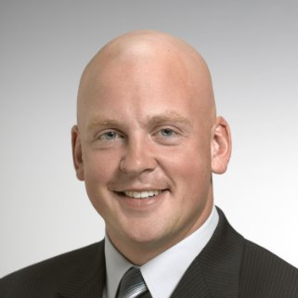
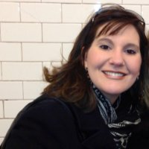
Peoples Bank Executives
CEO - Chuck Sulerzyski
CFO - John Rogers
CCO - Robyn Stevens
Director of Human Resources - Matt Edgell
Director of Learning and Development – Saundra Kesterson

Slide 3
Introduction to Peoples Bank
Founded in 1902, Peoples Bank has been in business for more than 115 years
The first bank in Ohio to gain insurance licensure
$3.5 billion in total assets
Operating in Ohio, West Virginia, and Kentucky
76 sales offices including 67 full-service bank branches and 75 ATMs
Headquartered in Marietta, Ohio

Slide 4
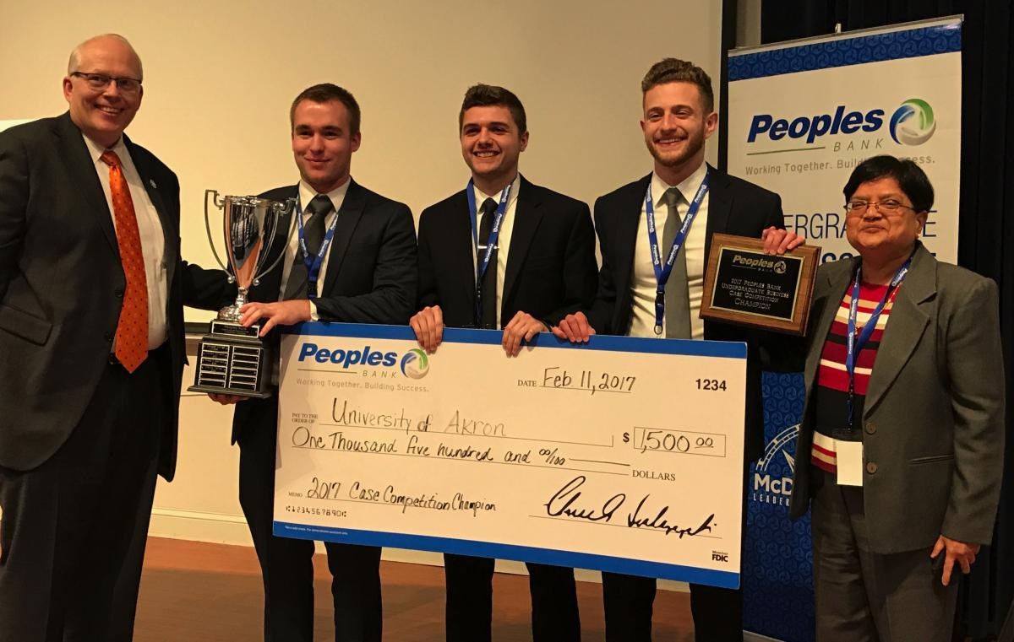
Getting Connected with Peoples Bank
Professional Development Program

Slide 5
Peoples Bank Branch Map

Slide 6
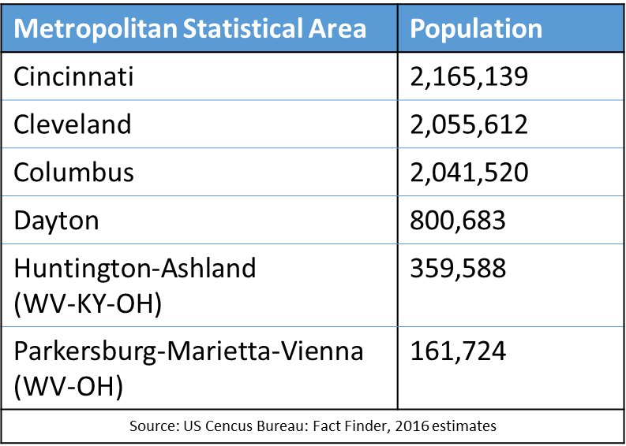

Slide 7
Total Earnings

Slide 8
Loan Portfolio Composition

Slide 9
Income Composition

Slide 10
Texas Ratios

Slide 11
Correlation/Regression Analysis
Leadership and performance data: 1990-2016
CEO, CFO, and board changes
Net interest margin and return on assets
Attempt to quantify relationship between leadership changes and bank’s position
Past research- Adams and Mehran (2011), Boone et al. (2007), Pathan and Skully (2010)

Slide 13
Board Composition
Public information available
Well diversified body
Four females on board
13 members total

Slide 14
Current Succession Plan
Emphasis on internal development
Supplementation with external hires where appropriate

Slide 15
Professional Development Program and Retention
Professional Development program
Ability to allocate resources to development
Program structure
Internal flexible but highly ambiguous
Opportunity for growth in several functions but lack of structure
Dependent on talent pool
Existing employees may also be deterred
Develop written talent management program

Slide 16
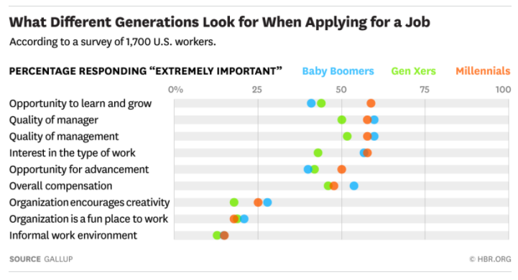

Slide 17
C-Suite and Board Succession Planning
Literature suggests internal hires are more common and perform better
External hires (current CEO) can benefit in other scenarios
Board of Directors already has a formalized process for succession
Continue to diversify its members
Carry out plan to extend formal process to C-suite succession

Slide 18
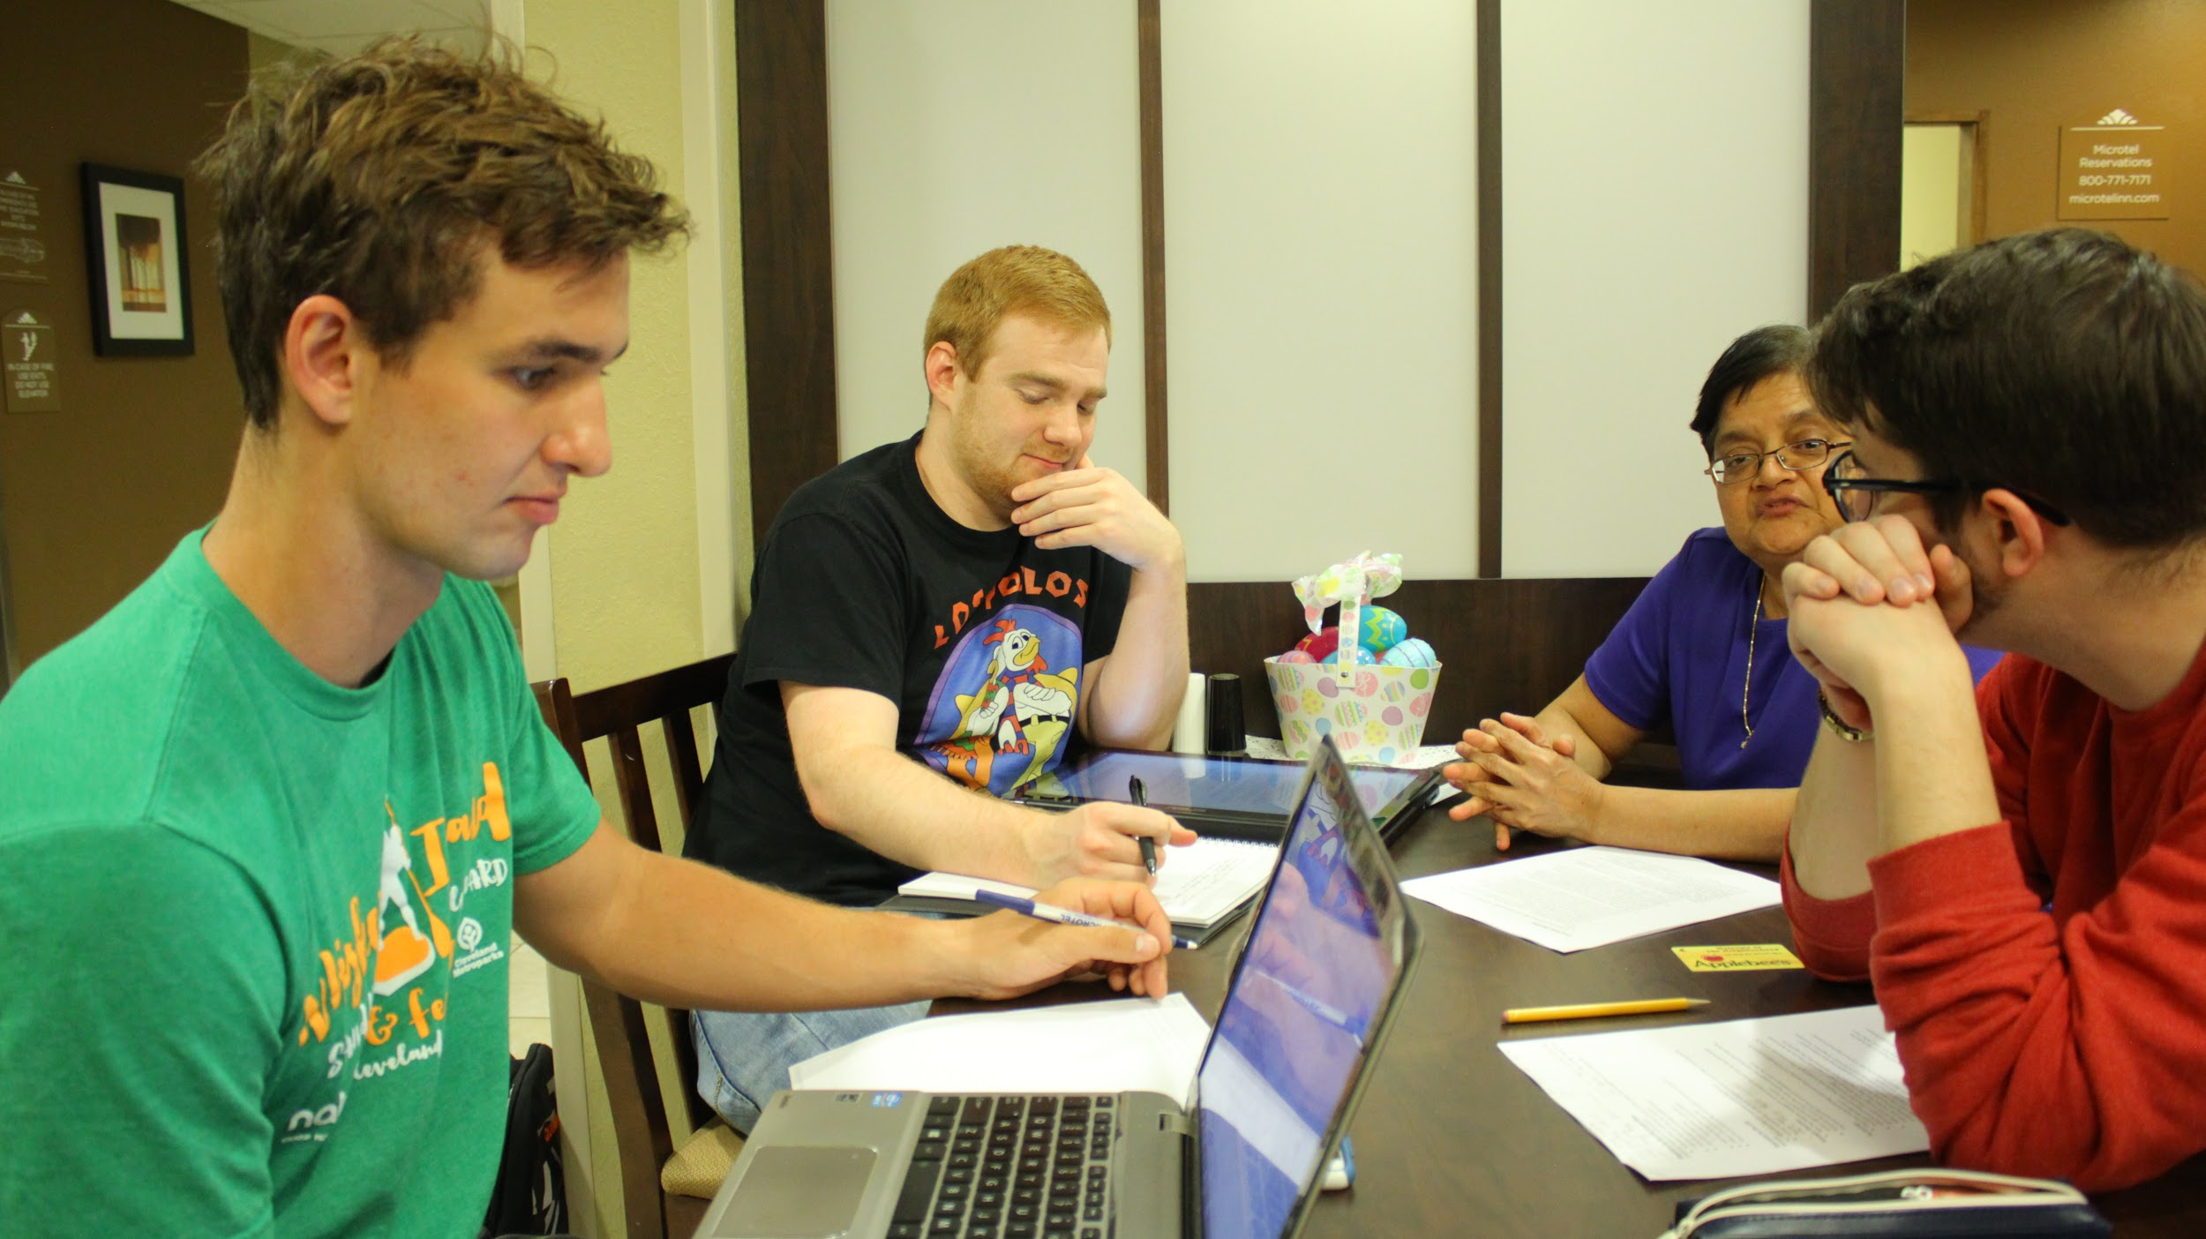
Challenges of Creating Video
Travel, prep and logistics of going to Marietta, Ohio.

Slide 19
Challenges of Creating Video
Time frame of interviews.
Being conscious of everyone’s schedule.
Only ONE take.
Getting creative input from the team and implementing it.
The many hours of editing...

Slide 20
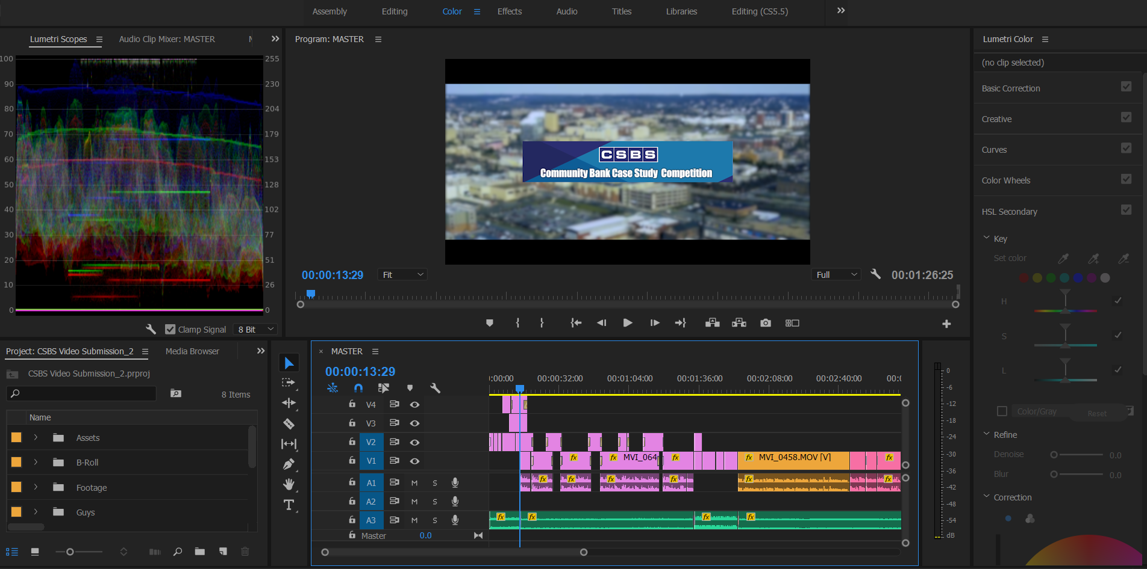
Overview of Video Timeline

