Slide 1
Determinants of Losses on Construction Loans:
Bad Loans, Bad Banks, or Bad Markets?
Emily Johnston Ross
Federal Deposit Insurance Corporation
Joseph B. Nichols
Board of Governors of the Federal Reserve System
Lynn Shibut
Federal Deposit Insurance Corporation
September 2021
The analysis, conclusions, and opinions set forth here are those of the author(s) alone and do not necessarily reflect the views of the Federal Deposit Insurance Corporation, the Board of Governors of the Federal Reserve System, or the United States. The authors wish to thank: Lily Freedman, A.J. Micheli and Michael Pessin for research assistance; Suzi Gardner, Derek Johnson, Michael McCann, and Ken Redline for expert advice, and; Domenic Barbato, Rosalind Bennett, Mike Brennan, Kayla Freeman, Lisa Garcia, Peter Martino, Ajay Palvia, Smith Williams, and Mary Zaki for useful comments. All errors and omissions are our own.

Slide 2
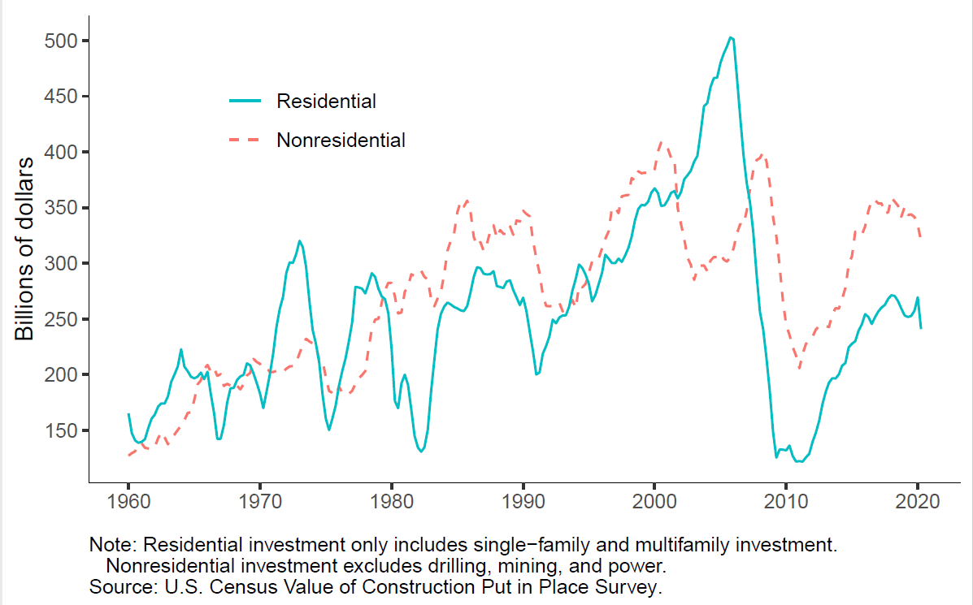
Motivation: Investment in Construction 1960-2020

Slide 3
Motivation: Study Objectives
During real estate downturns, Acquisition, Development and Construction (ADC) loans
  Weaken banks
  Trigger bank failures
Yet losses are not well understood
  Complex process
  Lack of data
  First loan level study of Loss Given Default (LGD)!
Primary research questions
  Do the loans, the banks or the markets explain losses?
  What are the implications for lenders and regulators?
Focus is on distressed LGD because that’s when it matters

Slide 4
Construction Lending Characteristics
Collateral
  Created during loan term, value uncertain
Monitoring
  More intensive than other types of mortgages
Default
  No regular payments by borrower
  Thus term defaults are largely decided by bank
Risks
  High sensitivity to real estate cycles
  Construction

Slide 5
Data
Primary Data Source: FDIC Loss Share program
  Over 275 banks and over 15,000 loans
  Late 2008 – 2015: Distress period
Supplemented with Call Report, SOD, market data
Benchmarking uses the Y-14 data (Large Banks)

Slide 6
Sample Characteristics
Mostly defaulted during a distress period
Mostly originated during the preceding boom
  Some were originated after many banks had stopped lending
A lot of small loans
61% of the loans are in the South, 2% in Northeast
A lot of single-family residential (SFR) land and development loans, especially in the South
1 in 4 loans were “out-of-territory” loans
Note: the paper contains a substantial amount of descriptive statistics.

Slide 7
Distribution of LGD
Note: As much as the data allowed, the LGD definition follows Basel. However, it excluded servicing costs because they weren’t reported under the Loss Share program.

Slide 8
Methodology
We use a two-step estimation approach to capture the bi-modal distribution of the LGD data
  The first stage is the probability of a non-zero loss
  The second stage is the amount of loss, given that it is non-zero
We also calculate and report the overall marginal effect across both regressions
We run separate sets of regressions for SFR and commercial collateral
We examine several loan, originating bank, and market characteristics

Slide 9
Effect of Loan Characteristics
Loans in judicial foreclosure states have higher LGDs
  6.7 ppts for SFR collateral, 7.1 ppts for commercial
LGD increases significantly if the lender has increased the loan amount over the initial commitment
  10.3 ppts for SFR, 14.6 ppts for commercial
For SFR
  Land and development loans have higher LGDs than later stage (vertical) construction loans (+13.7 ppts) *
  Maturity defaults have lower LGDs (-7.4 ppts)
  Out of territory loans have higher LGDs (+4.1 ppt)
* A similar measure is not available for commercial collateral.

Slide 10
Effect of Bank Characteristics
Banks with high ADC loan growth have higher LGDs
  One standard deviation increase in 3-year growth before origination increases LGD by 3 ppts
Smaller banks have slightly higher LGDs
  This may reflect the capacity to manage distressed loans
  At mean, 50% increase in bank size reduces LGD by 1 ppt
Measures of bank health at origination were insignificant

Slide 11
Effect of Market Measures at Origination
High growth in local ADC loans/total loans increases LGD
  One standard deviation in the 3-year growth increases LGD by 8.4 ppts for SFR collateral, 4.8 ppts for commercial
High level of local ADC loans/total loans increases LGD, especially for commercial
Higher local CRE vacancy rate increases LGD
  1 ppt increase in vacancy rate increases LGD for SFR by 1.2 ppts, commercial by 2.0 ppts
1-year increase in housing permits to housing stock significantly increased LGD
  One standard deviation increase in measure increases LGD by 2.8 ppt for SFR, 2.6 ppt for commercial

Slide 12
Effect of Market Measures after Origination
The change in the local share of ADC loans to total loans from origination to default influenced LGDs
  A 1 ppt increase in the ratio increases LGD on SFR collateral by 1.9 ppts, commercial by 3.0 ppts
  This captures the impact of over-supply on the collateral value
The noncurrent rate of local banks in the market at default increases LGD
  A 1 ppt increase in the ratio increases LGD on SFR by 0.46 ppt, commercial by 0.38 ppt

Slide 13
Counterfactual Analysis
For each variable, we
Calculated the 25th and 75th percentile values
Determined which one was “good” and “bad” for LGD
For each category, separately for SFR and commercial, we
Estimated LGD
  Using the “good” percentile for that category, and the mean for all other variables
  Using the “bad” percentile for that category, and the mean for all other variables
Calculated the difference
Results
  Loans and markets matter more than banks
  Market characteristics at origination matter a lot

Slide 14
Implications: Market Effects
Macroprudential
  Supports higher capital requirements for ADC
  Consider potential future market conditions for both monitoring and stress testing
Microprudential
  Monitoring limited to loan and bank characteristics will overlook a significant portion of credit risk
  Banks and regulators should actively monitor both supply and demand at the market level, in order to anticipate potential oversupply
  May be beneficial to create standard reports to support examiner review of ADC loans at exams

Slide 15
Other Implications
Loan effects
  Not all ADC loans pose the same risks
  “Horizontal” construction is especially risky
Definitions matter
  Many costs associated loan workouts are excluded from loan loss reserve estimates

