Slide 1
Clayton Legear
President & Chief Executive Officer
Merchants & Marine Bank
Pascagoula, MS

Slide 2

Community Banking
A View From the Field

Slide 3
An Industry, Endangered
A Lesson from The Field
A species is classified as endangered when its population has declined between 50 and 70 percent. This decline is measured over 10 years or three generations of the species, whichever is longer.
A species is classified as endangered when its population has declined at least 70 percent and the cause of the decline is known. A species is also classified as endangered when its population has declined at least 50 percent and the cause of the decline is not known.
Source: National Geographic Society

Slide 4
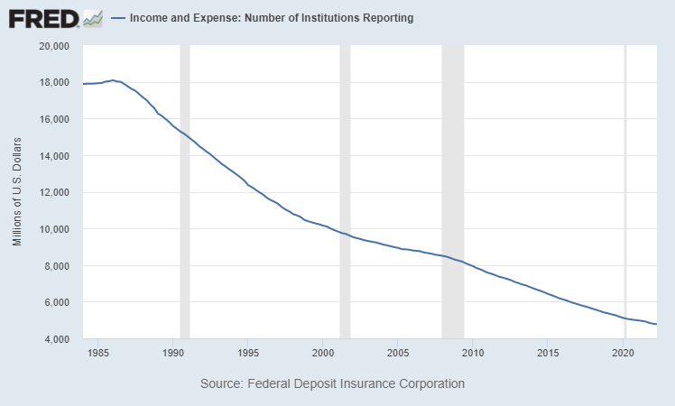
An Industry, Endangered

Slide 5
Community Banking
Under Pressure

Slide 6
Under Pressure
Habitat Loss
The buffers that once insulated Community Banks from other segments of the economy are disappearing. Once restrictive interstate and intrastate branching rules have all but disappeared in recent decades as electronic banking has also become mainstream. This has simultaneously paved the way for rapid growth among some banks and greatly increased competition for almost every bank.
Over Exploitation
Community Banks face mounting pressure to generate increasingly higher performance levels to remain independent. This pressure comes from a variety of sources, including: banks and credit unions seeking additional scale through acquisitions, community bank shareholders seeking liquidity for their shares, and even activist investors seeking to drive quick and rapid returns by taking stakes in stable community banks and pressing for change.

Slide 7
Under Pressure
Invasive Species
Community Banks are facing an unprecedented onslaught of competition from non-bank competitors. From credit unions, to fintech firms, to traditional merchants – community banks are confronting a rapidly growing field of competition for loans, deposits and payment services. And, in many cases, these competitors have little to no regulatory oversight
Climate Change
Community Banks battle ongoing, and often unpredictable, “climate changes” as a normal part of business. Despite the best efforts of elected officials and bank regulators, the continual ebb and flow of the bank regulatory climate presents significant challenges to community banks. Continually adapting to these ongoing changes diverts limited community bank time and resources away from scaling services, driving growth, pursuing innovation and enhancing profitability.

Slide 8
Community Banking
Committed to Brighter Futures

Slide 9
Community Banking
A Roadmap for Success

Slide 10
A Roadmap for Success
An Unwavering Focus on Our Core Business
A Community Bank’s core business remains locally focused and people centric, something that is not easily replicated by other competitors. Rather than being a liability, Community Banks deep personal relationships and often detailed local knowledge are a competitive advantage. While technology, product offerings, and business strategies can enhance your Core Business, they can never replace it.
A Commitment to Building Bankers
Community Bankers are declining in numbers but are arguably more needed than ever in our country. Whether it is responding to a global financial panic, leading local economic development efforts, or supporting local charities, communities need strong Community Bankers. Community Banks across the country need them to. Our ability to develop the next generation of Community Bankers will directly impact our industry’s long-term trajectory, as well as that of our Country.

Slide 11
A Roadmap for Success
A Reimagined Capital Stack
Stable Community Banks are increasingly disappearing as a result of sales to provide liquidity and returns to bank shareholders. With many Community Banks privately held, and many others only thinly traded, accessing longer-term capital when needed for shareholder exits is increasingly challenging. Finding alternatives to pair willing investors with Community Banks who desire independence could dramatically reduce bank consolidation.
Passionate Storytelling & Advocacy
Community Banks must remain passionate about telling their story and the stories of their clients. In an increasingly noisy world, it is more important than ever for Community Banks to control the narrative and tell their stories to all stakeholders.

Slide 12
A Roadmap for Success
Balanced Regulatory Conservation
Lawmakers and Bank Regulators will continue to play an important role in the future trajectory of Community Banking, whether they realize it or not. It is essential that bank rules, regulations and supervisory approaches evolve over time for safety and soundness purposes. However, the rapid changes experienced in recent years and the increasingly divisive tone at the top is leading to more Community Banks disappearing.

Slide 13

Let’s Connect!
Clayton Legear
Clayton.Legear@mandmbank.com
www.linkedin.com/in/clayton-legear/

Slide 14
Clayton Legear
President & Chief Executive Officer
Merchants & Marine Bank
Pascagoula, MS

