Slide 1
The Social Externalities of Bank Disclosure Regulation: Evidence from the Community Reinvestment Act
Sydney Kim (UIUC), Oktay Urcan (UIUC), and Hayoung Yoon (SMU)
September 2022

Slide 2
Motivation
» Banks’ social performance in equitable treatment of customers has been a matter of particular concern by banking regulators
» Enforcement efforts have been traditionally complemented with disclosure requirements
» e.g., HMDA, CRA, CFPB 2021 proposal

Slide 3
Research Question
» We examine…
» 2005 Community Reinvestment Act Reform
»Before: Banks were required to disclose details on the location of their loans (in low-, moderate-, middle-, upper- income areas)
»After: Asset threshold for the requirement was increased, exempting a group of banks from the mandatory disclosure

Slide 4
Summary of Paper
» Local business activities after the rule change
»A significant decline in small businesses in Low- and Moderate- income (LMI) zip codes
»A significant decline in small business employment and wages in LMI zip codes
»Stronger results in areas of high CRA implementation cost
» Bank lending behavior after the rule change
»Non-disclosing banks reduced lending to LMI areas after disclosure elimination

Slide 5
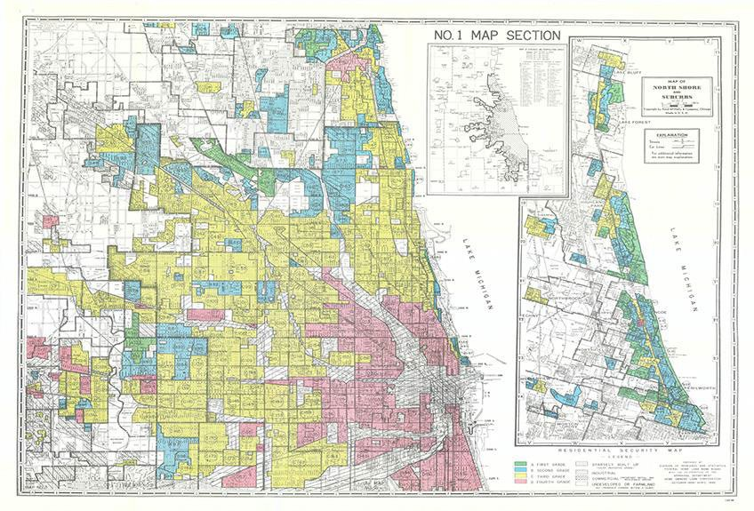
Community Reinvestment Act
» CRA 1977, enacted in response to the practice of “redlining”
Color-coded “Redlining” Map of the Chicago area, 1940 (“Residential Security” maps)
Green : “Best”
Blue: “Still Desirable”
Yellow: “Definitely Declining” Red: “Hazardous”

Slide 6
Community Reinvestment Act
» Two primary mechanisms (The 1995 Reform)
» Periodic bank performance evaluation (direct mechanism)
»Rating assigned based on Lending, Investment, Service tests
»Dahl et al. (2000); Agarwal et al. (2012)
» Disclosure (indirect mechanism)
»Banks are required to disclose the number and amount of small business loans to LMI areas.
»Provide the public (e.g., community organizations) with data to assess and monitor the activities of lenders in their neighborhoods (FRB 2005)

Slide 7
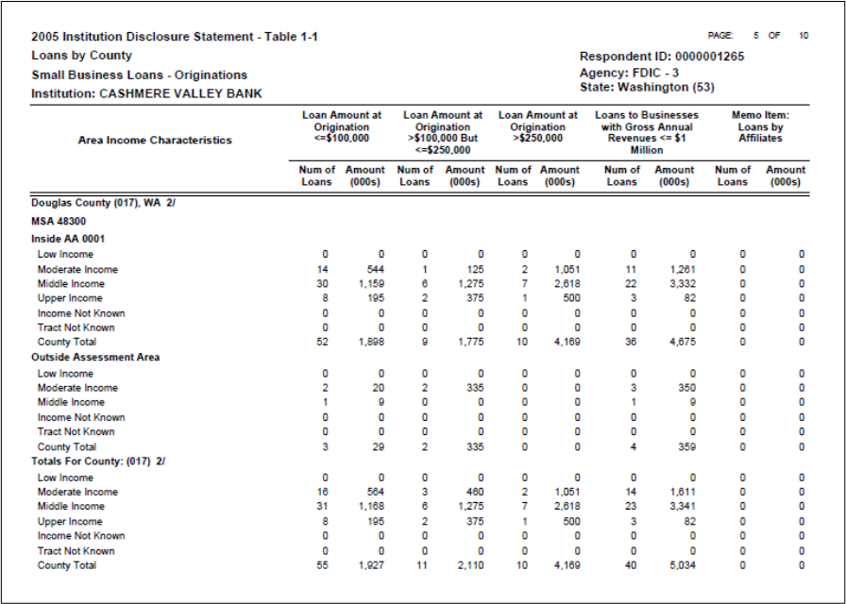
Example of CRA Geographic Disclosure

Slide 8
Predictions
» The reduction in disclosures would impact banks’ lending behavior and local business activities.
» Non-disclosers likely face less public shaming / reputational costs (e.g., Fishbein 1992; Zinman 2002; Apgar and Duda 2003; Miller 2006; Dyck et al. 2008; Christensen et al. 2020; Johnson 2020; Dou and Zou 2018)

Slide 9
Predictions
» We expect our results to be stronger according to:
Geographic disclosure intensity
» Zip codes with a large reduction in disclosure will experience a greater change in outcomes
CRA target eligibility status (i.e., LMI status)
» CRA target eligibility status provides strong incentives to comply with the goals of CRA ((Agarwal et al., 2012; Ding et al., 2018; Saadi, 2020; Begley and Purnanandam, 2021)
» Any CRA policy driven effects will be more pronounced in CRA target areas
Small business establishment size
» CRA policies apply to small business loans, therefore small businesses will be impacted.
» Stronger effects would be observed for smaller size categories, as reliance on bank credit is higher for small firms.

Slide 10
Sample
» 6 years surrounding the 2005 – reform (2002 - 2007)
» 1,091 disclosure exempt intermediate small banks identified based on 2003, 2004 total assets

Slide 11
Summary Statistics

Slide 12
CRA Disclosure Exemption and Local Business Activity
» We find that CRA reform reduces number of small business establishments by 2% (i.e., 4 small business establishments) in LMI zip codes with a large reduction in disclosure.
» This effect is concentrated in the smallest of the small business establishments (i.e., establishments with 1-9 employees).

Slide 13
Which Zip Codes Are Affected by the 2005 CRA Reform?
» Our results are concentrated in zip codes with
» High minority (non-white) population
» High number of community workers
» This suggests that our results are concentrated in zip codes where banks incur greater costs from the mandatory CRA requirements before the reform.

Slide 14
Labor Market Consequences
» We find that CRA reform also reduces small business employment and average wages in LMI zip codes with a large reduction in disclosure.

Slide 15
Why Do We Find These Results?
» By using hand-collected CRA performance evaluation reports, we document that banks reduce number of small business loans in LMI zip codes with a large reduction in disclosure.
» This suggests a lending channel explaining our results.

Slide 16
Other Community Activities by Non-Disclosing Banks
» We find no evidence that banks replace small business lending with other community activities including community development loans, community investment, and donations.

Slide 17
Conclusion
» We find that zip codes where the majority of disclosure-exempt banks stop disclosing after the 2005 reform experience a decrease in small businesses in LMI zip codes which the CRA targets.
» Our results are concentrated in zip codes that are predominantly non-white and with stronger community scrutiny in the pre-reform period.
» Using information from CRA PE reports, we find evidence that, during the non- disclosure period, non-disclosing banks indeed reduced lending to CRA target areas.

