Slide 1
Research Paper Session 1
Information and Bank Lending Terms
Discussion by
Mark Flannery, University of Florida

Slide 2
These three papers
  Look different in their topics and methods of analysis.
  But they all examine how information is used in bank lending.
  Obviously, crucial to academic and real-life bank operations.

Slide 3
Bank Monitoring with On-Site Inspections
Awesome data – as they say!
Academics frequently talk about monitoring,
  Without any data
  With varying conceptions of what it means

Slide 4
Lots of interesting connections between performance and monitoring.
  More inspections for larger, longer, and riskier loans. Table 3.
  Past interactions reduce inspections – relationship information?
  More inspections reduce defaults.
  Language affects draws; proof of relevance of these inspections.

Slide 5
While I enjoyed seeing all these things documented – really, for the first time – I kept wondering how inspections decisions interact with other elements of the loan deal.
Stock analysts: who should a new entrant choose to follow?
Joint determination of rate, fees, amounts, collateral, and now inspections.
Difficult statistical problem, but with these data I suggest they try to tackle it.
How?

Slide 6
Estimate loan rate regressions with inspection frequency as an explanatory variable.
  Already have an instrumental variable for inspections.
Show some more of the estimated coefficients on loan features, to help understand determinants of planned monitoring.
  Table 3 includes some interesting risk measures, which are not reported in later tables.
  It would be good to see how (if) the coefficients on risk measures vary when we add information on
    Past relationships (in Table 4)
    Selected other borrower characteristics (Table 8), or
    with borrower and contractor fixed effects (in Table 10)

Slide 7
Non-Information Asymmetry Benefits of Relationship Lending
“Relationship lending” is a major subject of analysis in the banking literature.
Thought to provide banks with valuable PRIVATE information.
This information asymmetry between past and potential new lenders affects competition for business.
  Often presented as generating forebearance if a firm encounters trouble in the future.
This paper uses Payroll Protection Plan loans to demonstrate the relevance of information asymmetry in bank-firm relationships.

Slide 8
Conclusions:
  Repeat borrowers are processed more rapidly.
  The bank might even lie for a borrower who falls outside PPP guidelines.
  Past deposits do not significantly affect processing speed.
BUT, what does this have to do with asymmetric information and the bank’s inclination to forebear in the future?
PPP loans fully guaranteed.
These firms were in pretty bad shape and deteriorating – AND the bank had loans outstanding to such firms.
Notes:
PPP applicants in bad shape:
p. 17: distance-to-default:, fins that, between Dec 19, 2019 and March 20, 2020 PPP firms’ pr(default) increased 6.6 times as much as non-ppp, matched sample firms.
“these firms are unlikely to have access to lenders’ funds without placing large collateral, committing to strict covenants, and increasing the cost of borrowing.”
Quote from page 19

Slide 9
Rushing through PPP applications means that the government makes your existing loans safer!
“The evidence is consistent with the evergreening mechanism where banks keep unprofitable firms alive …”
I find the presented results interesting, but
  I don’t see the relevance of this conclusion to the information asymmetry motivation.
  Exposition needs some more work.

Slide 10
Bank Loan Markups and Adverse Selection
I smiled when I had read enough of this paper to see what it is about. Great idea!
Franklin National Bank, failed in 1973.
  Had recently moved from Long Island into Manhattan
  Set about expanding their commercial loan portfolio
  WSJ story
  Groucho Marx
Notes:
In Manhattan, HQ at 450 Park Avenue

Slide 11
The Concept
More competitors should make any one lender expect a higher PD if their loan offer is accepted.
More competitors ➔ more opportunities for there to be negative information known to one of them
That is, the more serious is the winner’s curse.
Notes:
The concept: in lending and setting appropriate loan rates, each bank competes with other potential lenders and other potential loan offers.
If one bank quotes the lowest rate (best terms), there is a chance that it under-appreciated some risk that other potential lenders recognized.

Slide 12
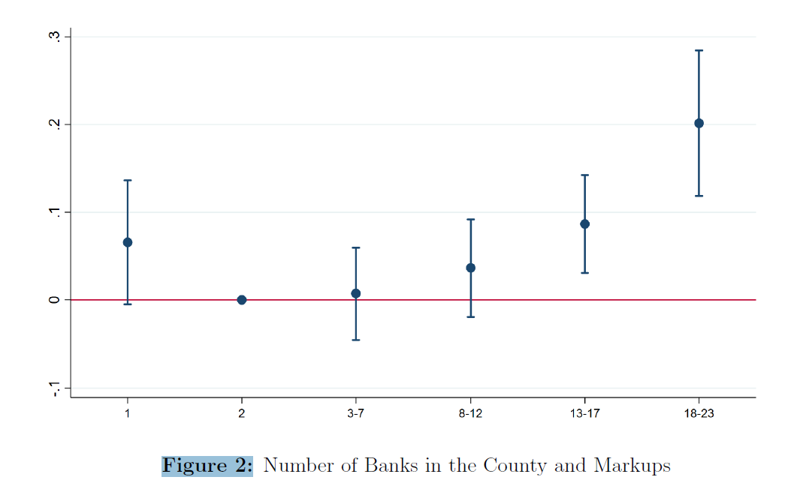
Loan rate markup
Risk-adjusted
Notes:
Similar plot for PDs, showing that banks actively recognize this element of the market for loans.
The “risk-adjusted” markups here are from a model that controls for observable firm characteristics, but not the internal info (PD, LGD)

Slide 13
I believe the story, at least in its broad outline. Two estimation issues:
Contradictory estimates?
  Tables 5 and 6 both explain Risk-Adjusted markups.
  Estimated coefficient on “One Bank” is significantly positive in Table 5.
  Same coefficient is significantly negative in Table 6, when include fixed effects. WHY?
Are markups computed from an inappropriate regression specification? Estimating markups from a regression of loan rate on firm and deal characteristics (Table 3).
  Fails to recognize an important constraint: that the loan rate will never be below the riskless rate. (Implied spread must be positive.)
  Instead, estimate the Spread as depending on firm and deal characteristics. Make a difference?

Slide 14
Some suggestions for further confirmation.
  Compute the theoretical effect of random noise on the probability of offering the lowest loan rate in any given group size. Compare to slope in Figure 2.
  Cut the larger loans out of the sample, expecting to see more dramatic effects.
  Think about MSAs as geographical unit, rather than counties.

Slide 15
Three nice papers
Tell us some interesting things about information in bank models

