Slide 1
Bank Loan Markups and Adverse Selection
Community Bank Research Conference
Mehdi Beyhaghi¹
Cesare Fracassi²
¹Richmond Fed ²UT Austin ³McGill
September 28, 2022
Gregory Weitzner³
The views expressed in this presentation are those of the authors. They do not necessarily represent the views of the Federal Reserve Bank of Richmond or the Federal Reserve System.
Bank Loan Markups

Slide 2
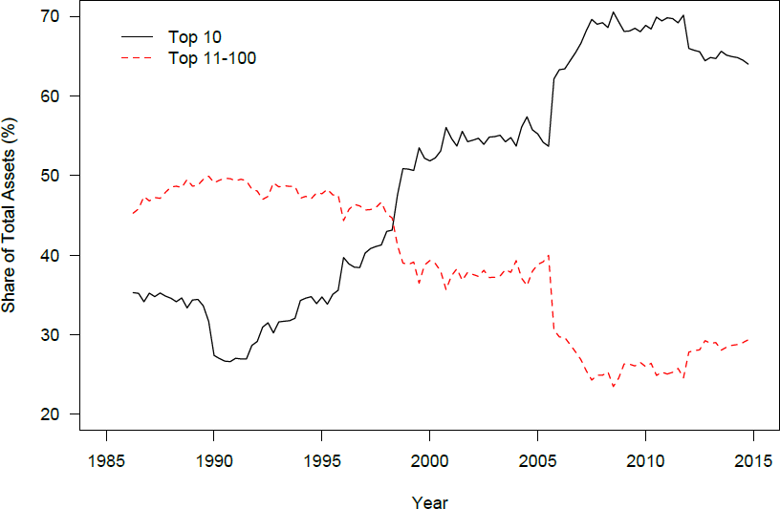
Motivation: Fernholz and Koch (2016) - BHCs
Bank Loan Markups

Slide 3
The Effect of Market Concentration on Prices
Standard theories of competition predict higher concentration leads to higher prices
Bank Loan Markups
3 / 22

Slide 4
The Effect of Market Concentration on Prices
Standard theories of competition predict higher concentration leads to higher prices
Many studies find that higher local market concentration leads to lower deposit rates
FDIC and DOJ rely on local deposit concentration measures when reviewing mergers
Bank Loan Markups
3 / 22

Slide 5
The Effect of Market Concentration on Prices
Standard theories of competition predict higher concentration leads to higher prices
Many studies find that higher local market concentration leads to lower deposit rates
FDIC and DOJ rely on local deposit concentration measures when reviewing mergers
...but credit markets are different than deposit/typical product markets
Asymmetric information:
Between borrower and lender: borrowers are often better informed about their creditworthiness Across lenders: some lenders know more about certain borrowers’ quality than other lenders
Bank Loan Markups
3 / 22

Slide 6
Market Concentration and Adverse Selection
Asymmetric information across lenders can create a positive relationship between the number of banks and interest rates in local banking markets.
Broecker (1990), Marquez (2002), Dell’Arrichia and Marquez (2006)
Bank Loan Markups
4 / 22

Slide 7
Market Concentration and Adverse Selection
Asymmetric information across lenders can create a positive relationship between the number of banks and interest rates in local banking markets.
Broecker (1990), Marquez (2002), Dell’Arrichia and Marquez (2006)
“The chief financial officer of a new bank once told the author that as soon as you open your doors, every deadbeat in town lines up to try to borrow from you” – Shaffer (1998)
In regions in which more banks operate, banks’ market power can increase.
Banks better informed about certain borrowers can charge higher rates to those borrowers because their outside options are worse
Bank Loan Markups
4 / 22

Slide 8
Market Concentration and Adverse Selection
Asymmetric information across lenders can create a positive relationship between the number of banks and interest rates in local banking markets.
Broecker (1990), Marquez (2002), Dell’Arrichia and Marquez (2006)
“The chief financial officer of a new bank once told the author that as soon as you open your doors, every deadbeat in town lines up to try to borrow from you” – Shaffer (1998)
In regions in which more banks operate, banks’ market power can increase.
Banks better informed about certain borrowers can charge higher rates to those borrowers because their outside options are worse
The relationship between market concentration and prices in credit markets is theoretically ambiguous
Bank Loan Markups
4 / 22

Slide 9
Key Empirical Problem: Distinguishing Market Power from Risk
 | Loan 1 | Loan 2
Bank | JP Morgan | JP Morgan
Quarter | 2017Q1 | 2017Q1
Loan characteristics | {x,y,z,..} | {x,y,z,..}
Location | St. Louis County | Franklin County
Number of Banks | 10 | 6
Interest Rate | 4.0% | 4.5%
Bank Loan Markups
5 / 22

Slide 10
Key Empirical Problem: Distinguishing Market Power from Risk
 | Loan 1 | Loan 2
Bank | JP Morgan | JP Morgan
Quarter | 2017Q1 | 2017Q1
Loan characteristics | {x,y,z,..} | {x,y,z,..}
Location | St. Louis County | Franklin County
Number of Banks | 10 | 6
Interest Rate | 4.0% | 4.5%
Is JP Morgan charging a higher markup on Loan 2 or is Loan 2 simply riskier?
Bank Loan Markups
5 / 22

Slide 11
Our Proposed Solution
 | Loan 1 | Loan 2
Bank | JP Morgan | JP Morgan
Quarter | 2017Q1 | 2017Q1
Loan characteristics | {x,y,z,..} | {x,y,z,..}
Probability of Default | 1.0% | 1.0%
Loss Given Default | 30.0% | 30.0%
Location | St. Louis County | Franklin County
Number of Banks | 10 | 6
Interest Rate | 4.0% | 4.5%
Control for the risk of the loan
Can reasonably argue the 0.5% difference in interest rates not because Loan 2 is riskier
Bank Loan Markups

Slide 12
Findings
Estimate loan-level markup controlling for banks’ private risk assessments
Markup measure is unrelated to future loan performance
Measure strongly related to future performance if we do not control for the risk of the loan
1
Bank Loan Markups
7 / 22

Slide 13
Findings
Estimate loan-level markup controlling for banks’ private risk assessments
Markup measure is unrelated to future loan performance
Measure strongly related to future performance if we do not control for the risk of the loan
1
2
Higher markups in regions with more banks
Bank Loan Markups
7 / 22

Slide 14
Findings
Estimate loan-level markup controlling for banks’ private risk assessments
Markup measure is unrelated to future loan performance
Measure strongly related to future performance if we do not control for the risk of the loan
1
2
Higher markups in regions with more banks
Evidence of adverse selection:
Markups higher for firms that stay with their existing banks
Markups drop following a shock that reduces asymmetric information in local markets
3
Bank Loan Markups
7 / 22

Slide 15
Roadmap
Methodology and Data
Interest Rate Decomposition: Markup
Markups and Market Concentration
Channel
Bank Loan Markups
8 / 22

Slide 16
Roadmap
1 Methodology and Data
2
Interest Rate Decomposition: Markup
3
Markups and Market Concentration
4 Channel
Bank Loan Markups
8 / 22

Slide 17
Methodology: Estimating Markup
Interest Rate = Marginal Cost + Markup
| {z } | {z }
Risk of Loan
Market Power
Bank Loan Markups
9 / 22

Slide 18
Methodology: Estimating Markup
Interest Rate = Marginal Cost + Markup
| {z } | {z }
Risk of Loan Market Power
We estimate marginal cost using a predictive regression with loan controls, PD and LGD
We also create a baseline measure where we do not control for PD and LGD
1
2
We then define the markup as M⁻arkup = Interest Rate − Inte⁻rest Rate
If M⁻arkup is measuring market power, it should not be related to the risk of the loan
We directly test this by regressing future loan performance on M⁻arkup
3
Bank Loan Markups
9 / 22

Slide 19
Data
Federal Reserve Y-14Q data on corporate loans over $1mm
Data used to monitor banks and perform stress tests
Detailed loan characteristics, loan performance and firm financials Internal bank risk assessments (PD and LGD)
“Internal estimates of PD and LGD must incorporate all relevant, material and available data, information and methods. A bank may utilize internal data and data from external sources.”
Bank Loan Markups
10 / 22

Slide 20
Data
Federal Reserve Y-14Q data on corporate loans over $1mm
Data used to monitor banks and perform stress tests
Detailed loan characteristics, loan performance and firm financials Internal bank risk assessments (PD and LGD)
“Internal estimates of PD and LGD must incorporate all relevant, material and available data, information and methods. A bank may utilize internal data and data from external sources.”
U.S. BHCs with over $50bn in assets
85.9% of U.S. banking sector assets
70.0% of commercial and industrial loan volume
Bank Loan Markups
10 / 22

Slide 21
Data
Federal Reserve Y-14Q data on corporate loans over $1mm
Data used to monitor banks and perform stress tests
Detailed loan characteristics, loan performance and firm financials Internal bank risk assessments (PD and LGD)
“Internal estimates of PD and LGD must incorporate all relevant, material and available data, information and methods. A bank may utilize internal data and data from external sources.”
U.S. BHCs with over $50bn in assets
85.9% of U.S. banking sector assets
70.0% of commercial and industrial loan volume
Quarterly sample: 2014Q4 - 2020Q3
Restrict sample to new loans
Remove publicly traded firms and syndicated loans
Bank Loan Markups
10 / 22

Slide 22
Summary Statistics
Loan Characteristics | Mean | SD | 10% | Median | 90% | N
Amount (million USD) | 6.97 | 14.15 | 1.04 | 2.54 | 15.75 | 28,033
Interest Rate (%) | 3.66 | 1.17 | 2.16 | 3.63 | 5.25 | 28,033
Probability of Default (%) | 1.38 | 1.74 | 0.21 | 0.90 | 2.83 | 28,033
Loss Given Default (%) | 35.28 | 14.88 | 15.00 | 36.00 | 50.50 | 28,033
Maturity (months) | 41.32 | 31.50 | 10.00 | 36.00 | 84.00 | 28,033
Non-Performance (%) | 2.01 | 14.03 | 0.00 | 0.00 | 0.00 | 28,033
Realized Default (%) | 0.81 | 8.96 | 0.00 | 0.00 | 0.00 | 28,033
Firm Characteristics
Assets (million USD) | 109.66 | 410.70 | 2.71 | 20.06 | 175.80 | 28,033
Leverage | 0.33 | 0.26 | 0.01 | 0.30 | 0.69 | 27,507
Profitability | 0.14 | 0.26 | -0.01 | 0.08 | 0.33 | 28,033
Tangibility | 0.91 | 0.17 | 0.67 | 1.00 | 1.00 | 27,963
Geographic Characteristics
Number of Banks | 10.88 | 5.48 | 3.00 | 11.00 | 18.00 | 28,033
One Bank | 0.03 | 0.17 | 0.00 | 0.00 | 0.00 | 28,033
Bank Loan Markups
11 / 22

Slide 23
Average Default Rates Across Interest Rate Bins
1.5
Average Realized Default (%)
1
.5
0
2.1
3
3.6
4.3
5.4
Beyhaghi, Fracassi and Weitzner
Bank Loan Markups
September 28, 2022
12 / 22

Slide 24
Average Default Rates Across PD Bins
2.5
Average Realized Default (%)
2
1.5
1
.5
0
.2
.5
.9
1.5
3.8
Bank Loan Markups
13 / 22

Slide 25
Roadmap
1 Methodology and Data
2
Interest Rate Decomposition: Markup
3
Markups and Market Concentration
4 Channel
Bank Loan Markups
13 / 22

Slide 26
Risk-Adjusted Markup Does Not Predict Performance
When we control for the risk of the loan, our estimate of markup does not predict future performance
This result provides validity to our measure of markup
Bank Loan Markups
14 / 22

Slide 27
Risk-Adjusted Markup Does Not Predict Performance
When we control for the risk of the loan, our estimate of markup does not predict future performance
This result provides validity to our measure of markup
In contrast, markup strongly predicts future performance if we do not control for its risk
Hence, banks’ are using private information to price their loans
Bank Loan Markups
14 / 22

Slide 28
Roadmap
1 Methodology and Data
2
Interest Rate Decomposition: Markup
3
Markups and Market Concentration
4 Channel
Bank Loan Markups
14 / 22

Slide 29
Markups and Market Concentration
Risk-Adjusted Markup (%)
(3) (4)
(1)
(2)
(5)
(6)
Number of Banks
One Bank Population Density Average Wages
0.010∗∗∗ (4.960)
Bank-Quarter FE Industry-Quarter FE Loan Type FE
Loan Purpose FE Firm Characteristics
YES YES YES YES YES
YES
YES
YES
Observations | 28,033 | 28,033 | 27,487 | 27,487 | 25,610 | 25,608
R-squared | 0.00 | 0.01 | 0.03 | 0.03 | 0.03 | 0.05
Bank Loan Markups
15 / 22

Slide 30
Markups and Market Concentration
Risk-Adjusted Markup (%)
 | (1) | (2) | (3) | (4) | (5) | (6)
Number of Banks | 0.010∗∗∗ | 0.011∗∗∗
(4.960)
(5.266)
0.114∗∗∗ (2.997)
One Bank
Population Density Average Wages
Bank-Quarter FE Industry-Quarter FE Loan Type FE
Loan Purpose FE Firm Characteristics
YES YES YES YES YES
YES
YES
YES
Observations | 28,033 | 28,033 | 27,487 | 27,487 | 25,610 | 25,608
R-squared | 0.00 | 0.01 | 0.03 | 0.03 | 0.03 | 0.05
Beyhaghi, Fracassi and Weitzner
Bank Loan Markups
September 28, 2022
15 / 22

Slide 31
Markups and Market Concentration
Risk-Adjusted Markup (%)
 | (1) | (2) | (3) | (4) | (5) | (6)
Number of Banks | 0.010∗∗∗ | 0.011∗∗∗ | 0.011∗∗∗
(4.960)
(5.266)
0.114∗∗∗ (2.997)
(4.913)
0.122∗∗∗ (3.134)
One Bank
Population Density Average Wages
Bank-Quarter FE Industry-Quarter FE Loan Type FE
Loan Purpose FE Firm Characteristics
YES YES YES YES YES
YES
YES
YES
Observations | 28,033 | 28,033 | 27,487 | 27,487 | 25,610 | 25,608
R-squared | 0.00 | 0.01 | 0.03 | 0.03 | 0.03 | 0.05
Beyhaghi, Fracassi and Weitzner
Bank Loan Markups
September 28, 2022
15 / 22

Slide 32
Markups and Market Concentration
Risk-Adjusted Markup (%)
 | (1) | (2) | (3) | (4) | (5) | (6)
Number of Banks | 0.010∗∗∗ | 0.011∗∗∗ | 0.011∗∗∗ | 0.010∗∗∗
(4.960)
(5.266)
0.114∗∗∗ (2.997)
(4.913)
0.122∗∗∗ (3.134)
(3.145)
0.127∗∗∗ (3.045)
0.005
(0.364)
One Bank
Population Density Average Wages
Bank-Quarter FE Industry-Quarter FE Loan Type FE
Loan Purpose FE Firm Characteristics
YES YES YES YES YES
YES
YES
YES
Observations | 28,033 | 28,033 | 27,487 | 27,487 | 25,610 | 25,608
R-squared | 0.00 | 0.01 | 0.03 | 0.03 | 0.03 | 0.05
Beyhaghi, Fracassi and Weitzner
Bank Loan Markups
September 28, 2022
15 / 22

Slide 33
Markups and Market Concentration
Risk-Adjusted Markup (%)
 | (1) | (2) | (3) | (4) | (5) | (6)
Number of Banks | 0.010∗∗∗ | 0.011∗∗∗ | 0.011∗∗∗ | 0.010∗∗∗ | 0.007∗∗
(4.960)
(5.266)
0.114∗∗∗ (2.997)
(4.913)
0.122∗∗∗ (3.134)
(3.145)
0.127∗∗∗ (3.045)
0.005
(0.364)
(2.188)
0.112∗∗∗ (2.798)
-0.006
(0.331) 0.170∗∗ (2.345)
One Bank
Population Density Average Wages
Bank-Quarter FE Industry-Quarter FE Loan Type FE
Loan Purpose FE Firm Characteristics
YES YES YES YES YES
YES
YES
YES
Observations | 28,033 | 28,033 | 27,487 | 27,487 | 25,610 | 25,608
R-squared | 0.00 | 0.01 | 0.03 | 0.03 | 0.03 | 0.05
Beyhaghi, Fracassi and Weitzner
Bank Loan Markups
September 28, 2022
15 / 22

Slide 34
Markups and Market Concentration
Risk-Adjusted Markup (%)
 | (1) | (2) | (3) | (4) | (5) | (6)
Number of Banks | 0.010∗∗∗ | 0.011∗∗∗ | 0.011∗∗∗ | 0.010∗∗∗ | 0.007∗∗ | 0.007∗∗
(4.960)
(5.266)
0.114∗∗∗ (2.997)
(4.913)
0.122∗∗∗ (3.134)
(3.145)
0.127∗∗∗ (3.045)
0.005
(0.364)
(2.188)
0.112∗∗∗ (2.798)
-0.006
(0.331) 0.170∗∗ (2.345)
(2.253)
0.119∗∗∗ (2.876)
-0.005
(0.242) 0.214∗∗ (2.554)
One Bank
Population Density Average Wages
Bank-Quarter FE Industry-Quarter FE Loan Type FE
Loan Purpose FE Firm Characteristics
YES YES YES YES YES
YES
YES
YES
Observations | 28,033 | 28,033 | 27,487 | 27,487 | 25,610 | 25,608
R-squared | 0.00 | 0.01 | 0.03 | 0.03 | 0.03 | 0.05
Bank Loan Markups

Slide 35
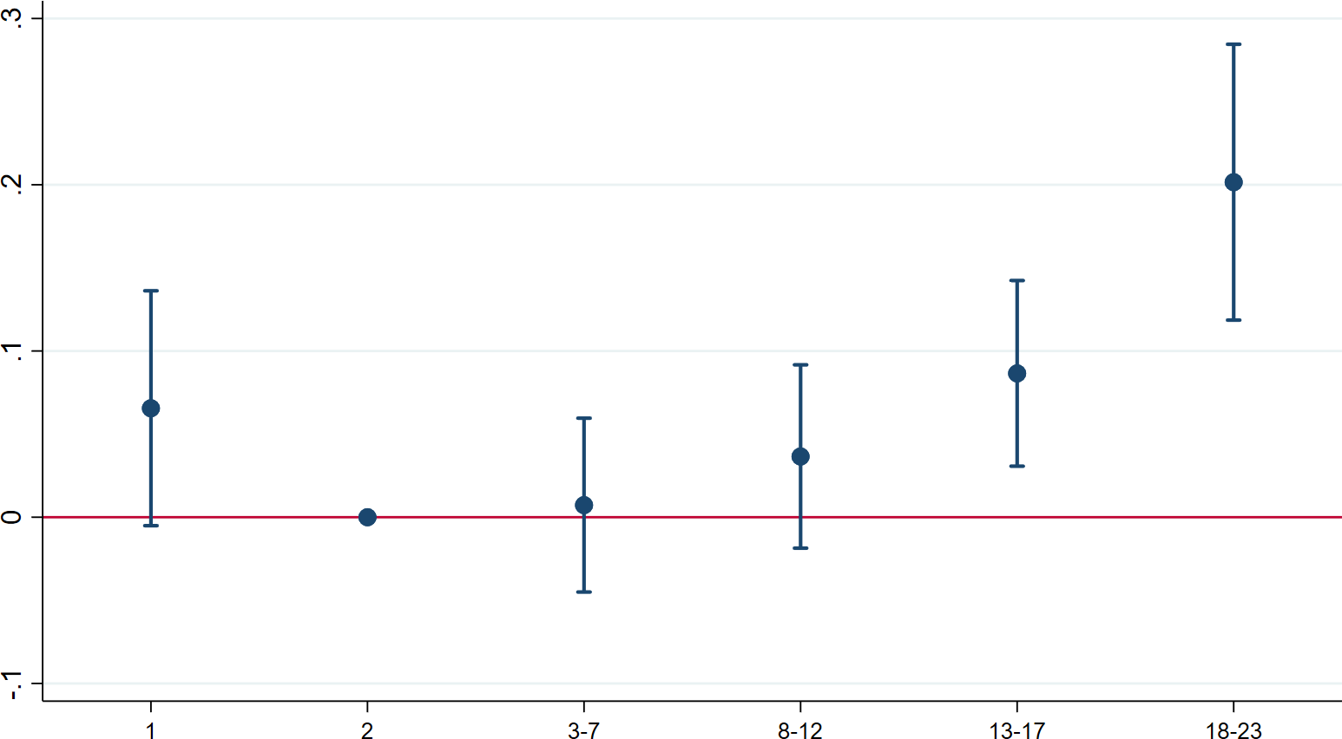
Number of Banks in the County and Markups
Bank Loan Markups
16 / 22

Slide 36
Roadmap
1 Methodology and Data
2
Interest Rate Decomposition: Markup
3
Markups and Market Concentration
4 Channel
Bank Loan Markups
16 / 22

Slide 37
Markups and Switching Banks
Hold-up problem: firms face higher markups if they stay with their existing banks
Common result in models of adverse selection
Intuition: a bank’s superior information about a particular borrower increases their market power because of adverse selection
Restrict analysis to firms with multiple loans in sample
Bank Loan Markups
17 / 22

Slide 38
Markups and Switching Banks
Hold-up problem: firms face higher markups if they stay with their existing banks
Common result in models of adverse selection
Intuition: a bank’s superior information about a particular borrower increases their market power because of adverse selection
Restrict analysis to firms with multiple loans in sample
We find that markups are about 7bps higher for firms that stay with their existing banks
Bank Loan Markups
17 / 22

Slide 39
Shock To Asymmetric Information in Local Loan Markets
We use capital surcharges that were imposed on global systemically important banks (GSIBs) in 2016 as a shock to asymmetric information
Favara, Ivanov, and Rezende (2021) show that following the imposition of these capital surcharges, GSIBs reduced their lending relative to other banks
This forced reduction in lending reduces the adverse selection problem in local markets
It becomes less of a bad signal if a firm does not receive a loan from a GSIB bank
Bank Loan Markups

Slide 40
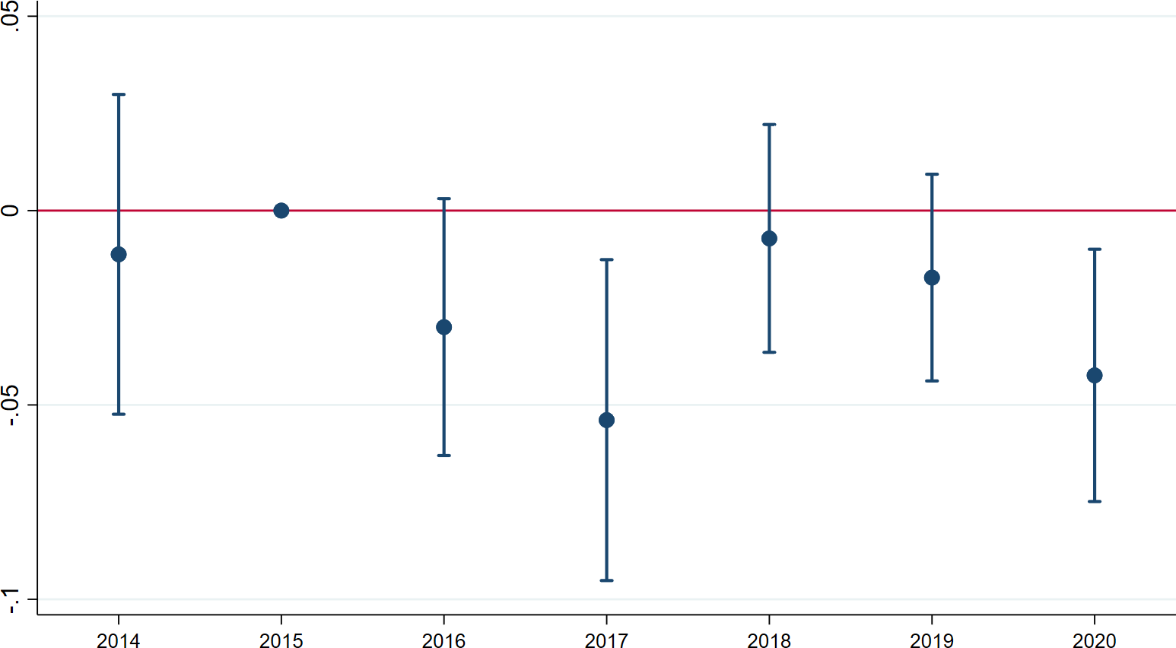
The Effect of GSIB Capital Surcharges on Market Shares
MarketShare_{b,t,c} = β₀ + β₁GSIB_{b} × Post_{t} + γ_{b,c} + δ_{t} + u_{b,t,c}
Bank Loan Markups

Slide 41
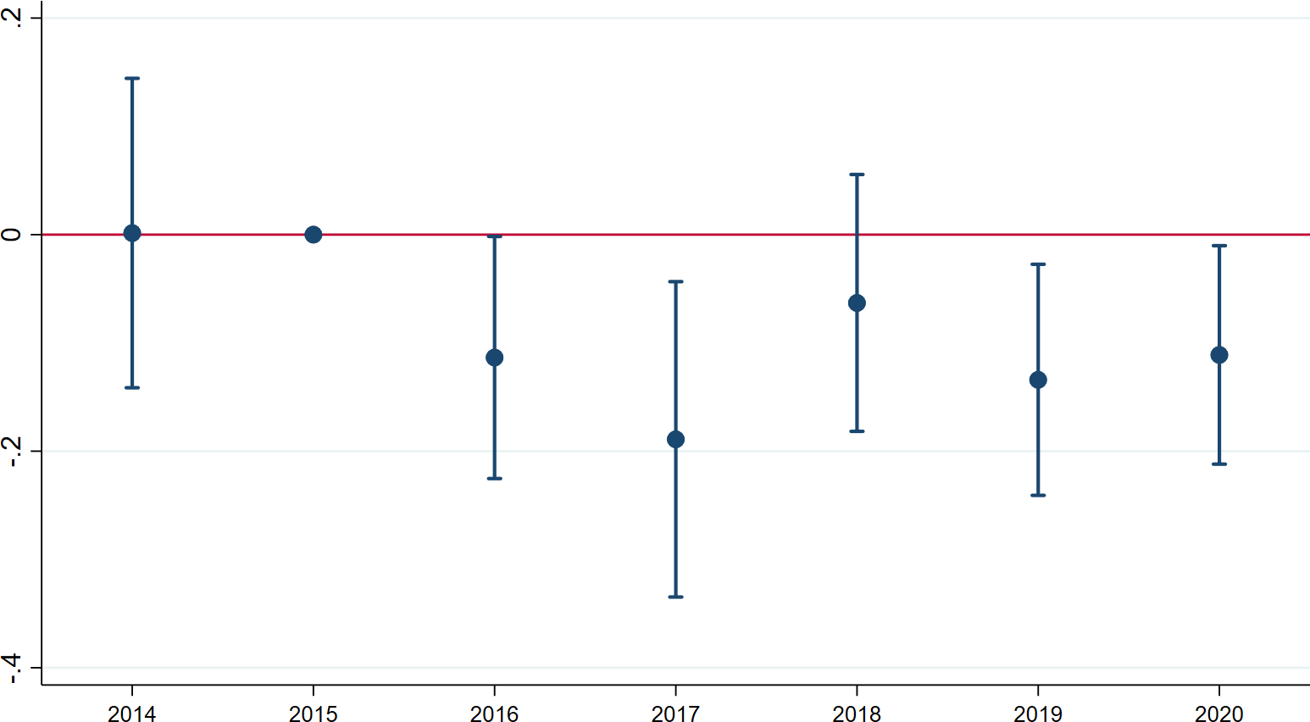
The Effect of GSIB Capital Surcharge on Markups
M⁻⁻⁻U_{l} = β₀ + β₁GSIB_{b} × Post_{t} + γ_{b,c} + δ_{t} + u_{b,t,c}
Bank Loan Markups

Slide 42
The Effect of GSIB Capital Surcharge on Markups
Effects are concentrated among borrowers that stay with their existing banks
Larger effect in counties with higher initial aggregate GSIB presence
Bank Loan Markups

Slide 43
Conclusion
In corporate loan markets, markups are lower in more concentrated local markets
Estimate markups using banks’ private risk assessments
Evidence consistent with adverse selection driving market power in local banking markets
Bank Loan Markups
22 / 22

Slide 44
Conclusion
In corporate loan markets, markups are lower in more concentrated local markets
Estimate markups using banks’ private risk assessments
Evidence consistent with adverse selection driving market power in local banking markets Standard methods for measuring market power may not be appropriate for loan markets
Deposit markets are not subject to the same degree of asymmetric information Higher concentration does not necessarily imply more market power
Our markup methodology could be useful to regulators with access to Y-14Q data
Bank Loan Markups
22 / 22

