Slide 1
Non-Information Asymmetry Benefits of Relationship Lending
2022
Community Banking Research Conference
September-2022
Daniel Rabetti Tel Aviv University & Visiting Cornell University

Slide 2
Motivation: asymmetric information
What we know about relationship lending
- Solve problems of asymmetric information:
- monitoring (Diamond (1984);
- screening (Ramakrishnan and Thakor (1984));
- adverse selection (lending to low-quality borrowers);
- moral hazard (borrowers' incentives to invest sub-optimally)
- Benefits for borrowers and lenders:
- relationship lending is associated with lower spreads,
larger loans, lower collateral requirements, and relaxed covenants in particular for less transparent firms (Pertesen and Rajan (1994), Cole (1998), Cayseele and Degryse (2000), Bharath et al (2011) and Prilmeier (2017).
Daniel Rabetti
Community Banking Conference

Slide 3
Motivation: Non-Information Asymmetry (Open question!)
What we don’t know about relationship lending
- Do banks favor relationship borrowers when there is no information asymmetry in the loan? If so, then:
- what are the benefits associated with it?
- what are the costs associated with it?
- why do banks favor relationship borrowers?
Daniel Rabetti
Community Banking Conference

Slide 4
The setting: a great laboratory
The Paycheck Protection Program (PPP) setting provides unique opportunity to test these questions:
- By construction: No asymmetric information in the loan structure:
- Loans are backed by the Federal Reserve;
- No restriction to borrowers' credit risk;
- Loan based on and limited to borrowers payroll size;
- Fixed interest rate and loan term structure;
- No colaterals or covenants.
- As consequence: - Information channel plays little role;
- Competition from less informative lenders;
- Opportunity to attract new customers.
Empirical Question!
Daniel Rabetti
Community Banking Conference

Slide 5
Data: public firms
Manually collected from 8K and 10K disclosures:
- About 1,000 firms' disclosures:
- a textual analysis algorithm extracts the loan amount, loan request, and disbursement date, and lender's name;
Daniel Rabetti
Community Banking Conference

Slide 6
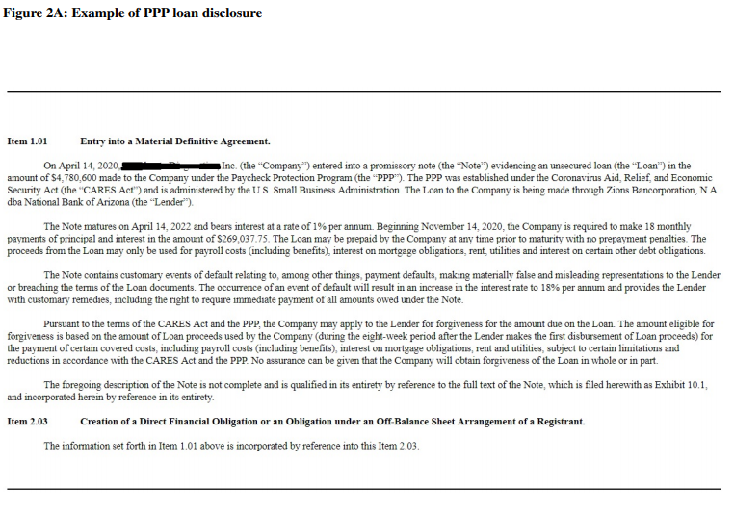
Data: public firms
Mannually collected from 8K and 10K disclosures:
- About 1,000 firms' disclosures:
- a textual analysis algorithm extracts the loan amount, loan request and disbursment date, and lender's name;
- check lender's name on SEC fillings;
- variation on relationship:
(i) any (e.g., deposit or scrow account); (ii) lending, and (iii) transaction relationship.
- JP Morgan: 51% (35%) any (lending) relationship.
Daniel Rabetti
Community Banking Conference

Slide 7
Data: public firms
Manually collected from 8K and 10K disclosures:
- About 1,000 firms' disclosures:
- a textual analysis algorithm extracts the loan amount, loan request, and disbursement date, and lender's name;
- check lender's name on SEC fillings;
- variation on relationship:
(i) any (e.g., deposit or scrow account); (ii) lending, and (iii) transaction relationship.
- JP Morgan: 51% (35%) any (lending) relationship.
Daniel Rabetti
Community Banking Conference

Slide 8
Data: private firms
The Small Business Administration (SBA) data:
- Full data released in August 2020, covering the entire population of lenders and borrowers.
- for PPP above 150K: >700K firms and >4K lenders; - key information about the firm and loan characteristics, such as loan size range, firm and lender name, state, NAIC code, and reported number of employees; - match SBA firms to DealScan dataset: - scope: limited information on firms; - missing data: loan request date and repayments; - selection issues: a small portion of matched firms;
Daniel Rabetti
Community Banking Conference

Slide 9
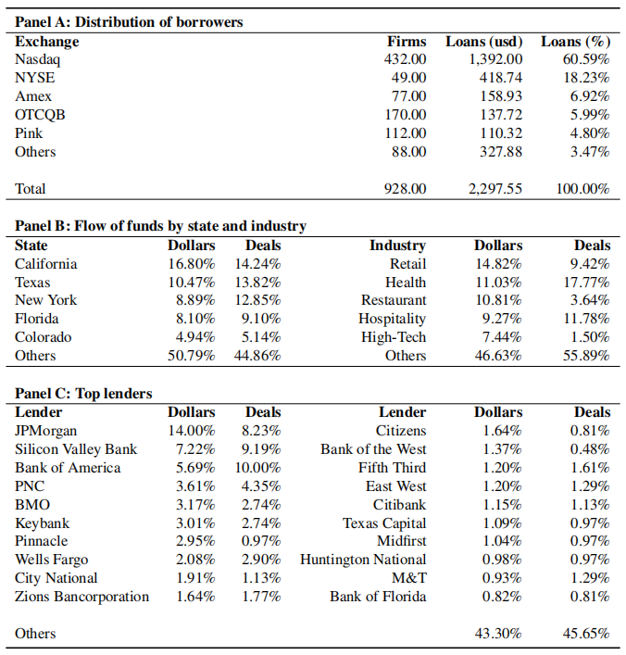
Distribution of funds
Daniel Rabetti
Community Banking Conference

Slide 10
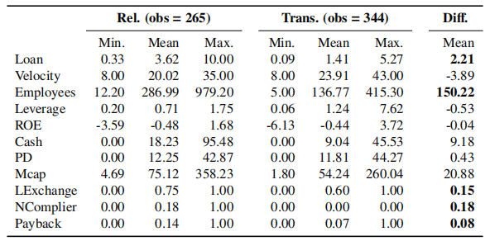
Summary statistics
Daniel Rabetti
Community Banking Conference

Slide 11
Research design
To examine the effects of relationship lending, the following model is constructed:
is one of the four response variables:
(i) Size: the logarithm of loan size in dollars;
(ii) Velocity: the distance in days between the loan request and loan received to date; (iii) Non-Complier: an indicator that switches on when the borrower has more than 500 employees;
(iv) Payback: an indicator that switches on when the borrower returns the PPP loan in full;
Daniel Rabetti
Community Banking Conference

Slide 12
Research design
To examine the effects of relationship lending, the following model is constructed:
is the relationship indicator and can be: (i) any relationship or transaction borrower (ii) lending relationship or transaction borrower.
Daniel Rabetti
Community Banking Conference

Slide 13
Research design
To examine the effects of relationship lending, the following model is constructed:
is a vector of lender's controls;
is a vector of borrower's controls;
is the industry fixed effect;
is the state fixed effect;
is the bank fixed effect;
Daniel Rabetti
Community Banking Conference

Slide 14
(I) Do banks favor relationship borrowers when there is no information asymetry?
Daniel Rabetti
Community Banking Conference

Slide 15
(I) Are there relationship lending benefits in the paycheck protection program?
Daniel Rabetti
Community Banking Conference

Slide 16
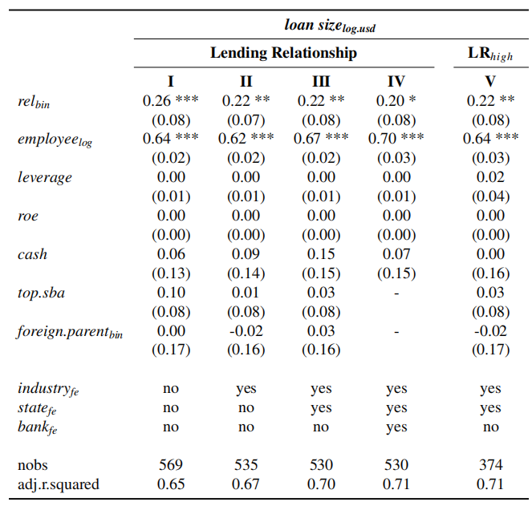
Benefits A: Loan Size ~ REL +...
Daniel Rabetti
Community Banking Conference

Slide 17
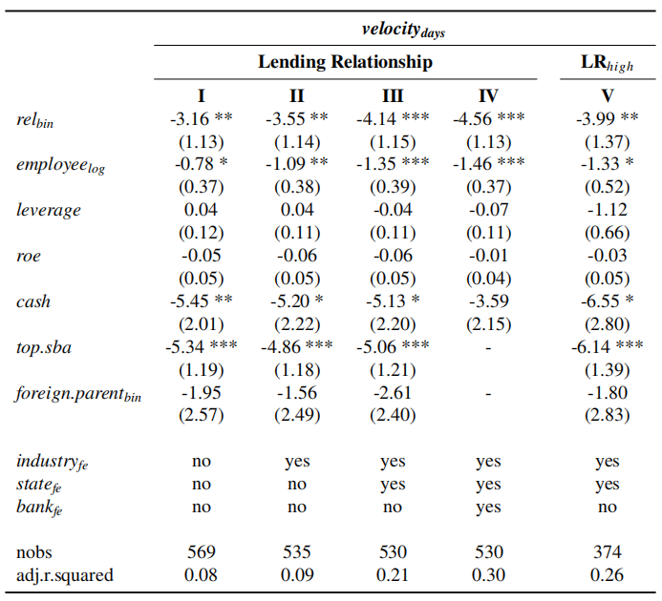
Benefits B: Velocity ~ REL +...
Daniel Rabetti
Community Banking Conference

Slide 18
Validity and robustness tests
Daniel Rabetti
Community Banking Conference

Slide 19
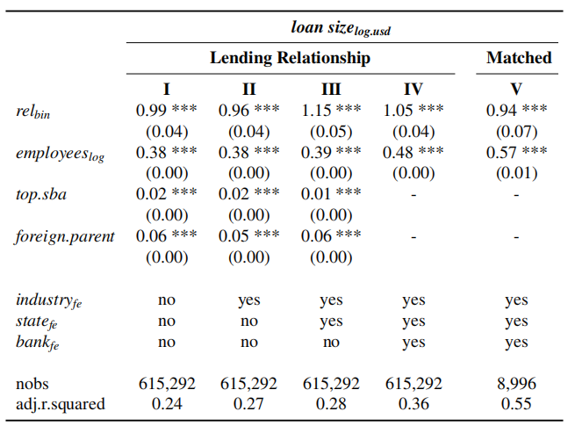
External Validity: Private firms
Daniel Rabetti
Community Banking Conference

Slide 20
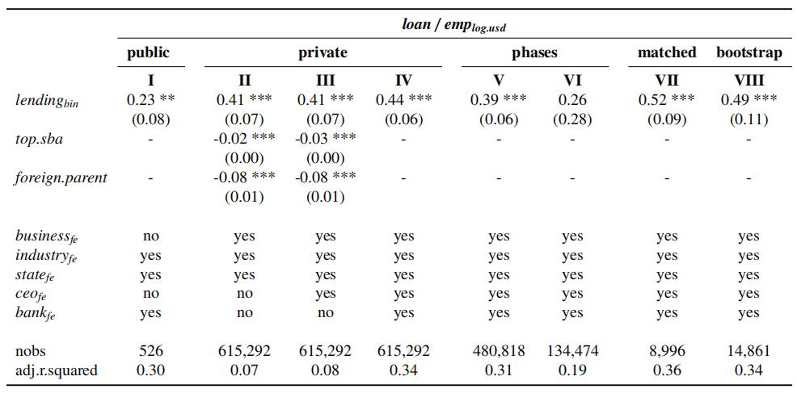
Alternative Specifications
Daniel Rabetti
Community Banking Conference

Slide 21
(I) Do banks favor relationship borrowers when there is no information asymetry in the loan? Yes, relationship borrowers receive larger loans and faster approvals.
Daniel Rabetti
Community Banking Conference

Slide 22
(II) Why do banks favor relationship borrowers? Tension: absence of information advantage
Daniel Rabetti
Community Banking Conference

Slide 23
Proposed motivations: Either for future business opportunities (Bolton(2016) or to mitigate borrower's default risk (evergreening)
Daniel Rabetti
Community Banking Conference

Slide 24
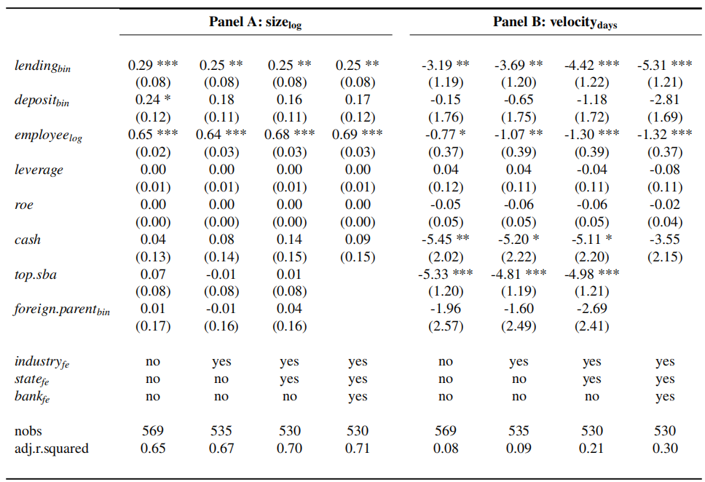
(1) Deposits vs Lending accounts
Daniel Rabetti
Community Banking Conference

Slide 25
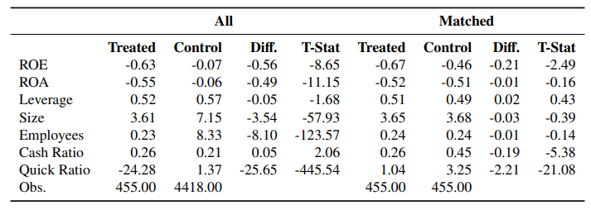
(2.1) Pre-crisis characteristics: Peers
Daniel Rabetti
Community Banking Conference

Slide 26
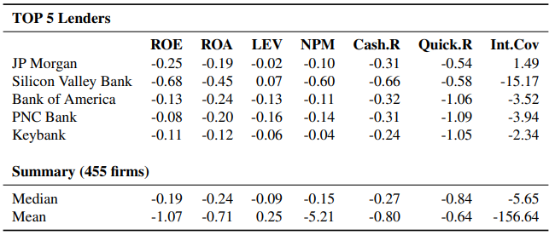
(2.2) Pre-crisis characteristics: Industry
Daniel Rabetti
Community Banking Conference

Slide 27
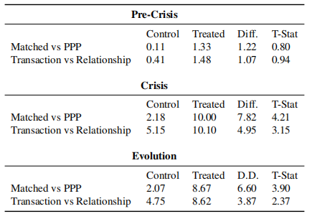
(3.1) Portfolio's default risk evolution
Daniel Rabetti
Community Banking Conference

Slide 28
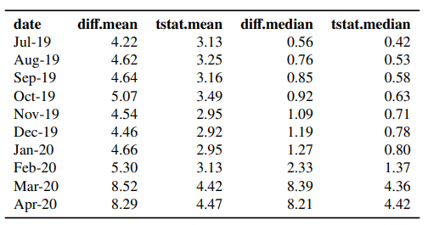
(3.2) Portfolio's default risk evolution
Daniel Rabetti
Community Banking Conference

Slide 29
(II) Why do banks favor relationship borrowers when there is no information asymetry in the loan? To mitigate borrowers' default risk at the lender's portfolio Evergreening motivation!
Daniel Rabetti
Community Banking Conference

Slide 30
(III) Are there relationship lending costs when there is no information asymmetry in the loan?
Daniel Rabetti
Community Banking Conference

Slide 31
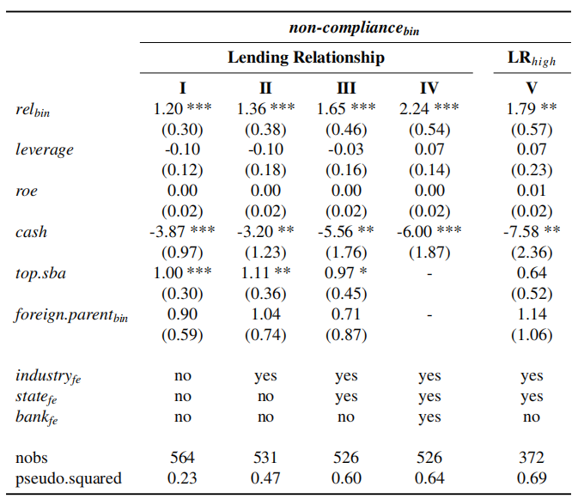
Costs A: Non-Compliance ~ REL +...
Daniel Rabetti
Community Banking Conference

Slide 32
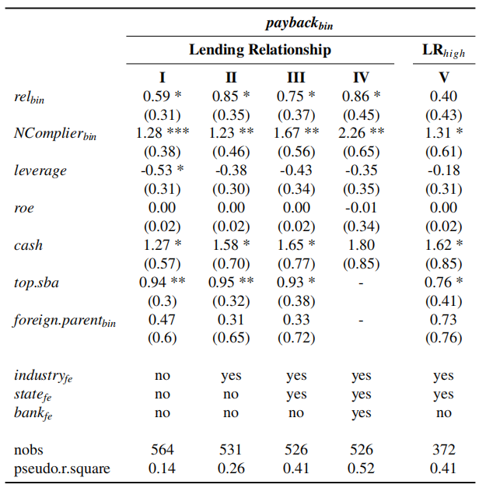
Costs B: Payback ~ REL +...
Daniel Rabetti
Community Banking Conference

Slide 33
Conclusion
What have we learned about relationship lending effects when information asymmetry in the loan plays a minor role?
- Lenders favor relationship borrowers:
- Benefits: larger loans and faster approvals;
- Why: to mitigate default risk associated with borrowers pre- crisis debt (evergreening mechanism);
- Costs: relationship borrowers are more like to violate the program rules and to return loans earlier;
- Implications: relationship lending effects are relevant in times of crisis. However, evergreening lending is an issue: (a) non-relationship borrowers move down the waiting line;
(b) transfers pre-crisis loan risks to the FED balance sheet.
Daniel Rabetti
Community Banking Conference

Slide 34
Thank You!
Daniel Rabetti Coller School of Management Tel Aviv University Contact: rabetti@mail.tau.ac.il
Daniel Rabetti
Community Banking Conference

