Slide 1
Minorities’ Access to Credit
2022 Community Bank Research Conference
Erica Xuewei Jiang
USC Marshall & UChicago Booth

Slide 2
What do we know about minorities’ access to credit?
Notes:
Reference: https://www.urban.org/urban-wire/what-different-denial-rates-can-tell-us-about-racial-disparities-mortgage-market

Slide 3
What explains the racial disparities?
Differences in income and credit profile
E.g., Bhutta, Hizmo, and Ringo (2021), Gerardi, Willen, and Zhang (2020)
Discrimination and biases
Statistical discrimination/noisy hard information (e.g., Bartlett, Morse, Stanton, and Wallace, 2022; Blattner and Nelson, 2021)
Human biases (e.g., Munnell et al, 1996; Giacoletti, Heimer, and Yu, 2021; Zhang and Willen, 2021)
Exposure to lenders with strict underwriting standards
E.g., Bhutta, Hizmo, and Ringo (2021), Bayer, Ferreira, and Ross (2018)
Neighborhood housing condition/Collateral-driven borrowing constraints
E.g., DeFusco (2018), Jiang and Zhang (2022)

Slide 4
Today’s Papers
Paper 1: The Impact of Minority Representation at Mortgage Lenders, by Scott Frame, Ruidi Huang, Erik J. Mayer, Adi Sunderam
Paper 2:Bank Competition and Entrepreneurial Gaps: Evidence from Bank Deregulation, by Xiang Li
Paper 3: Let Us Put Our Moneys Together: Minority-Owned Banks and Resilience to Crises, by Allen Berger, Maryann Feldman, W. Scott Langford, Raluca A. Roman

Slide 5
Today’s Papers
What helps close the racial gap? How to help minorities gain credit access?
Paper 1: The Impact of Minority Representation at Mortgage Lenders, by Scott Frame, Ruidi Huang, Erik J. Mayer, Adi Sunderam
Paper 2:Bank Competition and Entrepreneurial Gaps: Evidence from Bank Deregulation, by Xiang Li
Paper 3: Let Us Put Our Moneys Together: Minority-Owned Banks and Resilience to Crises, by Allen Berger, Maryann Feldman, W. Scott Langford, Raluca A. Roman

Slide 6
Today’s Papers
What can we do from the supply side of credit?
Paper 1: The Impact of Minority Representation at Mortgage Lenders, by Scott Frame, Ruidi Huang, Erik J. Mayer, Adi Sunderam
Paper 2:Bank Competition and Entrepreneurial Gaps: Evidence from Bank Deregulation, by Xiang Li
Paper 3: Let Us Put Our Moneys Together: Minority-Owned Banks and Resilience to Crises, by Allen Berger, Maryann Feldman, W. Scott Langford, Raluca A. Roman

Slide 7
Today’s Papers
Paper 1: The Impact of Minority Representation at Mortgage Lenders, by Scott Frame, Ruidi Huang, Erik J. Mayer, Adi Sunderam
Paper 3: Let Us Put Our Moneys Together: Minority-Owned Banks and Resilience to Crises, by Allen Berger, Maryann Feldman, W. Scott Langford, Raluca A. Roman
Solution: Increase minority presence on the supply side; minorities help minorities

Slide 8
Today’s Papers
Paper 2:Bank Competition and Entrepreneurial Gaps: Evidence from Bank Deregulation, by Xiang Li
Solution: market/bank competition disciplines lending

Slide 9
Big Picture Thoughts
Extremely insightful papers using rich, novel data
Great combination for this session!
→ What’s the most effective/efficient way to improve minorities’ credit access?
Role of loan officers
Paper 1
Role of organizations (owners)
Paper 3
Role of market
Paper 2

Slide 10
Paper 1 & 3: Minorities on the supply side

Slide 11
Paper 1: The Impact of Minority Representation at Mortgage Lenders
Studies role of minority loan officers in provision of mortgage credit
expanded confidential HMDA – MLO – FHA loan performance
Determine MLO race based on their names
Key findings
Minority loan officers are under-represented compared to US population
Minority applicants have better outcomes if matched to minority loan officers
Lower rejection rate
More likely to result in an origination
Lower ex-post default

Slide 12
Paper 3: Let Us Put Our Moneys Together: Minority-Owned Banks and Resilience to Crises
Studies role of minority-owned banks on economic resilience of minority communities
Minority-owned banks: more than 50 percent of the voting stock owned by racial minorities
Key findings
Minority-owned banks improve the economic resilience of minority communities
Mitigate employment losses for minorities (and also non-minorities) through both the GFC and the COVID crisis
maintain the small business and residential real estate credit supplies through each crisis

Slide 13
General Reactions
Overall, I’m fairly convinced by the findings of each paper
Now, given the effects of loan officers and bank owners, what’s their relative importance for helping minorities gain credit access?
What are the costs?

Slide 14
Comment 1: Role of LOs and Managers
Which organizational structure is closer to the current banking industry?
Do loan officers have enough discretion to make a difference?
Do owners have enough control to influence loan applications?
Notes:
https://www.youtube.com/watch?v=qYXQ1fLopno

Slide 15
Comment 1: Role of LOs and CEOs
Loan officers
Don’t set credit standards → done by underwriters; standards set by securitizes (e.g., GSEs) or at institution level
Yet, loan officers can decide whether to initiate a conversation with branch managers/underwriters to get some benefits for borrowers
Personal experience: combined LTV goes beyond the limit set by institution
Bank owners
Don’t make decisions at individual loan-basis/don’t interact with borrowers directly
Can set aggregate lending volume limit in each community
Can improve the representation of minority loan officers
Which one plays a more important role in helping minorities?
Is there a way to decompose the contribution?
Bank-county-year fixed effects seem to explain a large amount of variation in minority credit approval → seems to suggest the decision-making is at organization-level

Slide 16
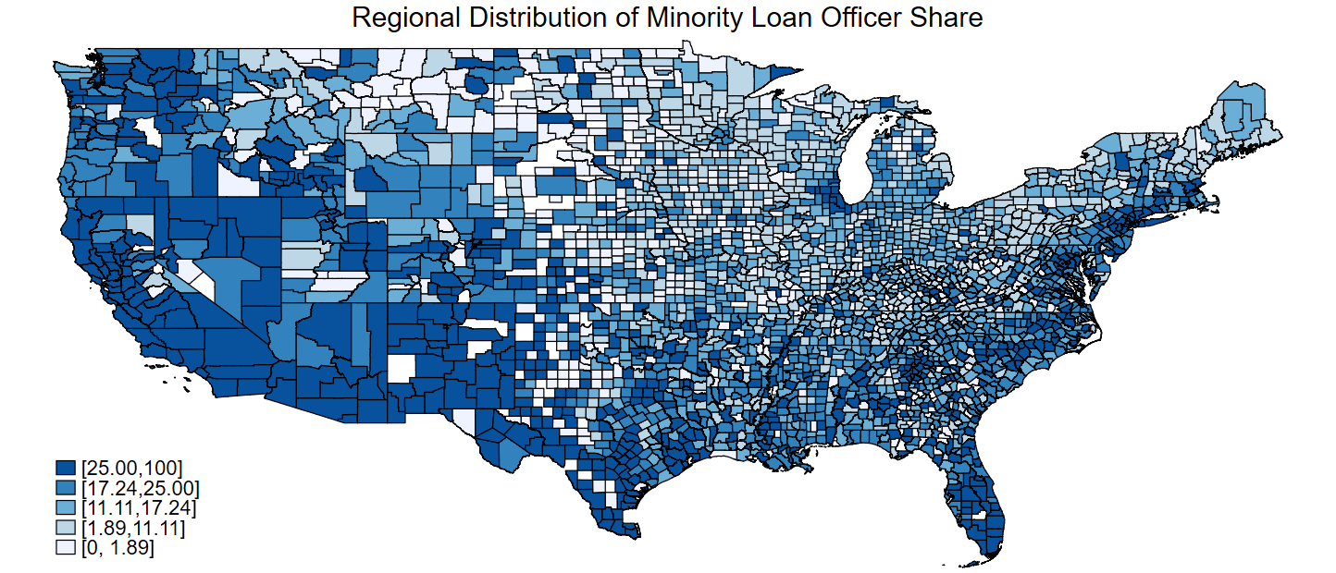
Comment 2: “Minority” vs individual race
When we combine all races together and call them “minority,” what are we doing and what are we missing?
Minority
Source: Jiang, Lee, and Liu, “The Role of Loan Officers in the FinTech Era: Implications for Disparities in Consumer Credit”

Slide 17
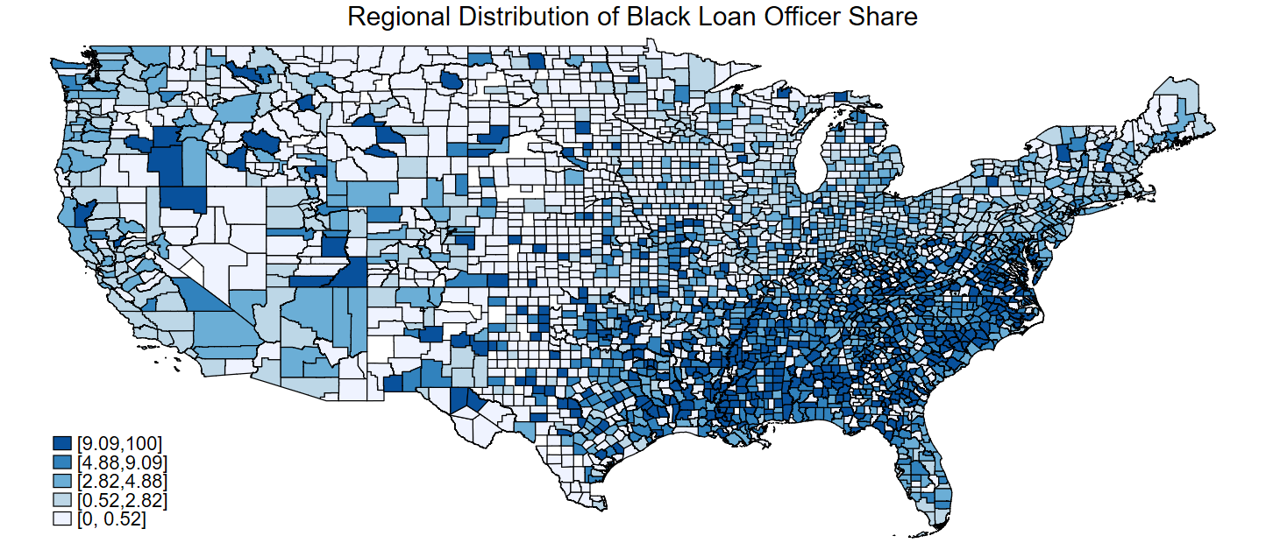
Comment 2: “Minority” vs individual race
When we combine all races together and call them “minority,” what are we doing and what are we missing?
Minority
Black
Source: Jiang, Lee, and Liu, “The Role of Loan Officers in the FinTech Era: Implications for Disparities in Consumer Credit”

Slide 18
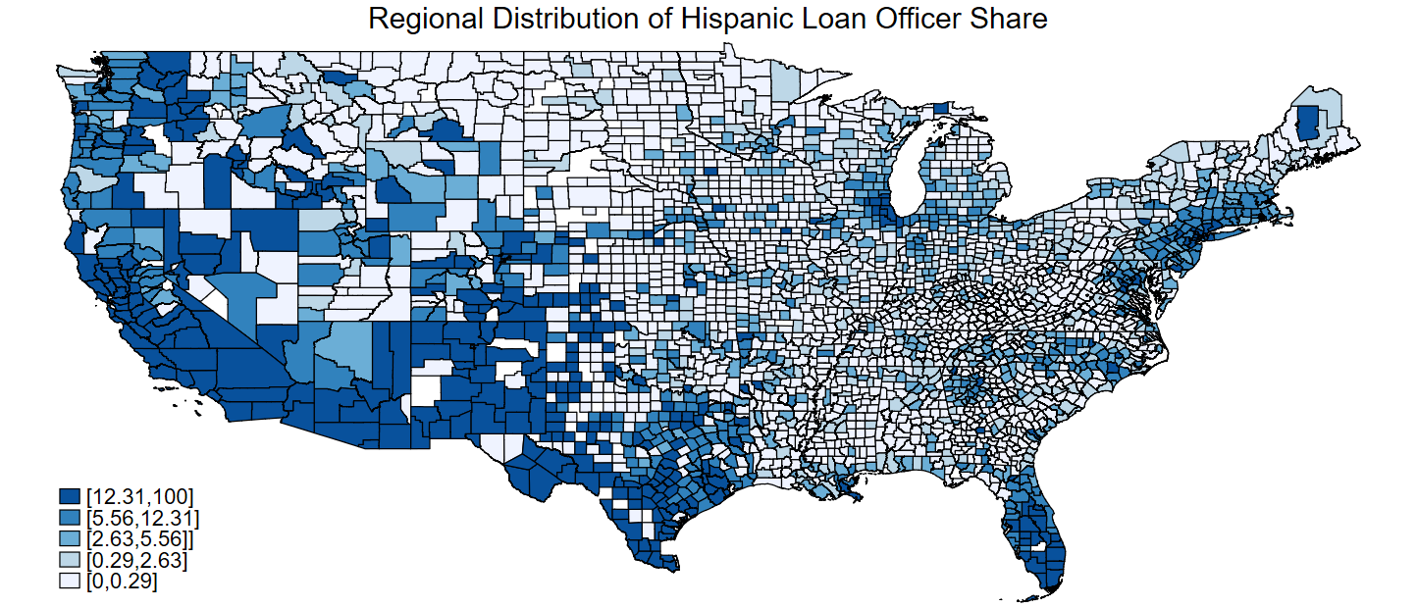
Comment 2: “Minority” vs individual race
When we combine all races together and call them “minority,” what are we doing and what are we missing?
Minority
Hispanic
Source: Jiang, Lee, and Liu, “The Role of Loan Officers in the FinTech Era: Implications for Disparities in Consumer Credit”

Slide 19
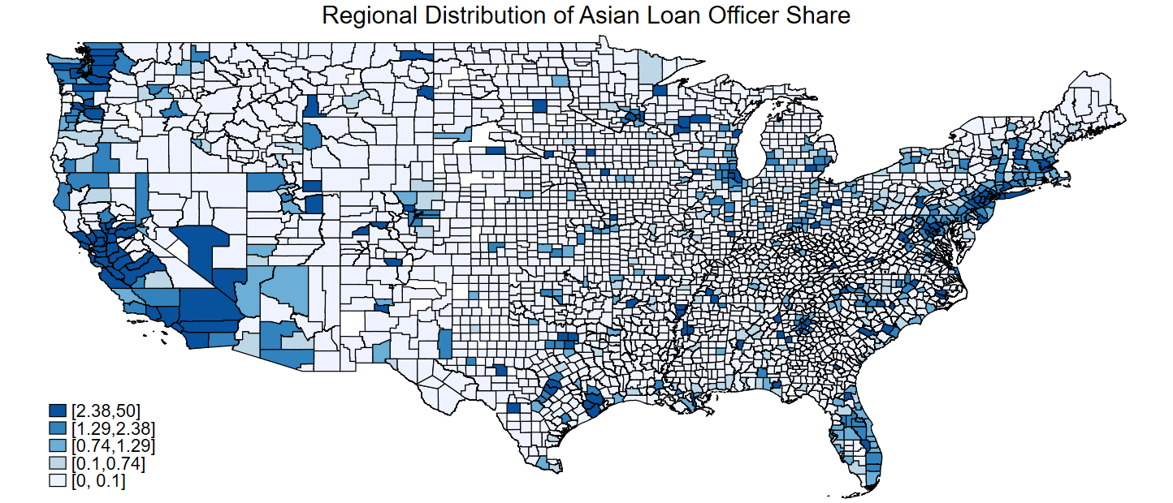
Comment 2: “Minority” vs individual race
When we combine all races together and call them “minority,” what are we doing and what are we missing?
Minority
Asian
Source: Jiang, Lee, and Liu, “The Role of Loan Officers in the FinTech Era: Implications for Disparities in Consumer Credit”

Slide 20
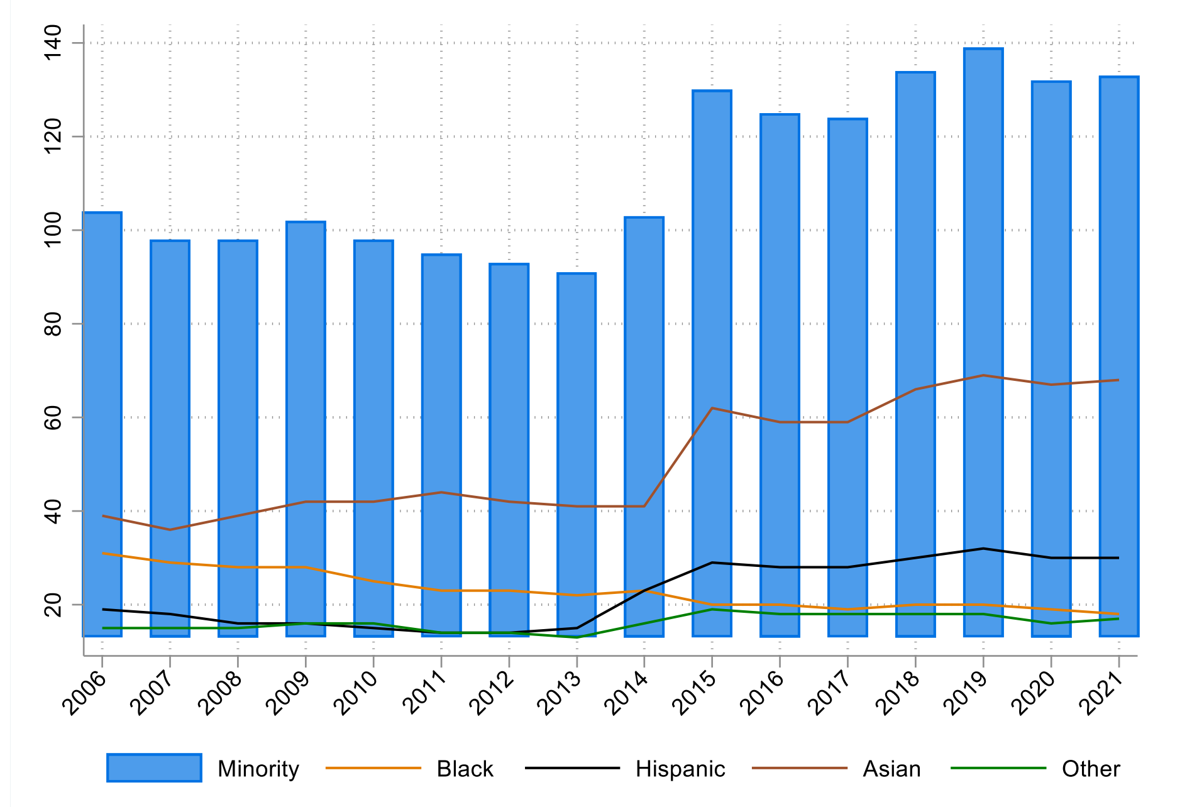
Comment 2: “Minority” vs individual race
When we combine all races together and call them “minority,” what are we doing and what are we missing?
Source: Berger, Feldman, Langford, and Roman, “Let Us Put Our Moneys Together: Minority-Owned Banks and Resilience to Crises”

Slide 21
Comment 2: “Minority” vs individual race
There are statistical reasons to group minorities together
Yet … throws away a lot of information
Large disparities across minorities
Any theoretical rationale behind grouping minorities together?
Do Black loan officers also help Asian borrowers access credit?
Do Hispanic-owned banks also improve Black community’s resilience?
Jiang, Lee, and Liu (2022): same-race seems to be what matters
→ Bigger picture comment: each racial minority group has its own challenges

Slide 22
Paper 2: Market Forces

Slide 23
Paper 2: Bank Competition and Entrepreneurial Gaps: Evidence from Bank Deregulation
Studies whether free financial market reduces discrimination in the lending market and narrows entrepreneurial gaps
Quantity (branch coverage and financial inclusion) and quality (complaints about discrimination)
Key findings
Increased competition reduces discrimination and narrows entrepreneurial gaps
Branch density increases, improved financial inclusion, fewer complaints about discrimination
Gender and racial gaps in business formation are narrowed, especially in industries that rely more on external financing/in areas that used to face more discrimination
More financing and better business performance

Slide 24
Comments and Thoughts
Very important question
Banking industry has been consolidating in the past decade or so
Overall number of banks has been declining; no new bank charters for several years after the GFC; many M&As; many branch closures; etc
Yet … banking industry seems to become more competitive
Competition from shadow banks and fintech companies
Digital disruption allows banks to compete more nationally
Overall time-series trend supports the empirical analysis in this paper

Slide 25
Comments and Thoughts
Regulation or competition?
→There has been significant progress in fair lending for consumer credit over the last 30 years
Using long time series provides nice variation for statistical analysis
Yet, the industry has been through many structural changes since 1990s
Would be nice to divide the analysis into multiple episodes
1990s
Early 2000 (housing boom; rise of private label MBS)
Financial crisis
Post crisis; stricter bank regulation

Slide 26
Summing Up
Very insightful papers bringing rich empirical evidence to bear on an important topic
Pieces of evidence on different supply-side elements that help improve minorities’ credit access
Remaining questions:
Which tool is more efficient; when and where we need regulatory intervention
Fundamental challenges faced by different minority racial groups
Is more credit necessarily good? More leverage → more risk

