Slide 1
“Let Us Put Our Moneys Together:” Minority-Owned Banks and
Resilience to Crises
Allen N. Berger Maryann P. Feldman
University of South Carolina Arizona State University
Center for Financial Institutions at the Darla Moore School of Business
Wharton Financial Institutions Center
European Banking Center
W. Scott Langford Raluca A. Roman
Arizona State University Federal Reserve Bank of Philadelphia

Slide 2
Overview
Relationship lending is the traditional technology to acquire and process soft information for borrowers without sufficient high quality hard information available.
We introduce “Shared Identity,” a novel additional method for collecting and processing soft information.
Shared Identity can either substitute for or complement relationship lending.

Slide 3
Overview
Shared Identity does not require labor- and time-intensive information gathering through repeated contact over time as does relationship lending.
  It may be collected from the moment the borrower enters the bank office.

Slide 4
Overview
Shared Identity is based on collective experiences of groups of people with a shared identity built up over time.
  Differs from relationship lending, where information accumulates through contact over time.

Slide 5
Overview
Loan officers/other bank employees may better screen and monitor borrowers with the same identity.
Soft information such as trustworthiness may be communicated verbally and nonverbally using shared dialects, vocabularies, mannerisms, social interests, and values.
Borrowers may also be less likely to strategically default on group members to avoid loss of reputation or community capital.

Slide 6
Overview
Shared Identity may be particularly important for those not always best served by the banking system.
  Racial and ethnic minorities that may be subject to taste-based or statistical discrimination in the US.
  Borrower groups identified by religion, immigrant status, national origin, or other classifications in other nations.
Shared Identity may mitigate racial disparities in employment, which are particularly sensitive to economic conditions through both the GFC (e.g., Orrenius and Zavodny 2010) and the COVID-19 Crisis (e.g., Brodeur, Gray, Islam and Bhuiyan 2021).
Plenty of literature on minority-owned banks, but we are not aware of any posing this view.

Slide 7
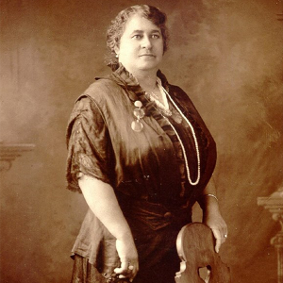
Minority-Owned Banks Promote the Economic Prospects of Their Communities
“Let us put our moneys together…
…let us put our money out at usury among ourselves and reap the benefit ourselves…”
Maggie Lena Walker (1901)
Her view is a bit on moral grounds –
we test a more subtle optimization story involving the efficient use of resources by minority-owned banks.

Slide 8
Key Findings - Minority-Owned Banks Work!
Result: Minority-owned banks mitigate employment losses through…
    The GFC.
    The COVID-19 Crisis.
    Effects observed in both minorities and non-minority groups.
    Shared Identity less effective during COVID-19, potentially due to lack of personal interactions crucial to the transmission of soft information.
    Negative impact during normal times, indicative of smoothing.
Mechanism: Small business and household credit supply.
Implications: If all US banks behaved like minority-owned banks in GFC…
  > 1.9 million minority jobs would have been maintained per year.
  > $50 billion in additional small business credit available per year.

Slide 9
Contributions to the Extant Literature
Relationship Lending (e.g., Boot 2000)
  Shared Identity could be a substitute or complement.
Economic Resilience (e.g., Martin and Sunley 2015)
  Minority-owned banks strengthen economic resilience during crises.
Minority-Owned Banks (e.g., Kwast and Black 1983)
  New technology for these banks.
  Works for minorities and non-minorities.
Finance-Growth Nexus (e.g., King and Levine 1993)
  Data do not support a significant economic growth role in normal times.

Slide 10
The Number of Minority-Owned Banks in the US
Notes: Minority refers to any of the categories of ownership denoted as Black, Hispanic, Asian, Native-American, Eskimo, Eluet, Arab, Multi-Racial. Source: Call Report.

Slide 11
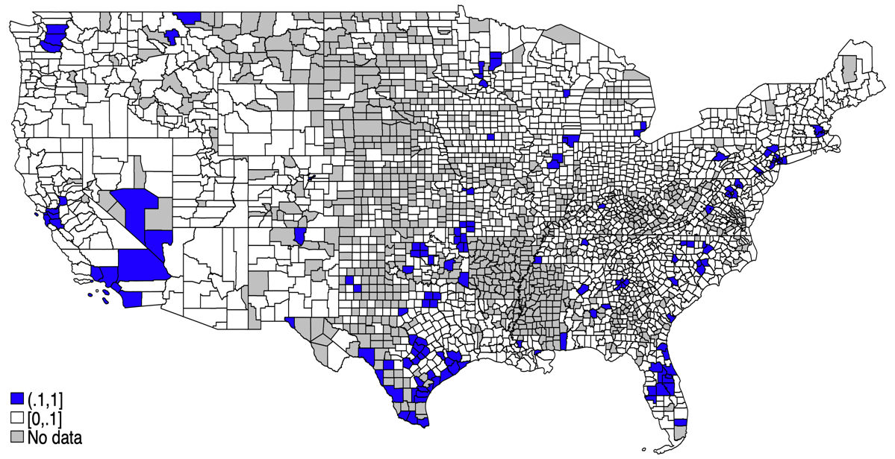
Minority-Owned Banks Across the US
Notes: Minority refers to any of the categories of ownership denoted as Black, Hispanic, Asian, Native-American, Eskimo, Eluet, Arab, Multi-Racial. Blue shows counties where we have minority-owned banks, white shows counties where we do not have minority-owned banks, while grey indicates counties with no data. Sources: Call Report; FDIC Summary of Deposits.

Slide 12
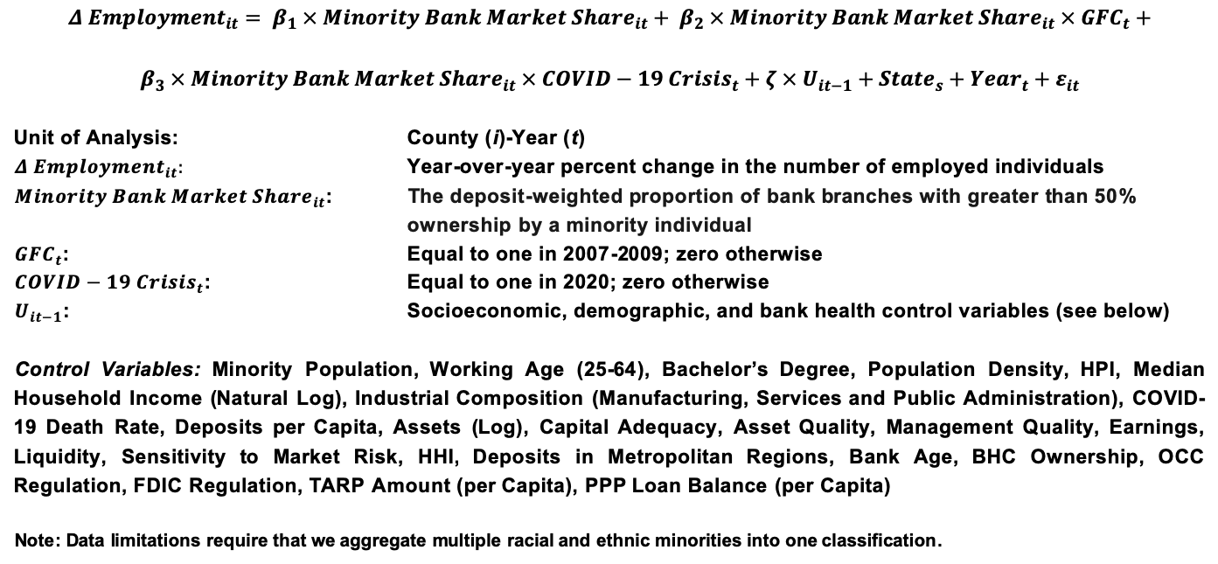
County-Level Model (2006-2020)
$$Δ {Employment}_{it}= β_{1} × {Minority Bank Market Share}_{it}+ β_{2} × {Minority Bank Market Share}_{it} × {GFC}_{t}+$$
$$β_{3} × {Minority Bank Market Share}_{it} × {COVID−19 Crisis}_{t}+ζ × U_{it−1}+{State}_{s}+{Year}_{t}+ε_{it}$$
Unit of Analysis: County (i)-Year (t)
${Δ Employment}_{it}:$ Year-over-year percent change in the number of employed individuals
${Minority Bank Market Share}_{it}$: The deposit-weighted proportion of bank branches with greater than 50% ownership by a minority individual
${GFC}_{t}$: Equal to one in 2007-2009; zero otherwise
${COVID−19 Crisis}_{t}$: Equal to one in 2020; zero otherwise
$U_{it−1}$: Socioeconomic, demographic, and bank health control variables (see below)
Control Variables: Minority Population, Working Age (25-64), Bachelor’s Degree, Population Density, HPI, Median Household Income (Natural Log), Industrial Composition (Manufacturing, Services and Public Administration), COVID-19 Death Rate, Deposits per Capita, Assets (Log), Capital Adequacy, Asset Quality, Management Quality, Earnings, Liquidity, Sensitivity to Market Risk, HHI, Deposits in Metropolitan Regions, Bank Age, BHC Ownership, OCC Regulation, FDIC Regulation, TARP Amount (per Capita), PPP Loan Balance (per Capita)
Note: Data limitations require that we aggregate multiple racial and ethnic minorities into one classification.

Slide 13
Minority-Owned Banks Enhance Economic Resilience Through Global Financial Crisis (GFC) and COVID-19 Crisis
Model | [1] | [2] | [3] | [4] | [5] | [6]
Sample | Full Sample | PSM | Full Sample | PSM | Full Sample | PSM
Dependent Variables: | Δ Overall Employment | Δ Overall Employment | Δ Minority Employment | Δ Minority Employment | Δ White Employment | Δ White Employment
Independent Variables:
Minority Bank Market Share | -1.50 | -9.39 | -14.21 | -23.98*** | 3.99 | -4.50
 | [-0.25] | [-1.47] | [-1.46] | [-2.87] | [0.77] | [-0.72]
Minority Bank Market Share × GFC | 39.57** | 34.25* | 111.9*** | 63.72** | 35.22** | 26.67
 | [2.34] | [1.91] | [3.69] | [2.49] | [2.17] | [1.51]
Minority Bank Market Share × COVID-19 Crisis | 10.96 | 54.20** | 39.27** | 79.21*** | 7.96 | 48.80**
 | [0.68] | [2.56] | [2.21] | [3.16] | [0.48] | [2.28]
PSM Match Sample | No | Yes | No | Yes | No | Yes
Control Variables | Yes | Yes | Yes | Yes | Yes | Yes
State & Year FEs | Yes | Yes | Yes | Yes | Yes | Yes
Observations | 28,129 | 1,756 | 28,129 | 1,756 | 28,129 | 1,756
R² | 0.26 | 0.46 | 0.17 | 0.34 | 0.24 | 0.43
The minority-owned bank market share mitigates employment losses through each crisis.
Strongest effects are observed on minority employment.
Positive effects are observed both overall and for non-minorities.
Results hold up against PSM specification, mitigating selection bias concerns.
Notes:
Go slower through slide

Slide 14
Results Hold, Conditioning on Bank Size
Model | [1] | [2] | [3] | [4] | [5] | [6] | [7] | [8] | [9]
Dependent Variable: | Δ Overall Employment |  |  | Δ Minority Employment |  |  | Δ White Employment
Sample | All Banks | < $10 B | < $2B | All Banks | < $10 B | < $2B | All Banks | < $10 B | < $2B
Independent Variables:
Minority Bank Market Share | -9.39 | -3.27 | 0.73 | -23.98*** | -11.48** | -3.39 | -4.50 | 0.14 | 2.46
 | [-1.47] | [-0.78] | [0.18] | [-2.87] | [-2.10] | [-0.60] | [-0.72] | [0.04] | [0.68]
Minority Bank Market Share × GFC | 34.25* | 24.31** | 20.61** | 63.72** | 47.67*** | 39.15*** | 26.67 | 19.22 | 15.37
 | [1.91] | [2.05] | [2.13] | [2.49] | [2.84] | [3.10] | [1.51] | [1.63] | [1.55]
Minority Bank Market Share × COVID-19 Crisis | 54.20** | 25.26* | 19.81* | 79.21*** | 36.71*** | 31.64*** | 48.80** | 22.04* | 16.22
 | [2.56] | [1.96] | [1.78] | [3.16] | [2.67] | [2.70] | [2.28] | [1.70] | [1.44]
PSM Match Sample | Yes | Yes | Yes | Yes | Yes | Yes | Yes | Yes | Yes
State & Year FEs | Yes | Yes | Yes | Yes | Yes | Yes | Yes | Yes | Yes
Observations | 1,756 | 1,685 | 1,411 | 1,756 | 1,685 | 1,411 | 1,756 | 1,685 | 1,411
R² | 0.46 | 0.45 | 0.51 | 0.34 | 0.32 | 0.35 | 0.43 | 0.42 | 0.47
Minority-owned banks are often small; smaller banks may be better counter-factual.
Results hold when sample is limited to small banks (<$10 billion; <$2 billion).
Strongest results in full sample, when minority-owned banks compete against large banks.

Slide 15
Results Hold Using Minority Ancestry as IV
Model | [1] | [2] | [3] | [4] | [5] | [6]
IV Stage | 1st Stage |  |  | 2nd Stage
Dependent Variables: | Minority Bank Share | Minority Bank Share × GFC | Minority Bank Share × COVID-19 Crisis | Δ Overall Employment | Δ Minority Employment | Δ White Employment
Independent Variables:
Minority Ancestry | 0.10*** | -0.00056 | 0.0018
 | [2.72] | [-0.24] | [1.01]
Minority Ancestry × GFC | -0.036*** | 0.044*** | -0.000070
 | [-2.60] | [2.79] | [-0.42]
Minority Ancestry × COVID-19 Crisis | 0.0015 | 0.00032 | 0.079***
 | [0.12] | [1.30] | [3.38]
Minority Bank Market Share |  |  |  | 0.24** | 0.27** | 0.25**
 |  |  |  | [2.48] | [2.08] | [2.56]
Minority Bank Market Share × GFC |  |  |  | 0.32* | 1.17** | 0.25
 |  |  |  | [1.72] | [2.33] | [1.51]
Minority Bank Market Share × COVID-19 Crisis |  |  |  | -0.10 | 0.20 | -0.16*
 |  |  |  | [-1.11] | [1.44] | [-1.74]
Observations | 28,129 | 28,129 | 28,129 | 28,129 | 28,129 | 28,129
R² | 0.16 | 0.05 | 0.09 | -0.06 | -0.06 | -0.06
F-Statistic | 8.20*** | 14.79*** | 14.12*** | 19.29*** | 10.50*** | 17.39***
To mitigate reverse causality concerns, we use minority ancestry as an IV.
Our main results hold.

Slide 16
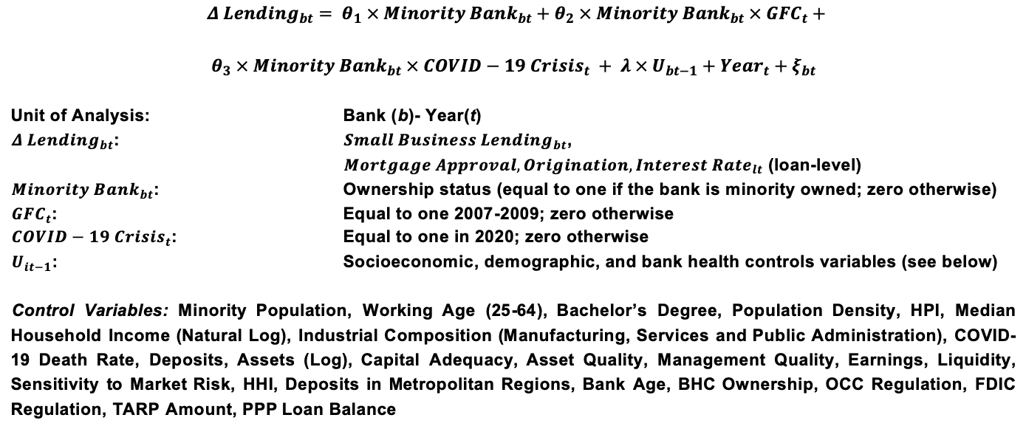
Lending Mechanism
$Δ {Lending}_{bt}= θ_{1} × {Minority Bank}_{bt}+θ_{2} × {Minority Bank}_{bt} × {GFC}_{t}+$
$$θ_{3} × {Minority Bank}_{bt} × {COVID−19 Crisis}_{t} + λ × U_{bt−1}+{Year}_{t}+ξ_{bt}$$
Unit of Analysis: Bank (b)- Year(t)
${Δ Lending}_{bt}$: ${Small Business Lending}_{bt}$,
${Mortgage Approval, Origination, Interest Rate}_{lt}$ (loan-level)
${Minority Bank}_{bt}$: Ownership status (equal to one if the bank is minority owned; zero otherwise)
${GFC}_{t}$: Equal to one 2007-2009; zero otherwise
${COVID−19 Crisis}_{t}$: Equal to one in 2020; zero otherwise
$U_{it−1}$: Socioeconomic, demographic, and bank health controls variables (see below)
Control Variables: Minority Population, Working Age (25-64), Bachelor’s Degree, Population Density, HPI, Median Household Income (Natural Log), Industrial Composition (Manufacturing, Services and Public Administration), COVID-19 Death Rate, Deposits, Assets (Log), Capital Adequacy, Asset Quality, Management Quality, Earnings, Liquidity, Sensitivity to Market Risk, HHI, Deposits in Metropolitan Regions, Bank Age, BHC Ownership, OCC Regulation, FDIC Regulation, TARP Amount, PPP Loan Balance

Slide 17
Mechanism: Small Business Lending (Call Report Data)
Model | [1] | [2] | [3] | [4]
Dependent Variable: | Δ Small Business Lending | Δ Small Business Lending | Δ Small Business Lending | Δ Small Business Lending
Independent Variables:
Minority Bank | -1.89 | -7.96*** | -7.07** | 2.06
 | [-1.05] | [-2.73] | [-2.41] | [0.48]
Minority Bank × GFC | 12.50** | 13.10** | 13.73** | -6.90
 | [2.14] | [2.28] | [2.40] | [-1.11]
Minority Bank × COVID-19 Crisis | 193.1 | 199.8 | 130.6 | 48.69
 | [1.53] | [1.60] | [1.05] | [1.10]
High Minority Area |  |  |  | 5.30
 |  |  |  | [1.27]
Minority Bank × High Minority Area |  |  |  | -9.46*
 |  |  |  | [-1.77]
High Minority Area × GFC |  |  |  | -0.41
 |  |  |  | [-0.25]
Minority Bank × High Minority Area × GFC |  |  |  | 21.34**
 |  |  |  | [2.42]
High Minority Area × COVID-19 Crisis |  |  |  | -21.67
 |  |  |  | [-0.41]
Minority Bank × High Minority Area × COVID-19 Crisis |  |  |  | 96.18
 |  |  |  | [0.69]
Bank Controls | No | Yes | Yes | Yes
County Controls | No | No | Yes | Yes
Year FE | Yes | Yes | Yes | Yes
Observations | 58,443 | 58.443 | 58,443 | 58,443
R² | 0.010 | 0.032 | 0.040 | 0.040
Minority-owned banks maintained small business lending at higher rates through crises.
Minority-owned banks with branch networks in counties with a higher proportion of minority residents continued lending at higher rates.

Slide 18
Mechanism: Small Business Lending (Community Reinvestment Act Data)
Model | [1] | [2] | [3] | [4]
Dependent Variable: | Δ Overall Small Business Origination | Δ < $100K Small Business Origination | Δ $100-250K Small Business Origination | Δ $250K-1M Small Business Origination
Independent Variables:
Minority Bank | -4.52*** | -5.26*** | -0.50*** | -0.17***
 | [-8.52] | [-10.32] | [-9.44] | [-4.73]
Minority Bank × GFC | 1.46** | 1.61*** | 0.17* | 0.011
 | [2.19] | [3.72] | [1.95] | [0.13]
Minority Bank × COVID-19 Crisis | 2.63*** | 4.80*** | 0.83** | -0.48***
 | [3.77] | [7.66] | [2.52] | [-6.55]
Bank & County Controls | Yes | Yes | Yes | Yes
State & Year FE | Yes | Yes | Yes | Yes
Observations | 621,449 | 537,501 | 236,012 | 242,076
R² | 0.0027 | 0.0039 | 0.027 | 0.016
Small business lending mechanism works through small loans.

Slide 19
Mechanism: Household Home Mortgage Lending (Home Mortgage Disclosure Act Data)
Model | [1] | [2] | [3] | [4] | [5]
Dependent Variable: | Approved | Approved | Originated | Originated | Interest Rate
Independent Variables:
Minority Bank | 0.027** | 0.038*** | 0.019 | 0.029** | 0.131
 | [2.27] | [3.26] | [1.39] | [2.16] | [1.55]
Minority Bank × GFC | 0.086*** | 0.076*** | 0.12*** | 0.11***
 | [5.01] | [4.72] | [5.89] | [5.60]
Minority Bank × COVID-19 Crisis | 0.009 | -0.020 | 0.019 | -0.022 | 0.64***
 | [0.51] | [-1.19] | [0.96] | [-1.01] | [9.47]
Minority HH | -0.036*** | -0.033*** | -0.037*** | -0.033*** | -0.16***
 | [-7.36] | [-6.52] | [-7.21] | [-6.06] | [-13.15]
Minority HH × GFC |  | -0.053*** |  | -0.079***
 |  | [-7.32] |  | [-7.01]
Minority HH × COVID-19 Crisis |  | 0.008*** |  | 0.006* | 0.042***
 |  | [2.74] |  | [1.68] | [3.95]
Minority Bank × Minority HH |  | -0.037* |  | -0.037* | 0.020
 |  | [-1.86] |  | [-1.66] | [0.36]
Minority Bank × Minority HH × GFC |  | 0.031 |  | 0.032
 |  | [1.12] |  | [0.91]
Minority Bank × Minority HH × COVID-19 Crisis |  | 0.069** |  | 0.091*** | -0.22***
 |  | [2.32] |  | [2.70] | [-3.14]
Bank & County Controls | Yes | Yes | Yes | Yes | Yes
State & Year FE | Yes | Yes | Yes | Yes | Yes
Observations | 3,034,722 | 3,034,722 | 2,776,079 | 2,776,079 | 765,827
R² | 0.10 | 0.10 | 0.12 | 0.12 | 0.35
Minority-owned banks continued home mortgage lending at higher rates through crises.
In the COVID-19 Crisis, these banks maintained lending for minorities in particular.

Slide 20
Maggie Lena Walker was right!
Minority owned banks strengthen economic resilience through economic downturns.
  For both GFC and COVID-19 Crisis.
  Strongest impacts on minorities.
  Also strengthen economic resilience for non-minorities.
    Shared Identity less effective during COVID-19, potentially due to lack of personal interactions crucial to the transmission of soft information.
    Negative impact during normal times, indicative of smoothing.

Slide 21
Maggie Lena Walker was right!
Mechanism
  Minority-owned banks continue lending through crises at higher rates (Call Report Data)
  The largest effect is on small loans, consistent with soft-information lending (CRA Data).
  Household home mortgages also maintained (HMDA Data).

Slide 22
Maggie Lena Walker was right!
The Shared Identity concept has implications for bank lending behavior and the broader economy, as well as implications beyond the US banking landscape.
  There may be many dimensions beyond race and ethnicity (e.g., religion, immigrant status, national origin, etc.) that could apply to banks worldwide.
  Such shared identity may be powerful in unleashing positive economic benefits to communities.

Slide 23

Thank you.
Questions? Comments?
scott.langford@asu.edu

