Slide 1
Sentiment in Bank Examination Reports and Bank Outcomes
Maureen Cowhey, Seung Jung Lee
Thomas Popeck Spiller, and Cindy M. Vojtech
September 29, 2022
Disclaimer: The views expressed herein are those of the authors, and do not necessarily represent the views of the Federal Reserve Board or its staff.

Slide 2
What Is the Extra Information in Bank Exams?
This paper investigates the effectiveness of supervision in maintaining the safety and soundness of the banking system in the United States
  Focused on small and medium-sized state-member banks (SMBs)
We look beyond the CAMELS rating to gauge the usefulness of more detailed information in the surveillance process
We study how sentiment in examination reports conveys important information on future bank outcomes

Slide 3
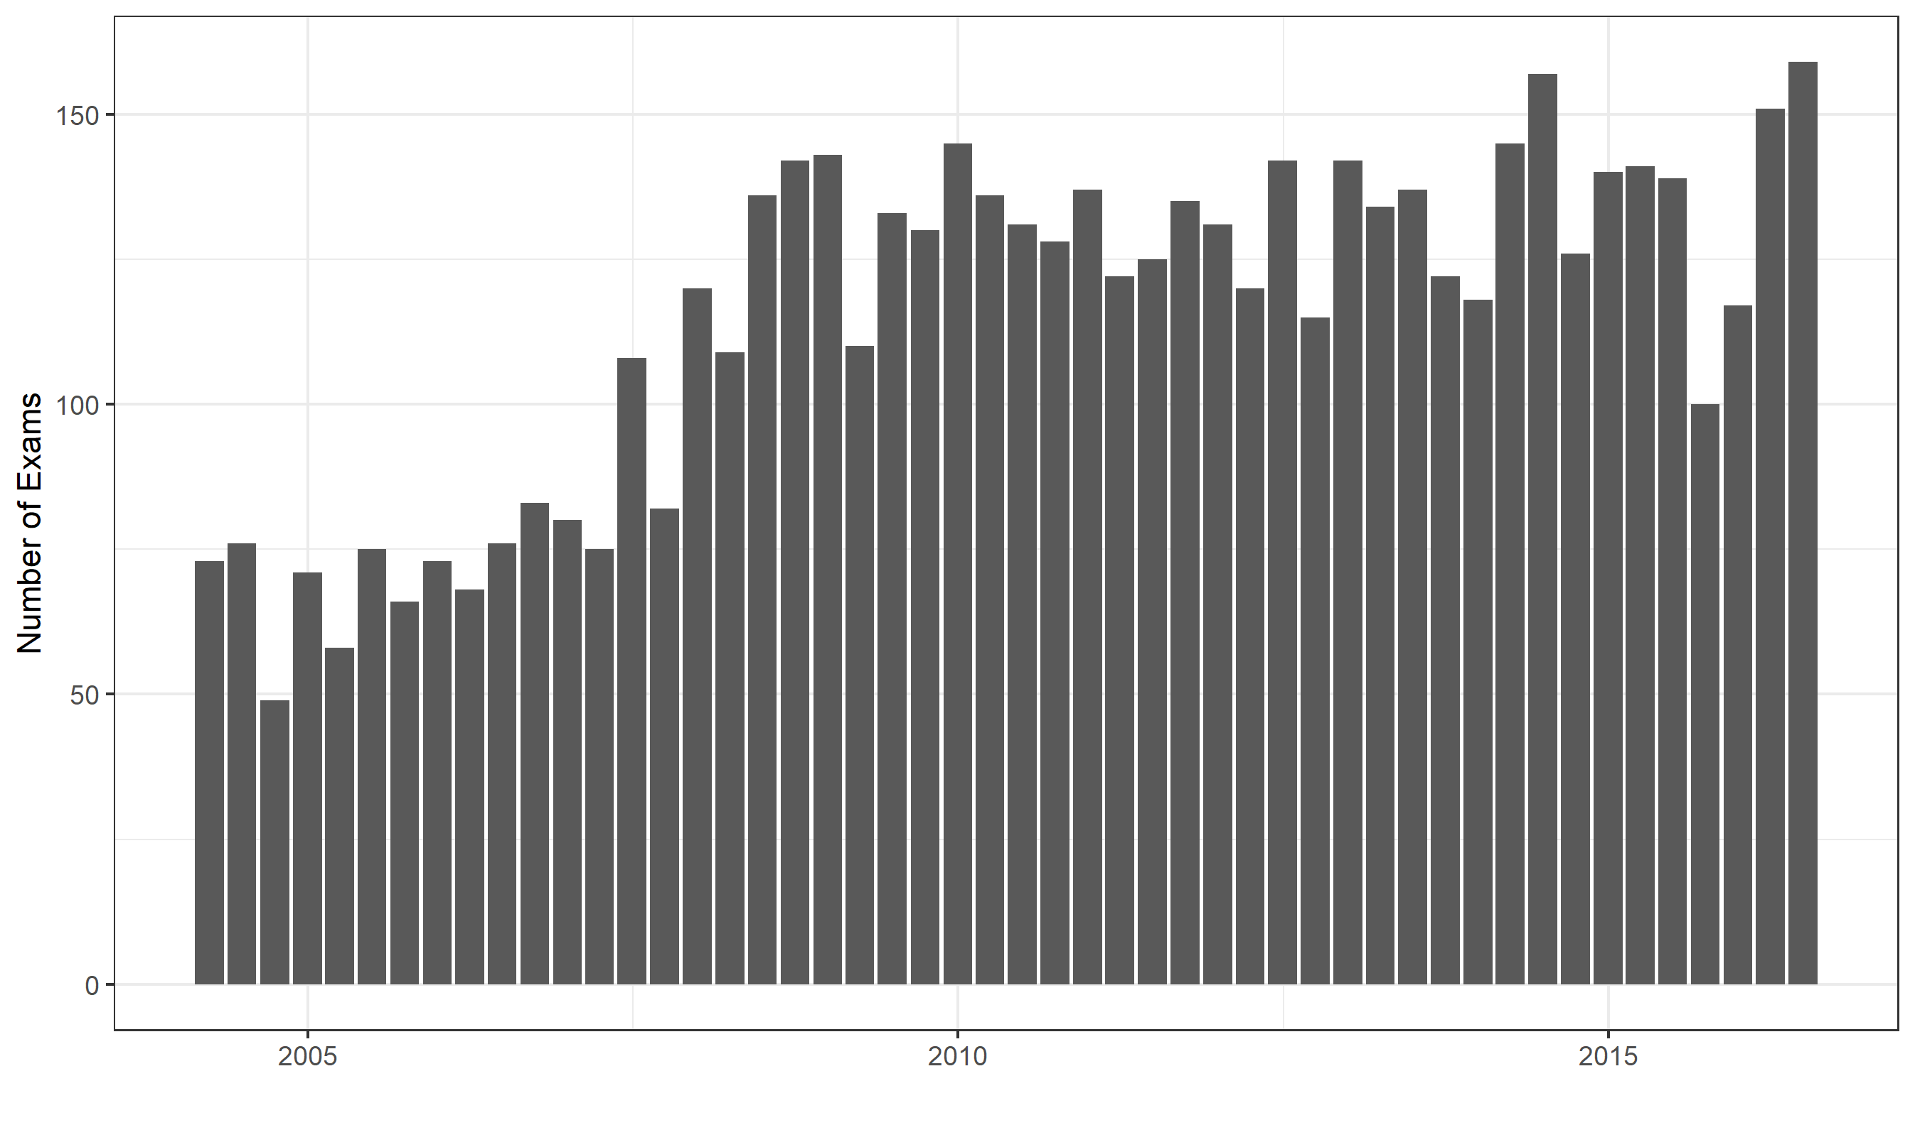
Comprehensive Full-Scope Bank Exam Process

Slide 4
CAMELS Ratings
Comprehensive score: Not additive of other scores
  Capital Adequacy: Ability of the bank to absorb losses
  Asset Quality: Known and likelihood of losses the bank might face
  Management: Quality of the management team, compliance function, audit function, and business strategy
  Earnings: Ability of the bank to provide returns on their activities
  Liquidity: Ability of the bank to absorb short term funding difficulties
  Sensitivity to Market Risk (we ignore in our analysis)

Slide 5
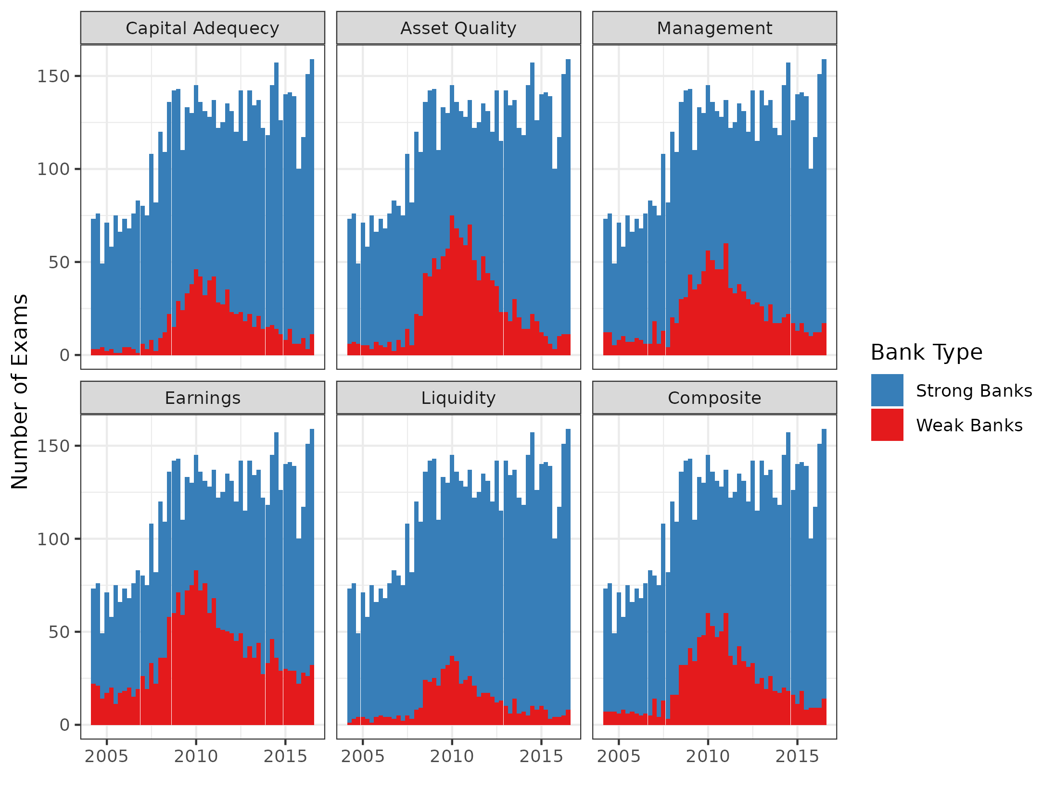
Strong/Weak Banks by CAMELS Component

Slide 6
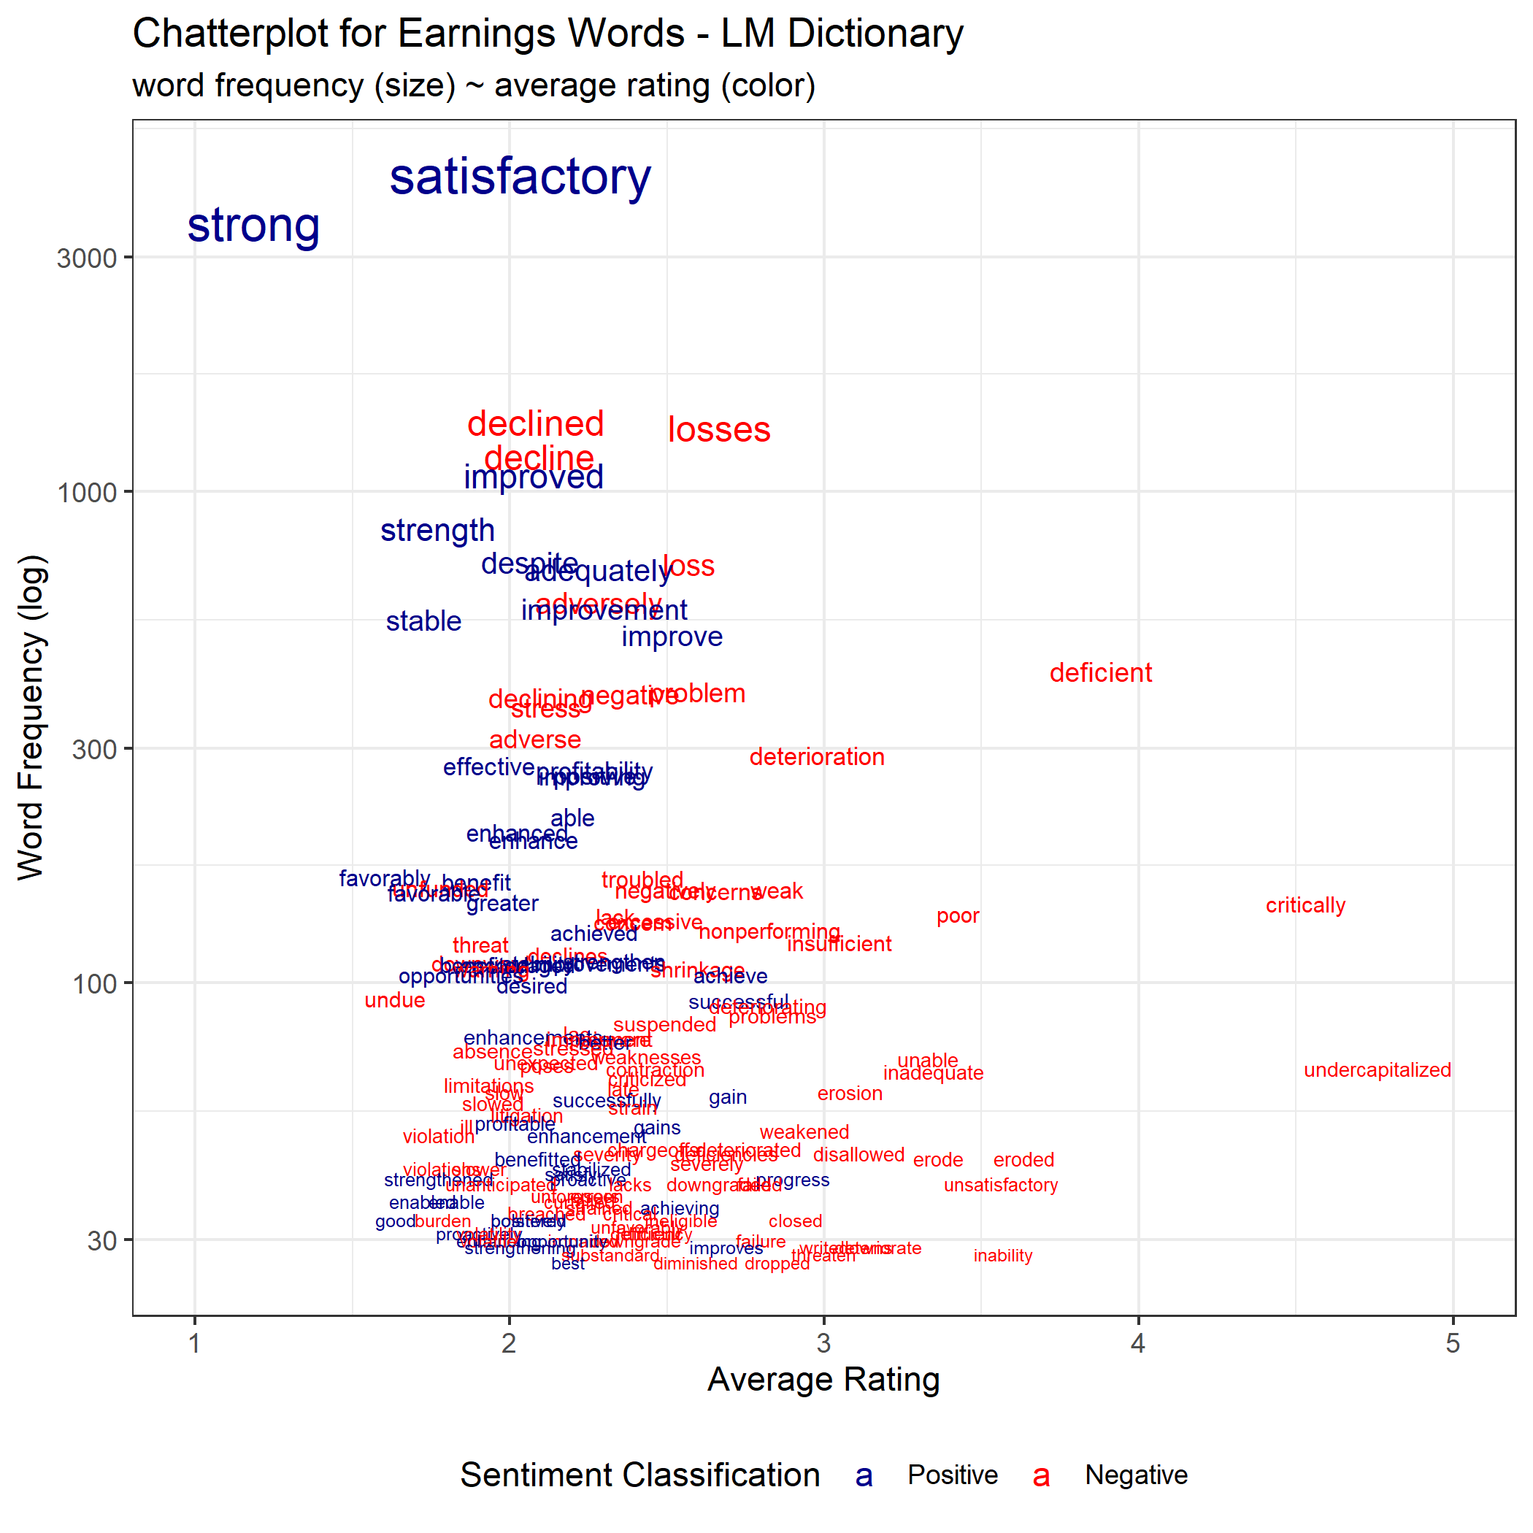
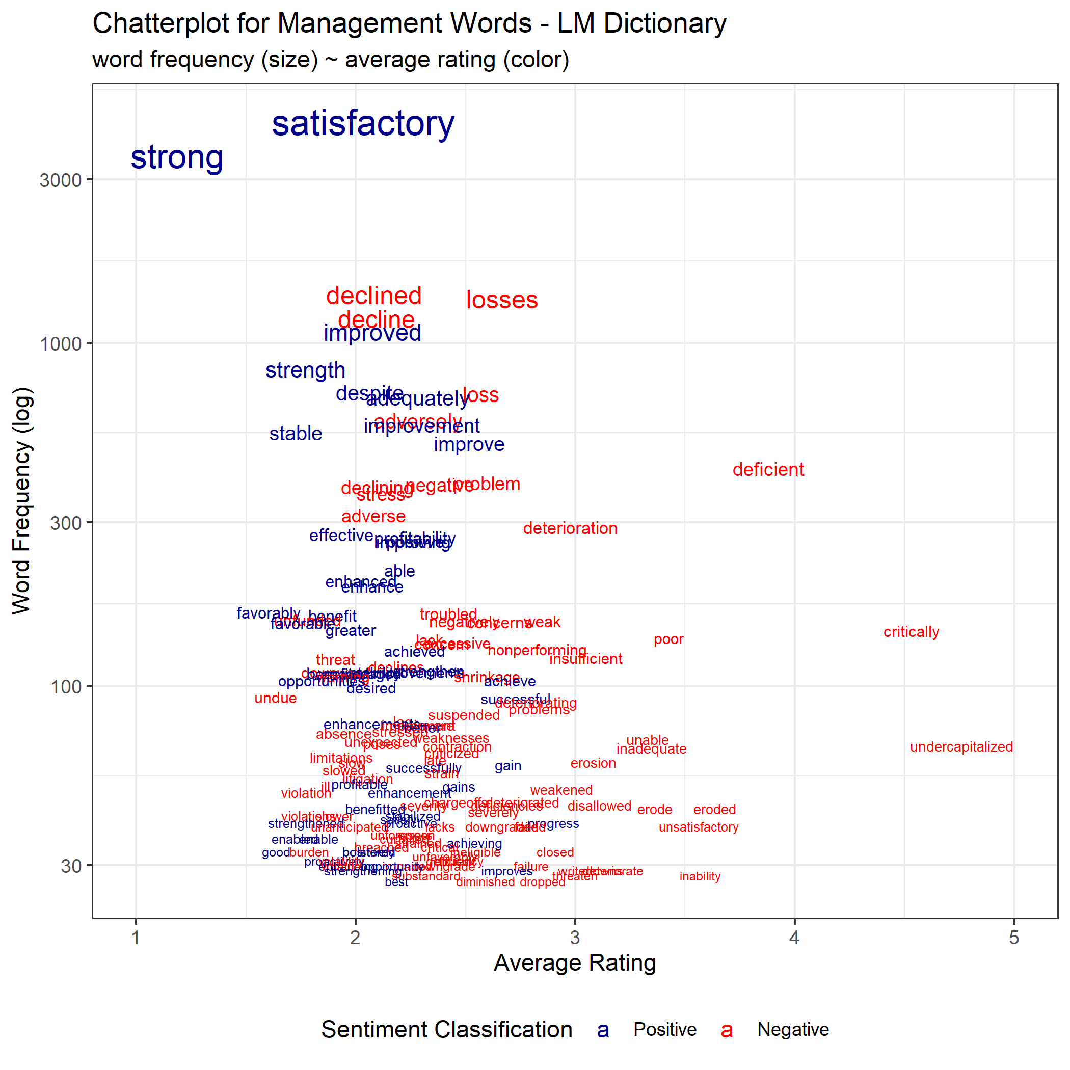
Chatterplot for Capital Sections

Slide 7
Evaluating Sentiment Scores
where s is the section of the exam, m is the sentiment score method, and l is the sentiment score lexicon, with constant term α and coefficient β and an error term ϵ
LM Polar and LM Valence Shifter have generally the highest explanatory power

Slide 8
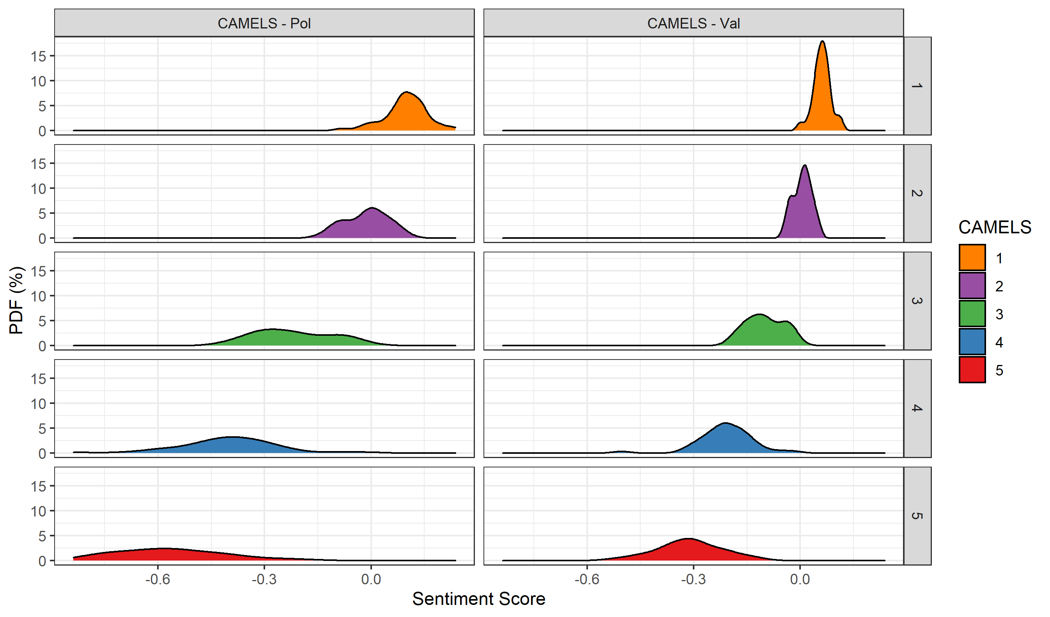
Sentiment Distribution by CAMELS Score

Slide 9
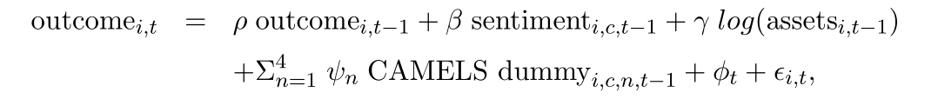

Measuring Outcomes
for bank i, in period t, for bank exam component c, and is a time fixed effect, respectively

Slide 10
Summary Findings

Slide 11
Other Results
When comparing the GFC and post-GFC periods, the results for asset quality and earnings are driven by the GFC period
When running similar analysis at longer horizons (2 years forward), results are still statistically significant (though magnitudes are smaller)
The results across components are generally the same when comparing the smallest banks to the rest of the sample

Slide 12
Conclusion
We investigate to see if supervisory information helps predict future bank outcomes
After controlling for bank ratings, the answer seems to be YES!
Bank supervisors play a meaningful role in the surveillance of the banking system by creating and sharing information that is embedded in reports through the bank examination process
  Supervisors seem to focus on different aspects of safety and soundness in different circumstances

Slide 13
Appendix

Slide 14
Extracting Sentiment from Bank Exam Reports
Consider different dictionaries:
  LM (Loughran and McDonald, 2011)
  FS (Correa, Garud, Londono, and Mislang, 2017)
  QDAP (Hu and Liu, 2004)
Consider different methodologies:
  Polar = (# of Positive Words – # of Negative Words)/(# of Positive + Negative Words)
  TF-IDF = Term Frequency - Inverse Document Frequency
  Valance shifter = include contextual information that influence the positive/negative state of a word

